Slide 1
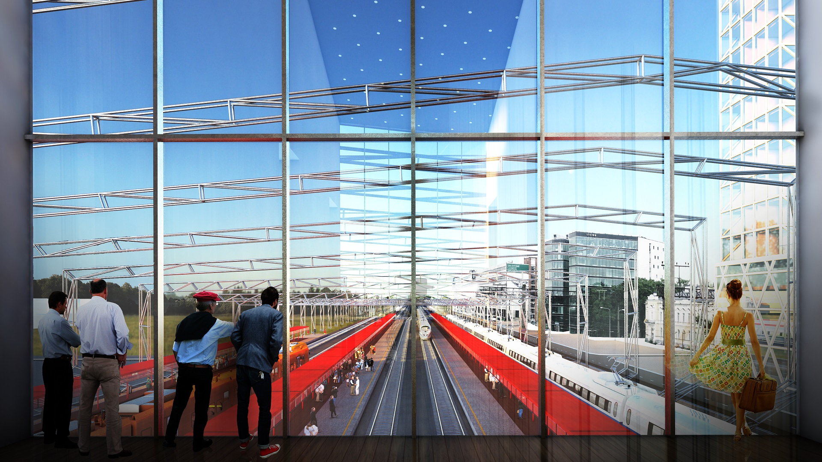
Rail Baltica –
Progress and future in Estonia
Riia Sillave
CEO Rail Baltic Estonia
Press conference
Vilnius, 23 January 2018

Slide 2
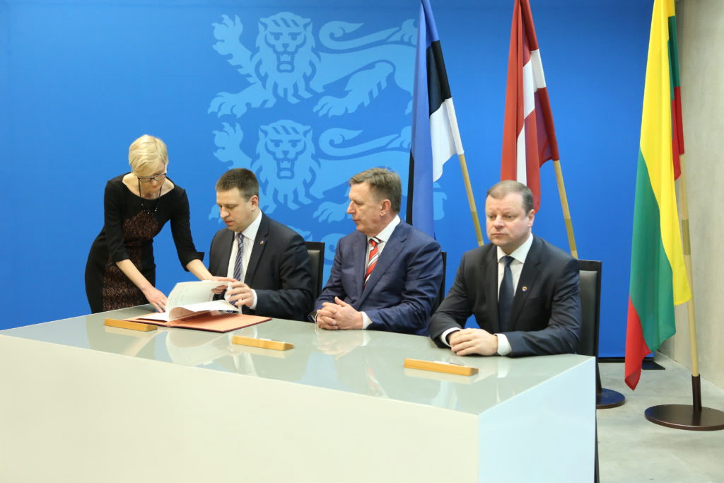

3 Baltic Prime Ministers sign Rail Baltica agreement
Estonian Parliament ratifies Rail Baltica agreement
Estonian President proclaims Rail Baltica accord ratification law

Slide 3
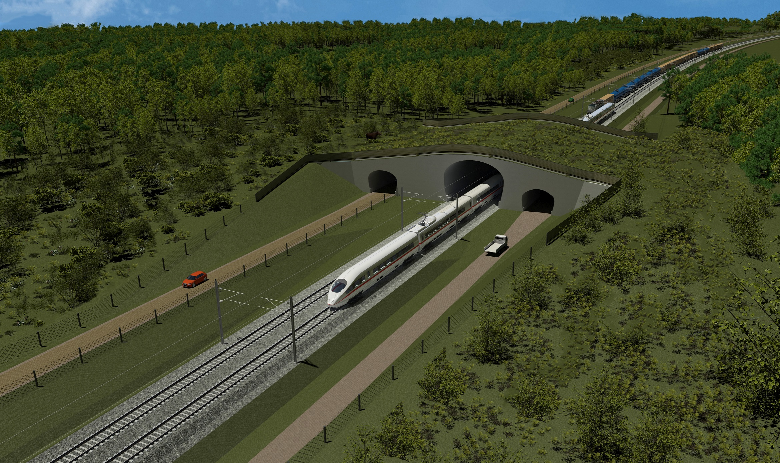
The strategic environmental assessment of RB in Estonia is approved
Technical feasibility study for animal passages – no fences for 1/3 of the track in Estonia

Slide 4
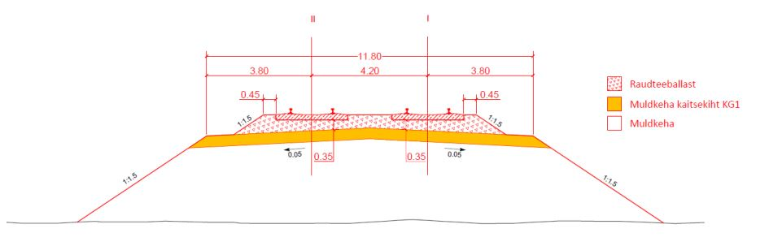
Security of supply and scarcity of raw materials analysis completed
Most of the needed materials are available locally – limestone, dolostone, sand and gravel
Geological surveys in Estonia have doubled in 2017 compared to 2016

Slide 5
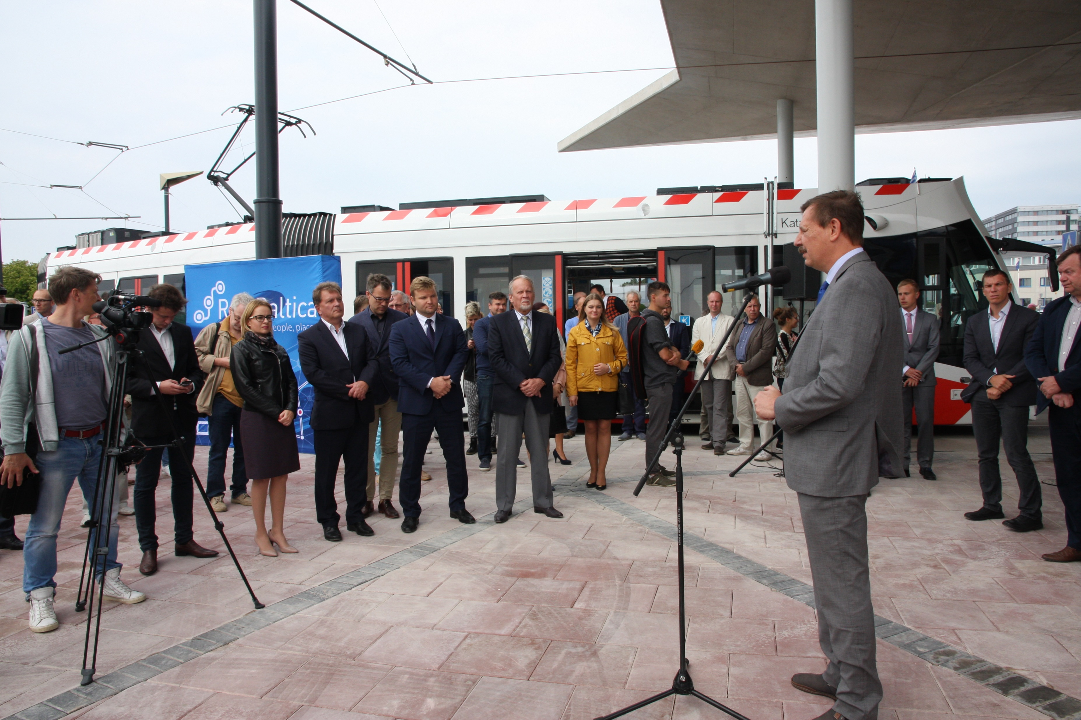
First tangible result of
Rail Baltica
Tram connection Tallinn city -
- Ülemiste -
- Airport
Opening
September 1
2017

Slide 6
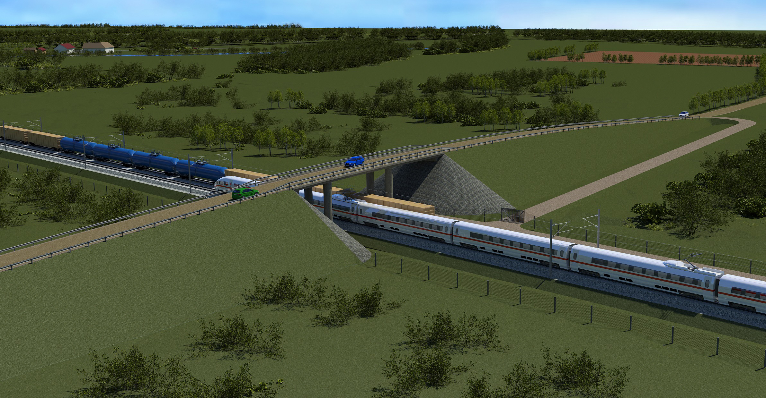
Analysis of the technological and spatial needs of Rail Baltic Muuga multimodal freight terminal
More than 100 interviews conducted in Estonia, Latvia, Lithuania, Finland, Russia, and elsewhere in Europe
The freight volume after first couple of years – 5 mln tons. In 2045 – 2050 predicted 10 mln tons.

Slide 7
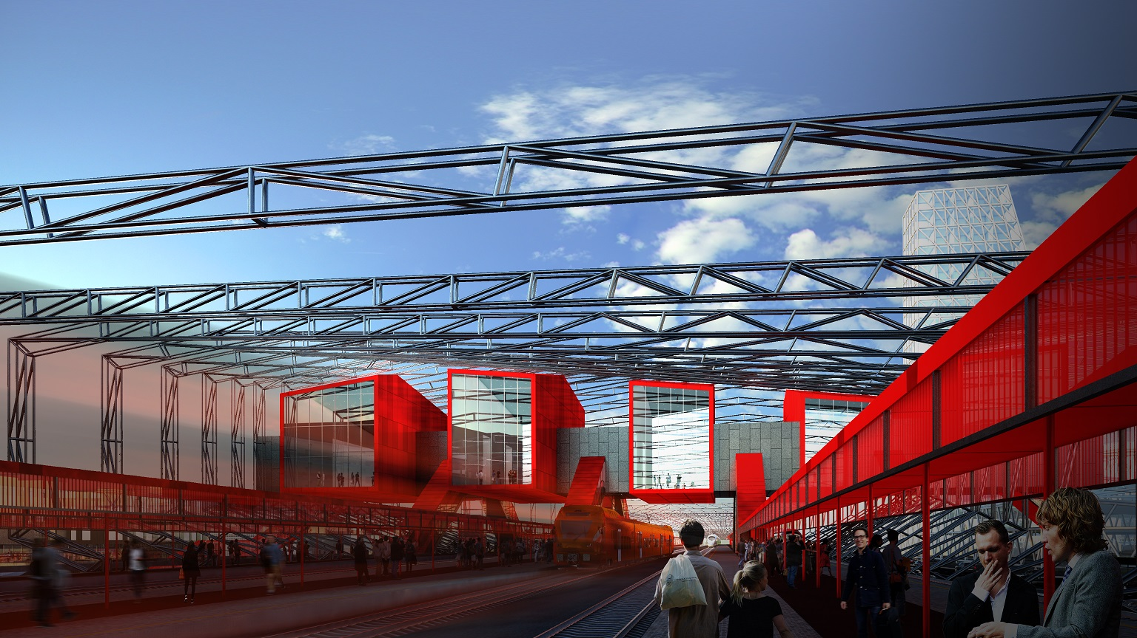
2018 –
Design phase
4 design procurements planned
in Estonia
Technical designing of Ülemiste passenger terminal

Slide 8
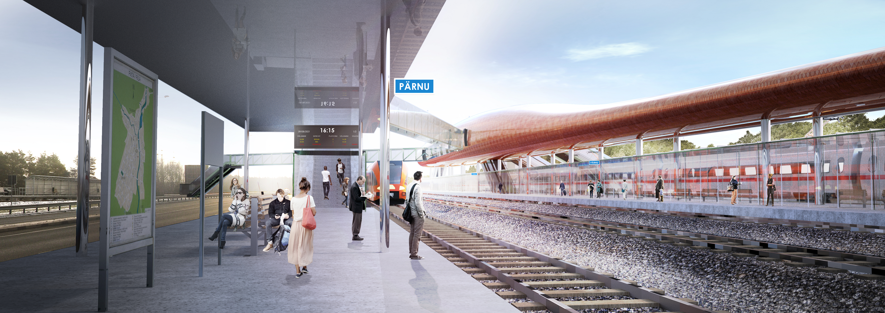
Technical designing of Pärnu passenger terminal

Slide 9
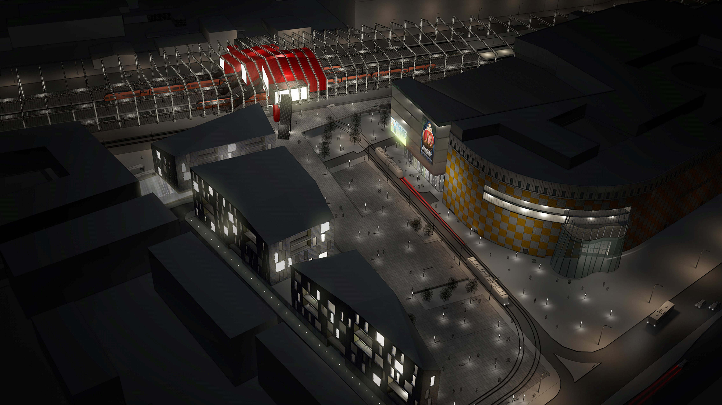
THANK YOU
Riia Sillave
CEO
Rail Baltic Estonia

