Slide 1
New „Rail Baltica“ line from Kaunas to Lithuanian/Latvian state border construction procurement (I stage)
Consultation with market
2020-04-20 | VILNIUS

Slide 2

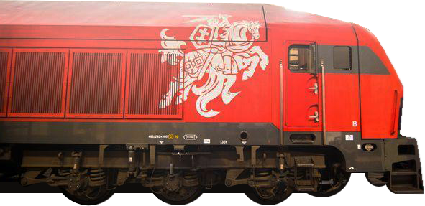
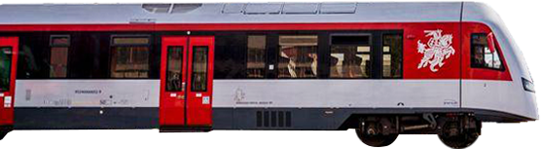
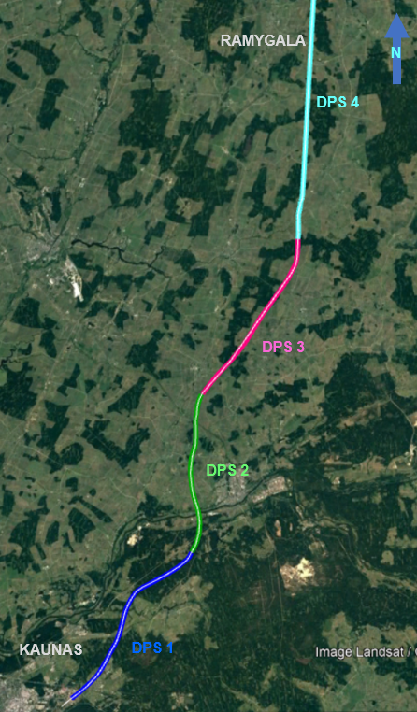
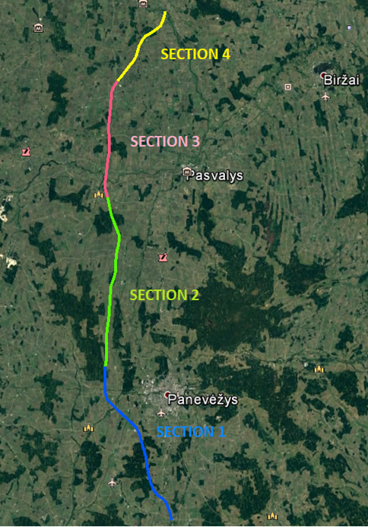
GENERAL INFORMATION
Kaunas – Ramygala
(-1+500 km ÷ 78+000 km)
Ramygala – LT/LV siena (78+000 km ÷ 168+513 km)
154+000 km ÷ 168+513 km | Vaškai-LT/LV siena | DPS4
135+500 km ÷ 154+000 km | Joniškėlis-Vaškai | DPS3
102+455 km ÷ 135+500 km | Berčiūnai-Joniškėlis | DPS2
78+000 km ÷ 102+455 km | Ramygala - Berčiūnai | DPS1
DPS4 | Šėta-Ramygala | 48+800 km ÷ 78+000 km
DPS3 | Žeimiai-Šėta | 31+100 km ÷ 48+800 km
DPS2 | Šveicarija-Žeimiai | 16+500 km ÷ 31+100 km
DPS1 | Kaunas-Šveicarija | -1+500 km ÷ 16+500 km

Slide 3
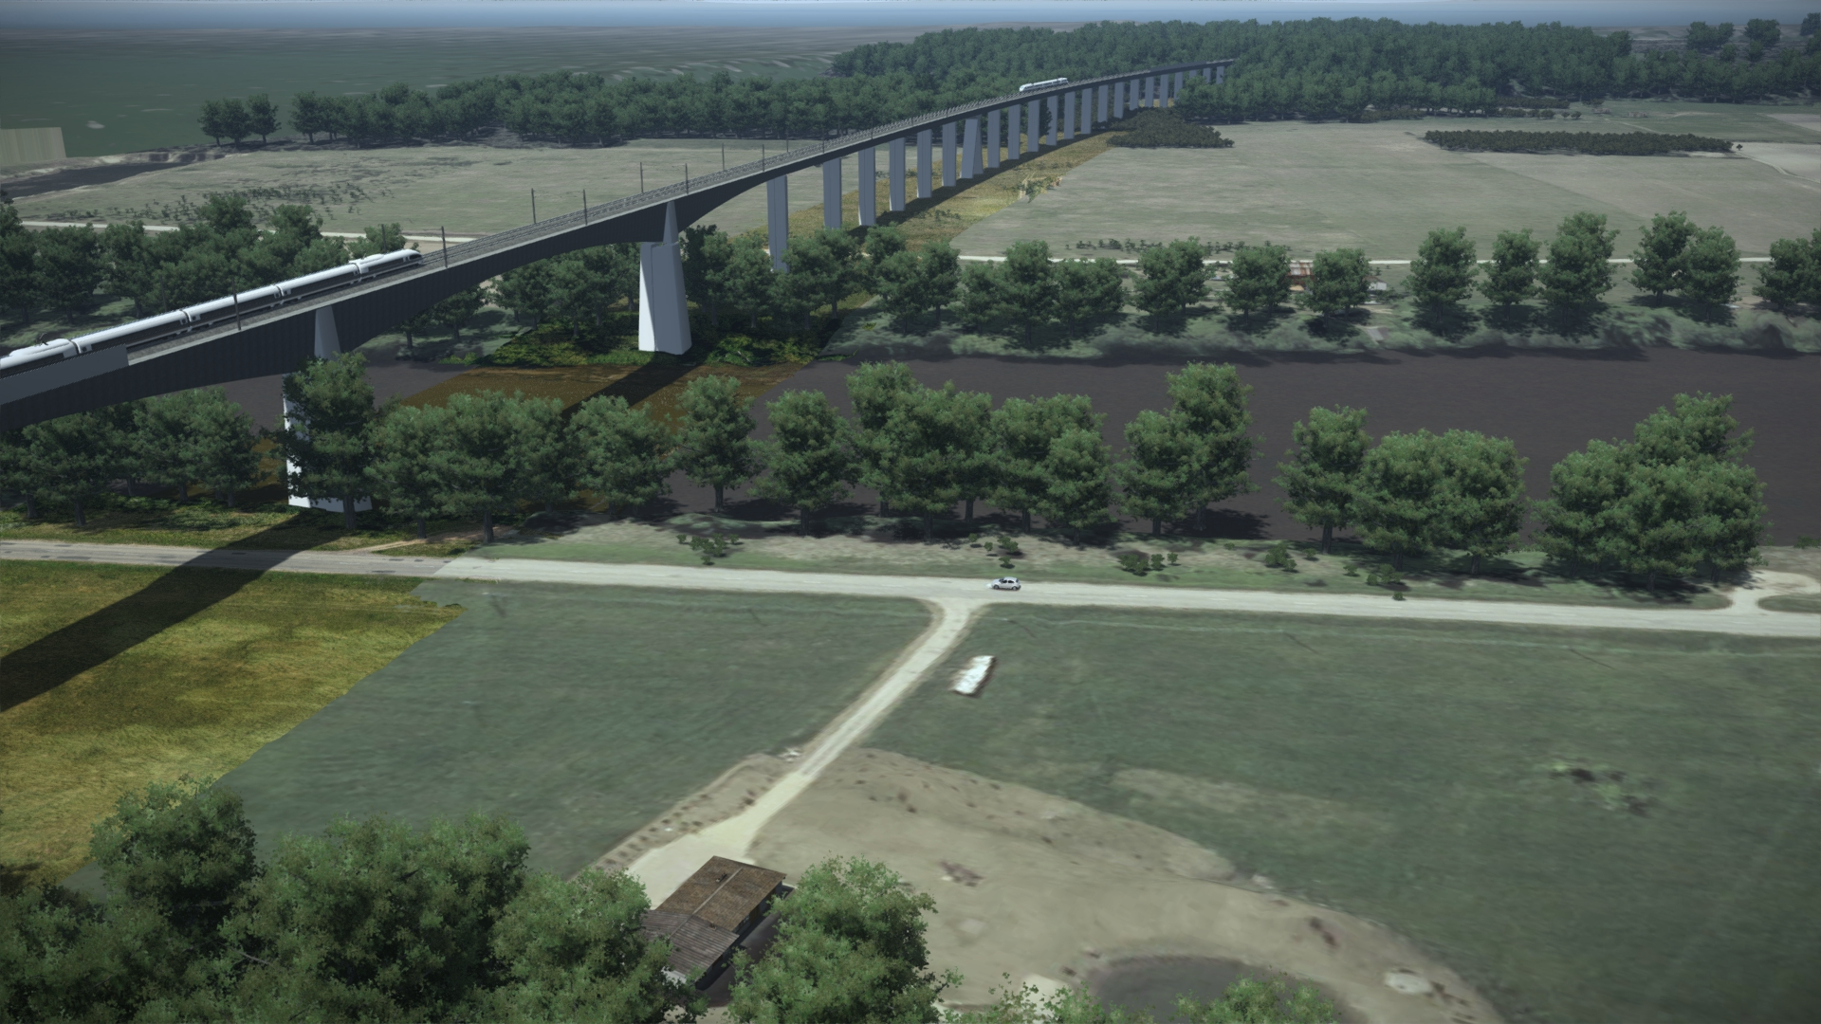
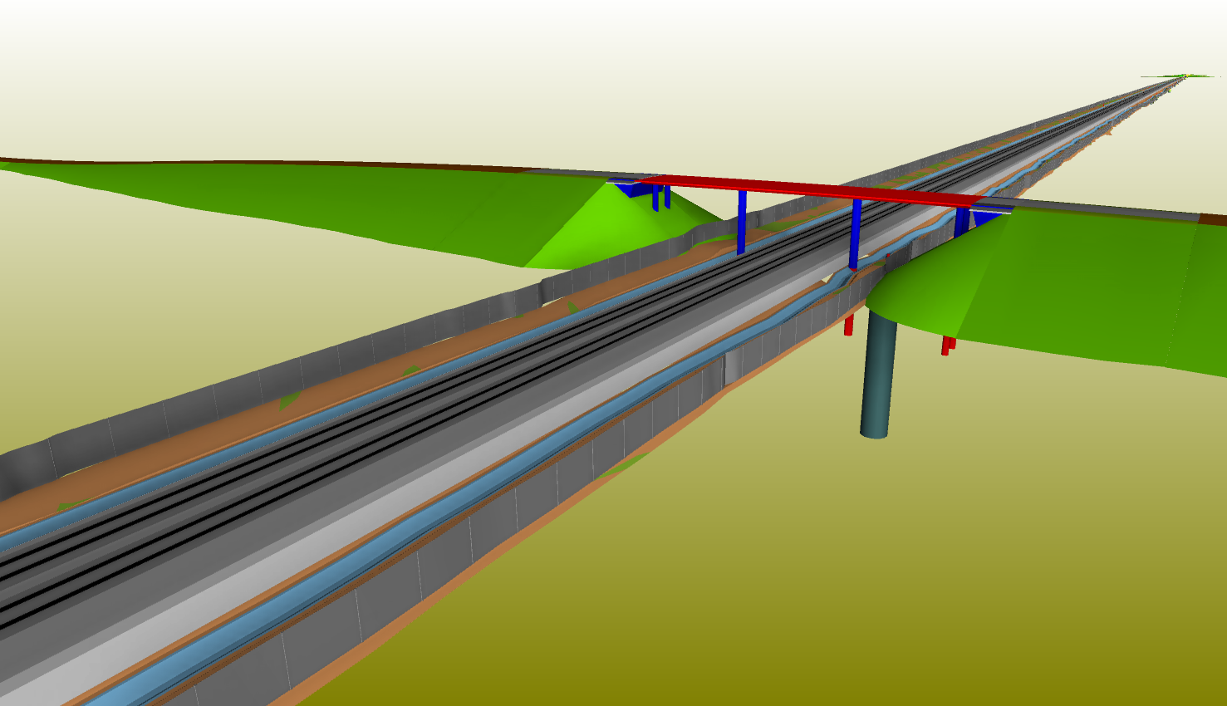
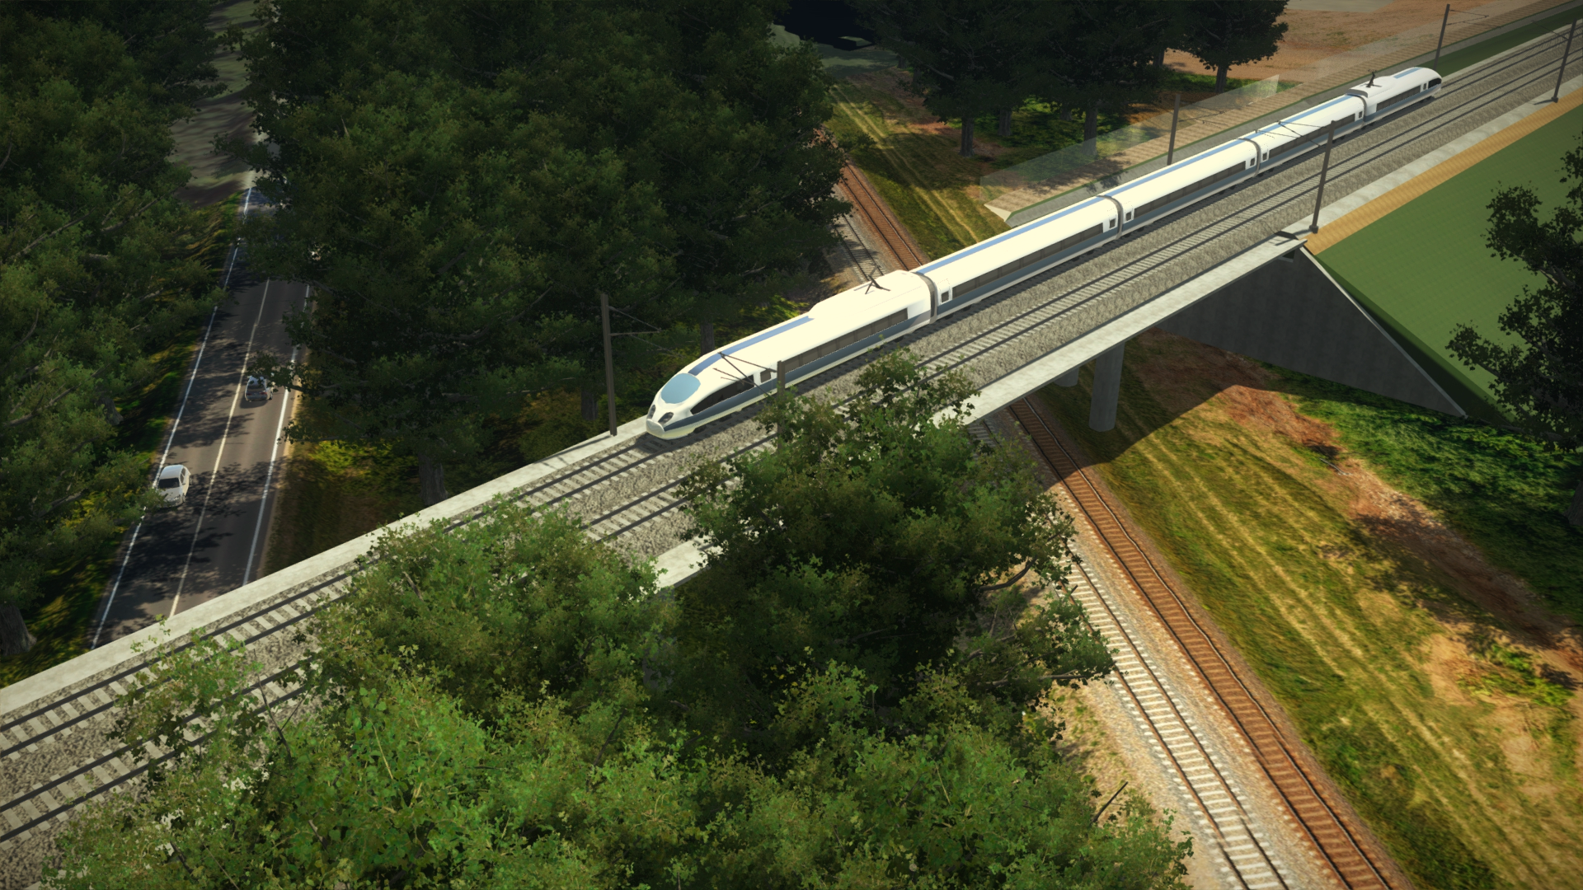
First full life cycle BIM Project in LGI
LGI – AB Lietuvos Geležinkelių Infrastruktūra (Contracting authority), hereinafter – Buyer.

Slide 4
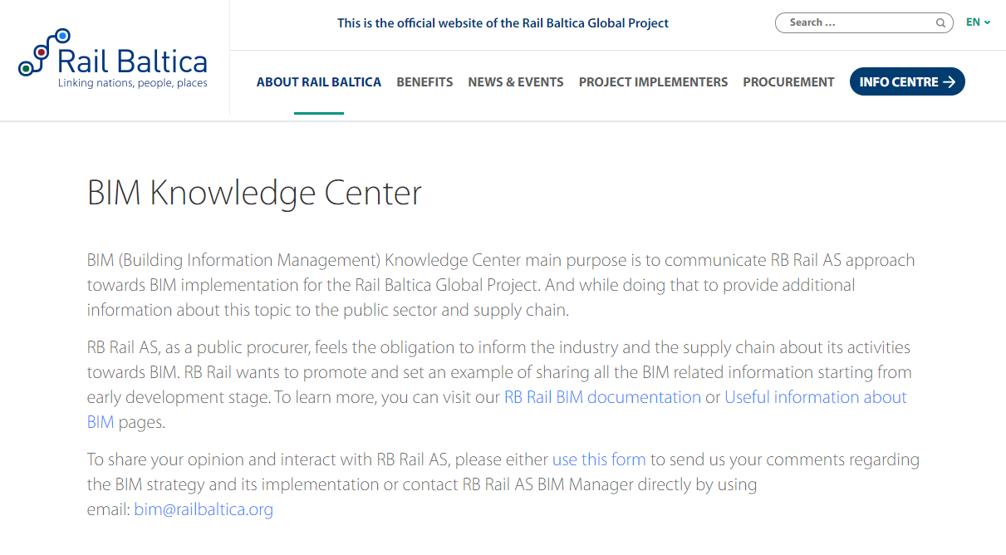
Building information model (BIM) in Project
Requirements for BIM model use, update and handing over - http://www.railbaltica.org/bim-knowledge-center/
Contractor will have an obligation to:
Use BIM model as it‘s described in Employers Information Requirements (seeRBDG-MAN-030-0103_BIM_EIR.pdf), including:
Quality Control;
Phasing and Construction Sequencing Simulations (4D);
Field Progress Tracking;
Quantity Take-Off (5D);
Vendor Equipment Submittals;
keep BIM model up to date while construction phase;
hand over „As Built“ model to Buyer after construction phase.

Slide 5
What will be the Procurement procedure?
Buyer is willing to set up a Dynamic Purchasing System (DPS)*
Overall purchase price – 0,5 mlrd. Eur.
Setting up of several DPS is planned:
New embankment for 249 km/h 1435 mm gauge railway doubletrack with railroad structures and access roads construction (Kaunas - Panevėžys line, from 0+500 km to 96+900 km – approximately 7 individual contracts);
• Track upper construction installation (section from 0+500 km to 58+400 km);
• Bridge over Neris river construction (section from 19+510 km to 21+010 km).
* PUBLIC PROCUREMENT LAW OF REPUBLIC OF LITHUANIA, clause 79. Dynamic Purchasing System. More on http://vpt.lrv.lt/en/e-public-procurement.

Slide 6
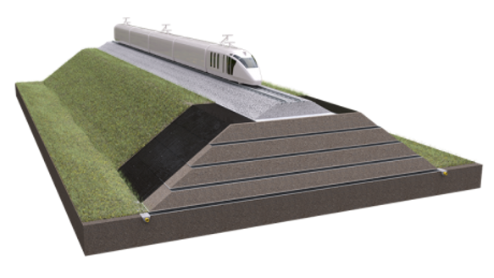
Project deadlines
New embankment for 1435 mm gauge railway doubletrack with railroad structures construction up to 65+900 km. Due date – 2022/12/31.
Access roads construction up to 65+900 km. Bridge over Neris river construction. Due date – 2023/12/31.
Track upper construction installation up to 58+400 km. Due date – 2023/12/31.
New embankment for 1435 mm gauge railway doubletrack with railroad structures and access roads construction up to 96+900 km. Due date – 2023/12/31.

Slide 7
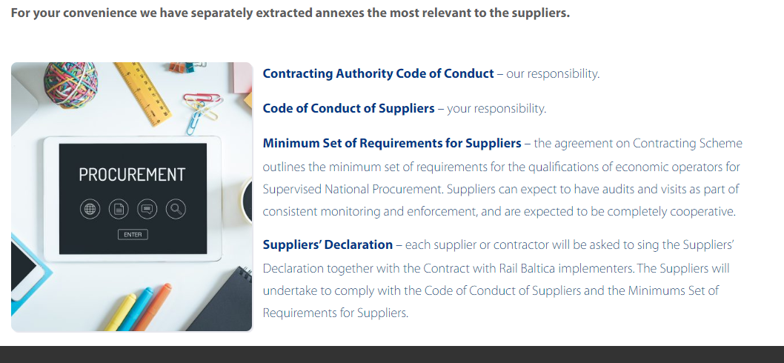
Suppliers Pre-Qualification (PQ)
Suppliers complete a standard Pre-Qualification (PQ). All suppliers who meet and pass the exclusion and seletion criteria (see annexes: Kvalifikaciniai reikalavimai sankasos ir statinių statybai; Kvalifikaciniai reikalavimai Neries tilto statybai; Kvalifikaciniai reikalavimai viršutinės kelio konstrukcijos įrengimui) within the PQ to be admitted to the DPS.
Qualification is based on Minimum Set of Requirements for Suppliers*
(see Common-procurement-standards-and-guidelines_appendix2.pdf).
* http://www.railbaltica.org/procurement/procurement-regulation-supplier-qualification/.

Slide 8
Supplier‘s proposal evaluation
Buyer, respecting past Projects experience and lessons learned, is intending to set the Multi-criteria evaluation (MCE) in order to achieve best service in terms of price/quality balance.
Supplier‘s proposal components and weights:
Price – 80%
Time scheduling – 15%
The Suppliers ability to evaluate process duration dependence to assigned resources will be awarded. Supplier aiming to maximum score must present it‘s exemplary (or successfully implemented Project) time schedule, which should contain sequential workflow tasks with assigned logical dependencies, where task durations are defined by assigned resource productivity which is justified by Supplier. Maximum score– 3 points.
Supplier, committed, to install and use a digital working time on site account system (for employees and heavy machinery) will be awarded with extra 3 points.
Employee experience (BIM Project management) – 5%
Buyer will award with a maximum score Supplier, who will provide a BIM project specialist, coordinator or manager with experience in BIM Project preparation, implementation or asset management in at least 5 Projects in 10 past years.
More in details - Consulting on MCE.pdf

Slide 9
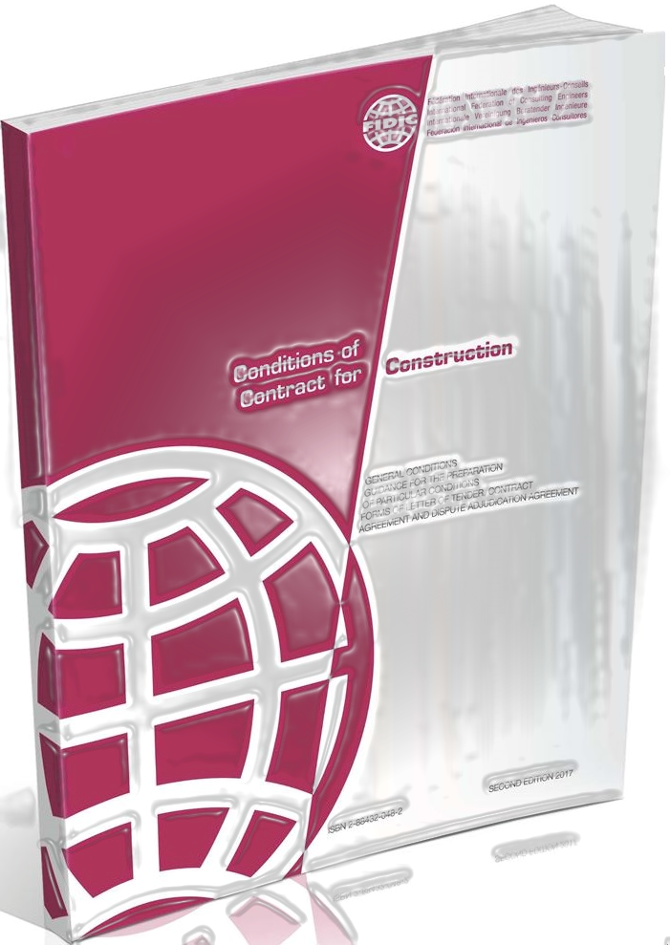
Construction Contract
Buyer will sign the Contract with the Winner, based on Red FIDIC book (second edition, 2009). The template of Particular Conditions is added to the consultation documents.
Set out implementation terms:
New embankment for 249 km/h 1435 mm gauge railway doubletrack with railroad structures and access roads construction (Kaunas – Panevėžys line, see slide „Project deadlines“ for more details) – 2022-12-31;
• Track upper construction installation (section from 0+500 km to 58+400 km) – 2023-12-31;
• Bridge over Neris river construction (section from 19+510 km to 21+010 km) – 2023-12-31.

Slide 10
Thank You

