Slide 1
Rail Baltica section Berčiūnai-Joniškėlis (DPS2) Joniškėlis – Vaškai (DPS3), Pasvalys district municipality PUBLIC HEARING
Jakub Sokoliński, Consultant Representative from IDOM Consulting, Engineering and Architecture
2021/07/15

Slide 2
Design and design supervision services for the construction of the new line from Ramygala to Lithuanian / Latvian state broder

Slide 4
INFORMATION OF THE PUBLIC MEETING
Chairman of the public meeting – Enrique Rico, Consultant Representative from IDOM Consulting, Engineering and Architecture
The secretary of the public meeting is Šarūnė Tučinskaitė, Project Administrator from UAB Kelprojektas
The customer is the RB Rail AS Lietuvos filialas
The builder is the AB„LTG Infra“
Proposals from the public concerned could be submitted before and during the public meeting.
Participants in the public meeting are registered.
The statements of the participants of the public meeting shall be recorded in the minutes.
The minutes of the public meeting will be prepared after the meeting in 3 working days.
The designer publishes the minutes with annexes in IS Infostatyba in 5 working days .
The designer submits the application for approval of the project proposals together with the project proposals, report with annexes, protocol, sound recording, directly to the civil servant of the municipal administration through the IS Infostatyba.
Pursuant to Article 36 of the Law on Public Administration of the Republic of Lithuania, a decision made by a civil servant of the municipal administration performing the functions of the chief architect of the municipality may be appealed to the Administrative Disputes Commission or an administrative court in accordance with the law.

Slide 5
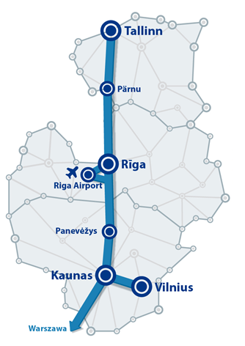
BACKGROUND
Existing Baltics connection with EU via Poland difficult, high cost
Rail Baltica joint project of three EU Member States – Estonia, Latvia and Lithuania.
New High Speed Railway Line fast-conventional double track 1435mm gauge
Symbolic return of the Baltic States to Europe.
Rail Baltica to become part of the EU TEN-T North Sea – Baltic Core Network Corridor:
linking Europe´s largest ports (Rotterdam, Hamburg and Antwerp) through the Netherlands, Belgium, Germany and Poland, with the three Baltic States.
Estonia, Latvia and Lithuania full integration into European railway area.
BACKGROUND
Notes:
Today most freight traffic transported by railway in Baltic states originates from CIS countries, especially from Russia, and rail transport services are mainly provided on East – West axis using existing 1520 mm gauge system which makes it difficult and costly to interconnect the Baltics with the rest of EU via Poland.
The Rail Baltica project is a joint project of three EU Member States – Estonia, Latvia and Lithuania – and concerns the building of a fast-conventional double track 1435mm gauge electrified railway line, meaning a symbolic return of the Baltic States to Europe.
Today most freight traffic transported by railway in Baltic states originates from CIS countries, especially from Russia, and rail transport services are mainly provided on East – West axis using existing 1520 mm gauge system which makes it difficult and costly to interconnect the Baltics with the rest of EU via Poland.
Rail Baltica has been therefore designed to become part of the EU TEN-T North Sea – Baltic Core Network Corridor, which links Europe´s largest ports of Rotterdam, Hamburg and Antwerp through the Netherlands, Belgium, Germany and Poland, with the three Baltic States, ensuring full integration of Estonia, Latvia and Lithuania into the single European railway area.

Slide 6
JONIŠKELIS -PASVALYS SECTION GENERAL DESCRIPTION
DPS2 Section

Slide 7
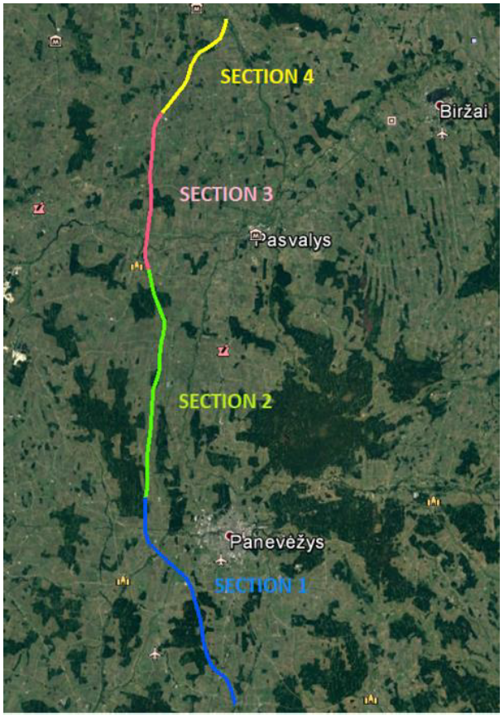
BERČIŪNAI-JONIŠKĖLIS
SECTION GENERAL DESCRIPTION
This section connects two main population áreas, Joniškelis, to the northeast of Pasvalys District Municipality, and Panevežys, in Panevežys District Municipality.
The alignment of this section has been designed within the boundaries of the approved Special Plan, running in close proximity to: Joniškelis, Jotainiai, Pušalotas, and Panevežys.
The stretch intersects several existing transport infrastructure, for which new grade separated junctions have been designed, avoiding level crossings that represent one of the rail sector´s biggest safety concerns.
Access roads parallel to the new railway line have been designed, ensuring connectivity among the adjacent private landplot owners.
NOTE: For the purpose of this presentation, we´ll be showing only the infrastructure within the boundaries of Panevezys Municipality.
ROAD NR. 1204
ROAD NR. 3023
ROAD NR. 3022
Notes:
This section connects two main population áreas, Šėta, to the northeast of Kedainiai District Municipality, and Ramygala, in Panevezys District Municipality.
The alignment of this section has been designed within the boundaries of the approved Special Plan, running in close proximity to: Jotainiai,Daniūnai, Pauslajys and Pagiriai.
The stretch intersects several existing transport infrastructure, for which new grade separated junctions have been designed, avoiding level crossings that represent one of the rail sector´s biggest safety concerns.
Access roads parallel to the new railway line have been designed, ensuring connectivity among the adjacent private landplot owners.
NOTE: For the purpose of this presentation, we´ll be showing only the infrastructure within the boundaries of Panevezys Municipality

Slide 8
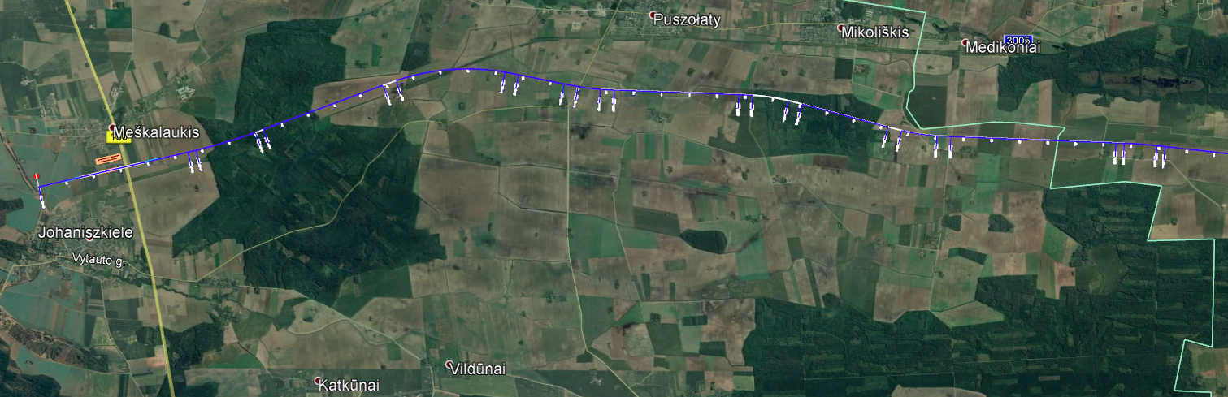
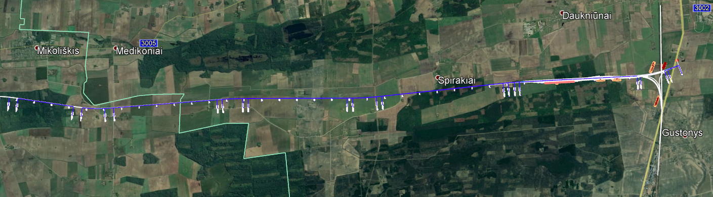
BERČIŪNAI-JONIŠKĖLIS
SECTION GENERAL DESCRIPTION
ROAD NO. 150
PANEVĖŽYS
INTERSECTION WITH
NARROW GAUGE
ROAD NO. 2904
ROAD NO. 3013
ECODUCT
MUNICIPALITY
BORDER
PSAVALYS
PANEVĖŽYS
INTERSECTION WITH
1520mm railway
ROAD NO. 3013
ROAD NO. 3013
ROAD NR. 3023
ROAD A9
PASVALYS
MUNICIPALITY
BORDER
ROAD NR. 3022
Notes:
This section connects two main population áreas, Šėta, to the northeast of Kedainiai District Municipality, and Ramygala, in Panevezys District Municipality.
The alignment of this section has been designed within the boundaries of the approved Special Plan, running in close proximity to: Jotainiai,Daniūnai, Pauslajys and Pagiriai.
The stretch intersects several existing transport infrastructure, for which new grade separated junctions have been designed, avoiding level crossings that represent one of the rail sector´s biggest safety concerns.
Access roads parallel to the new railway line have been designed, ensuring connectivity among the adjacent private landplot owners.
NOTE: For the purpose of this presentation, we´ll be showing only the infrastructure within the boundaries of Panevezys Municipality

Slide 9
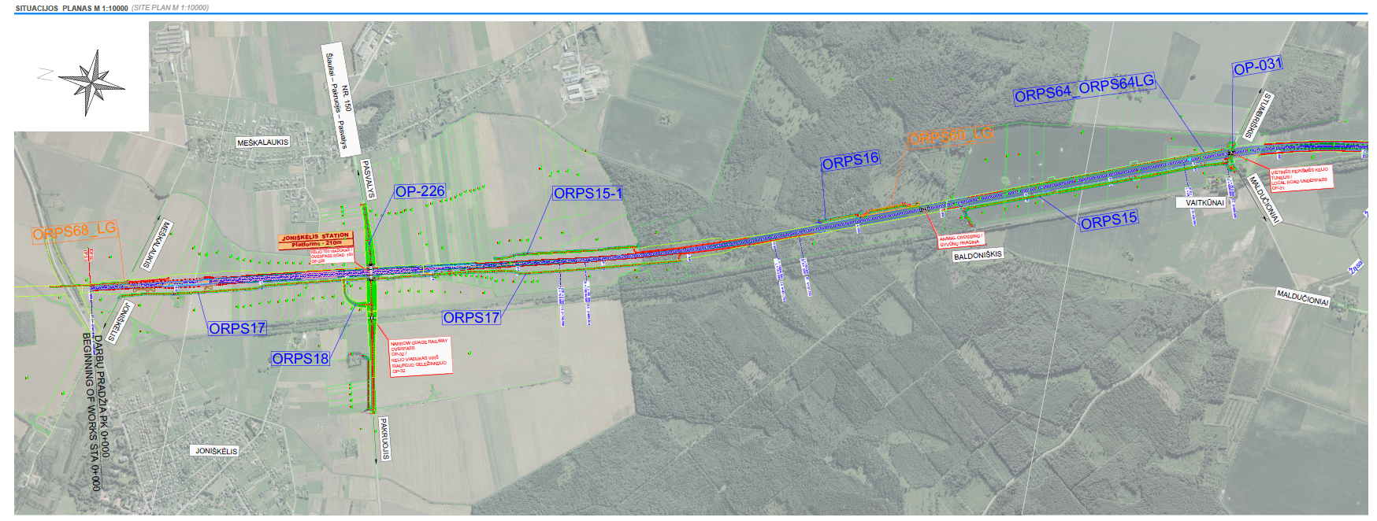
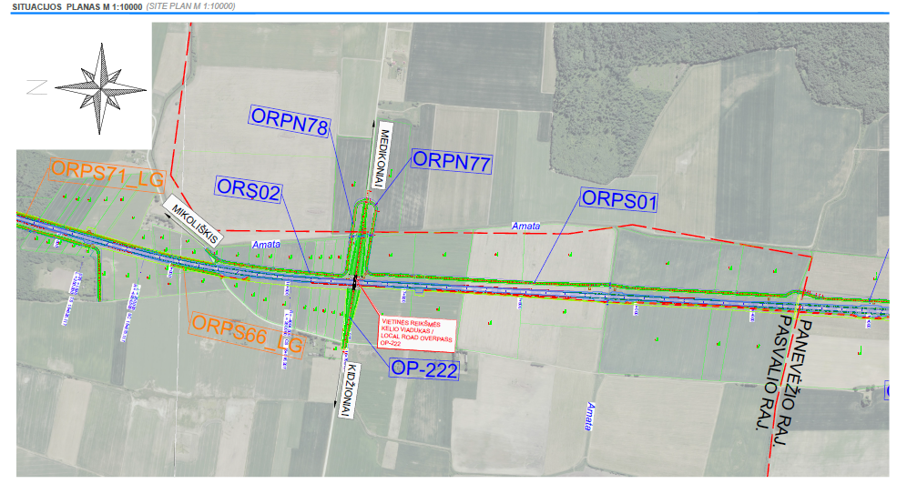
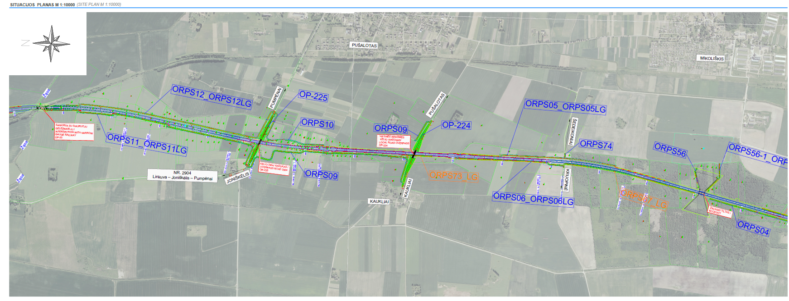
RAILWAY LOCATION PLAN-PASVALYS

Slide 10
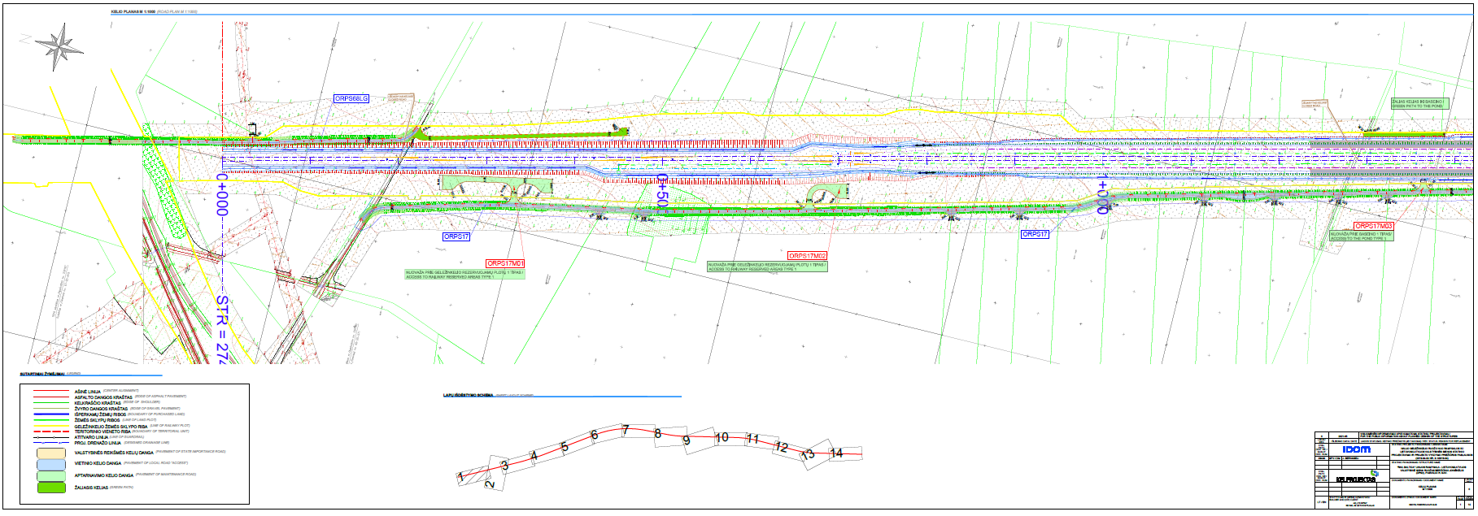
RAILWAY ALIGNMENT PLAN

Slide 11
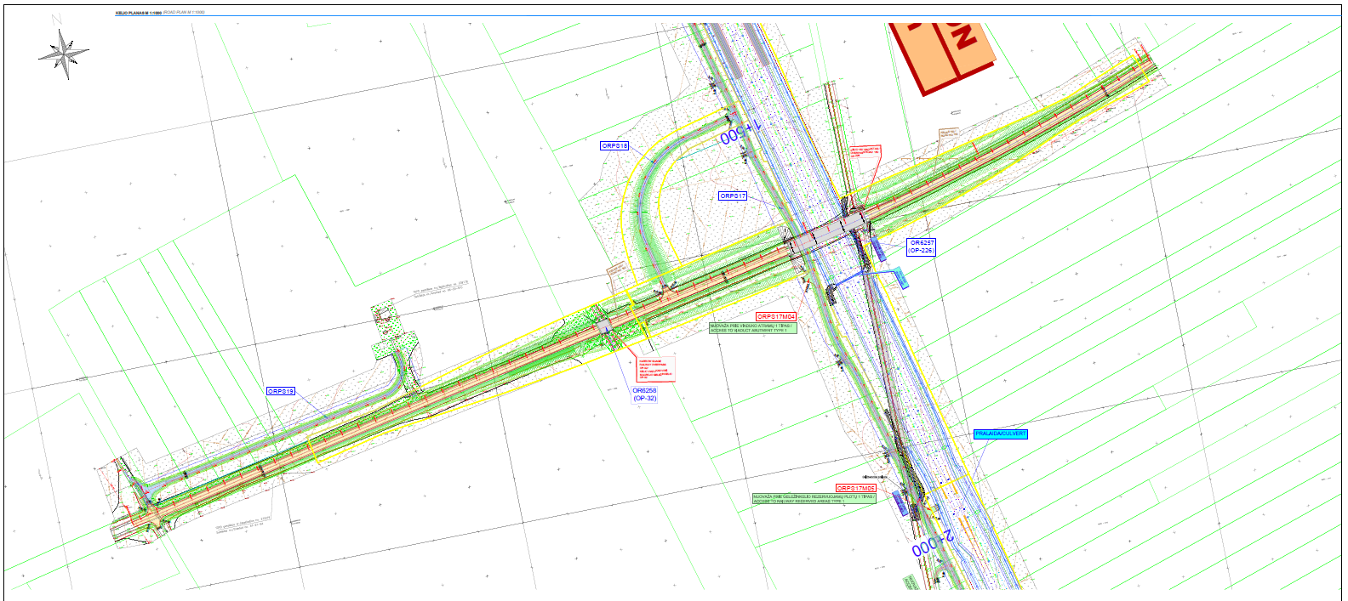
RAILWAY ALIGNMENT PLAN

Slide 12
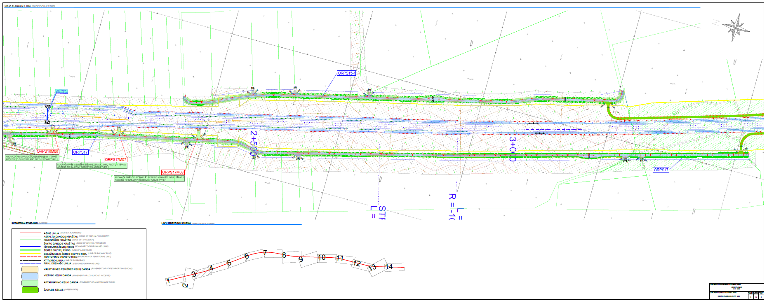
RAILWAY ALIGNMENT PLAN

Slide 13
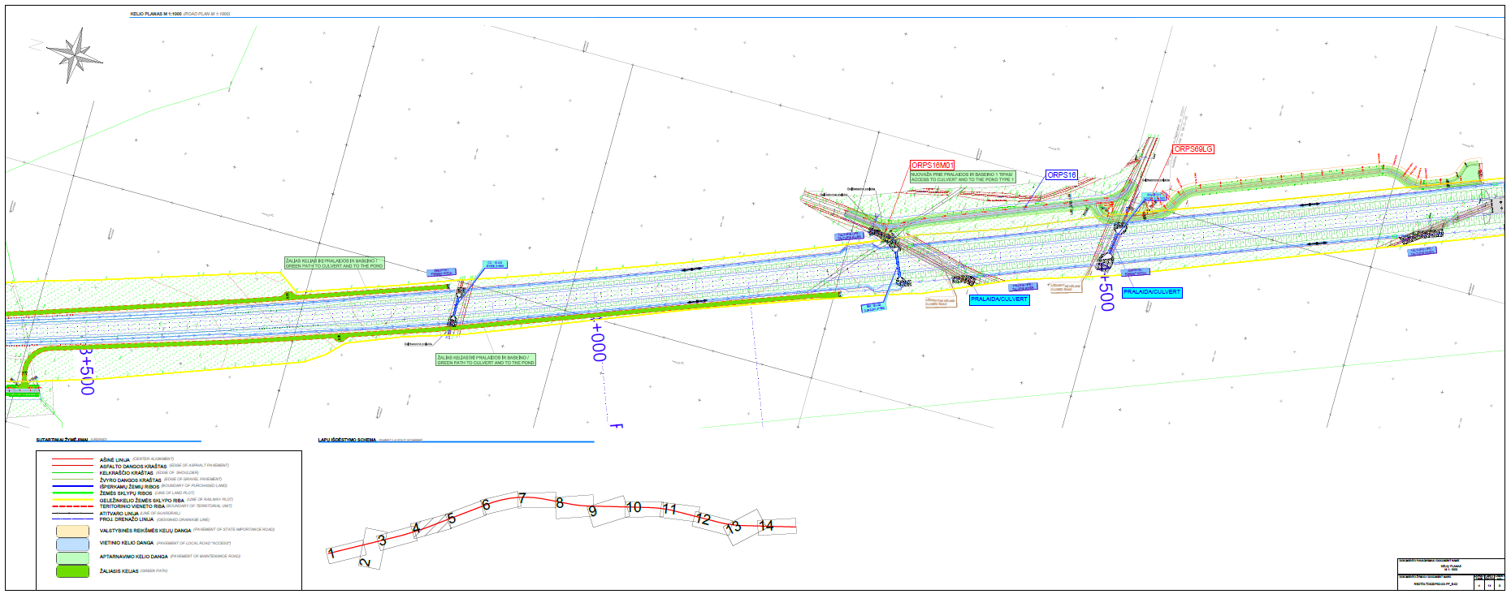
RAILWAY ALIGNMENT PLAN

Slide 14
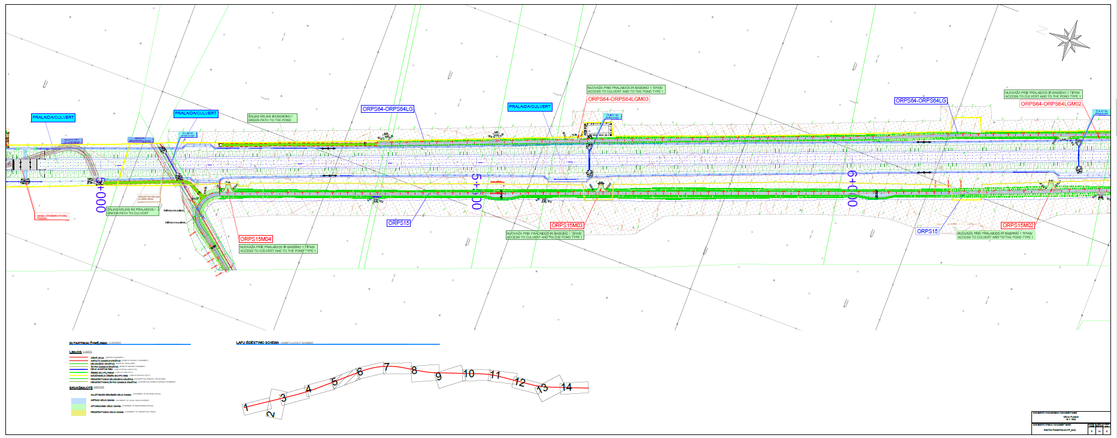
RAILWAY ALIGNMENT PLAN

Slide 15
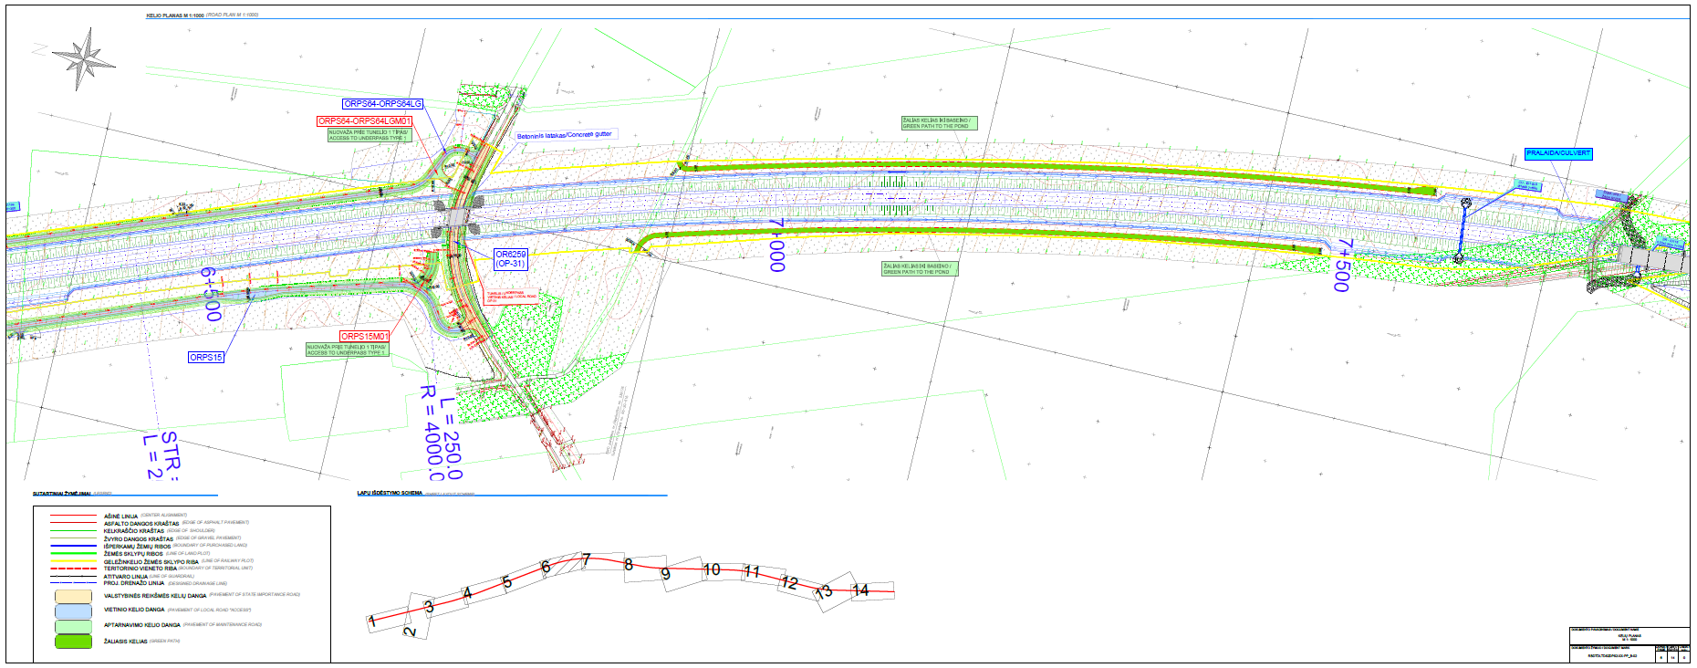
RAILWAY ALIGNMENT PLAN

Slide 16
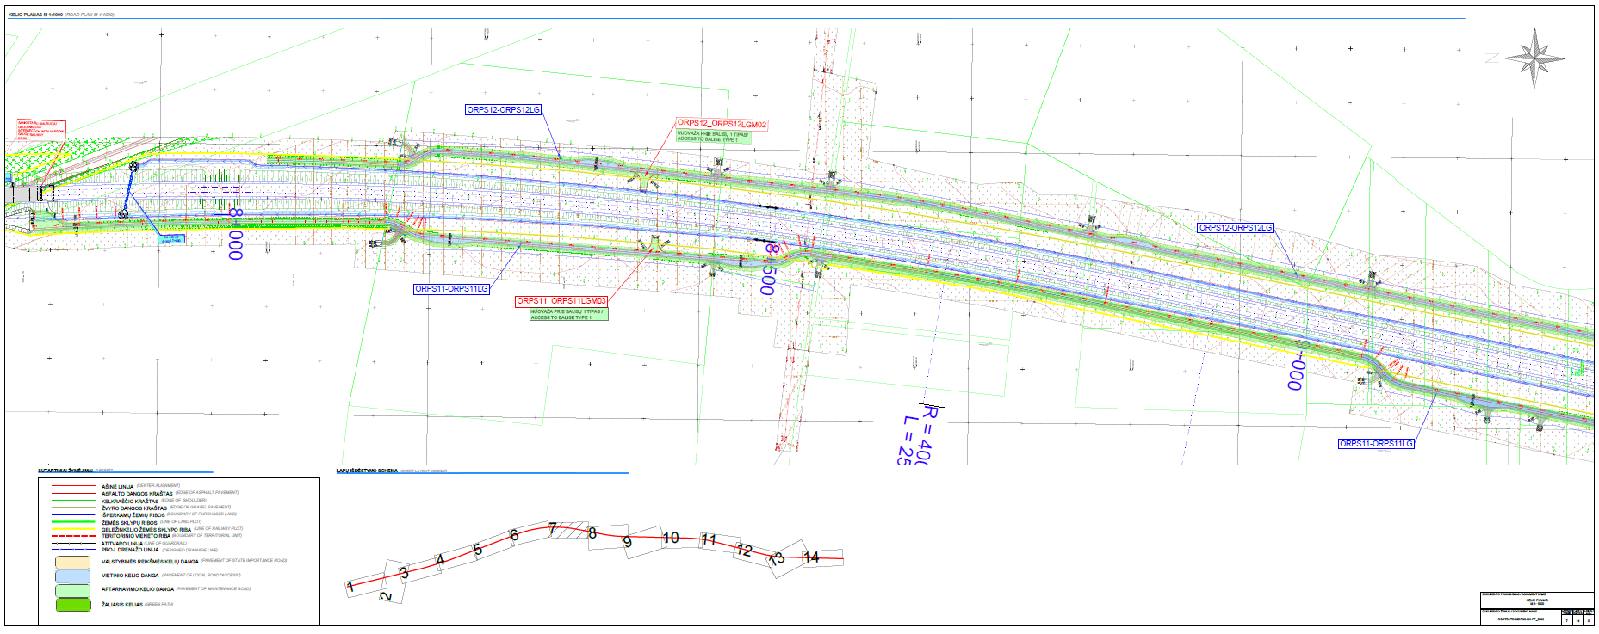
RAILWAY ALIGNMENT PLAN

Slide 17
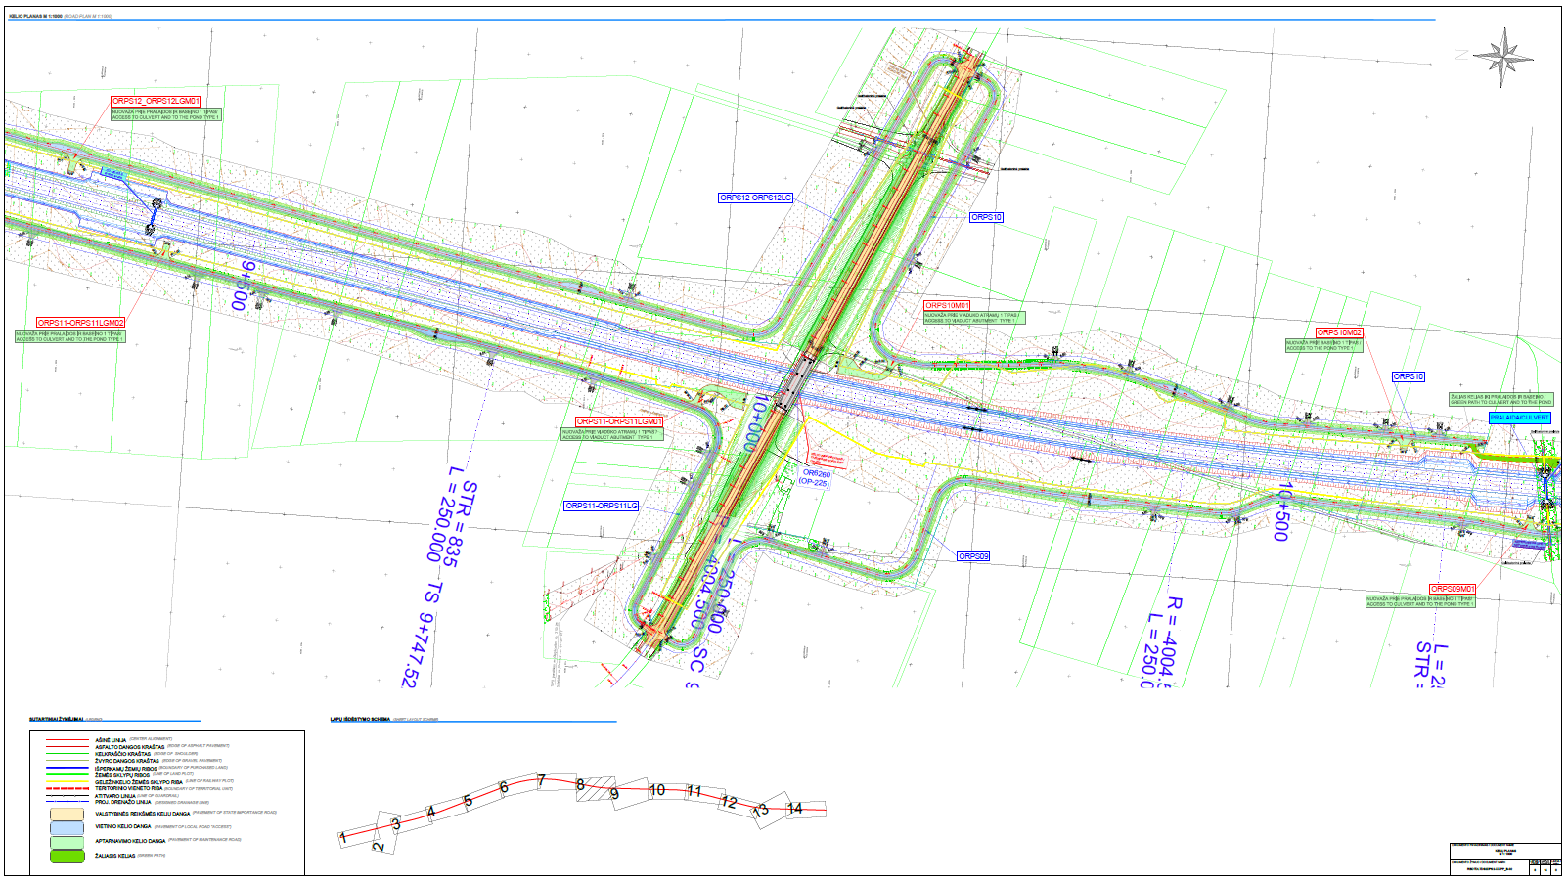
RAILWAY ALIGNMENT PLAN

Slide 18
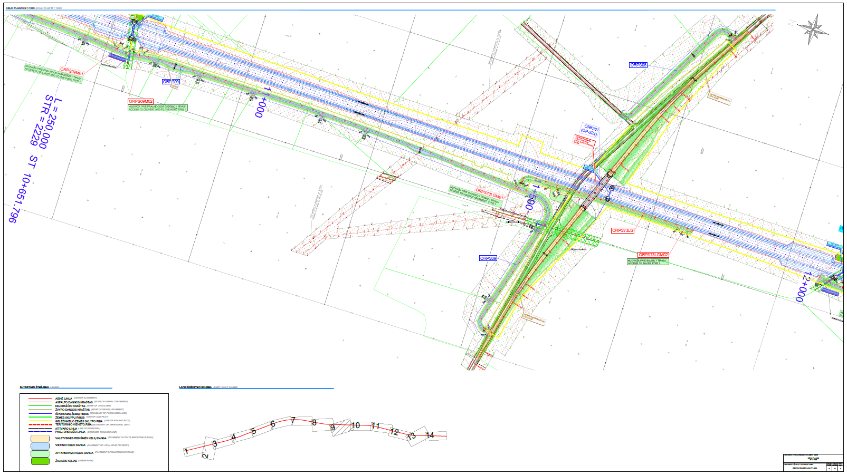
RAILWAY ALIGNMENT PLAN

Slide 19
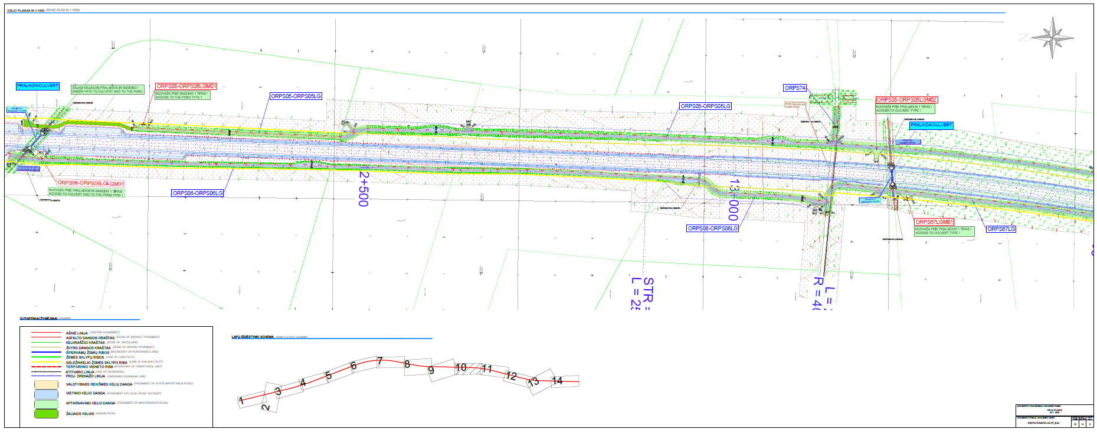
RAILWAY ALIGNMENT PLAN

Slide 20
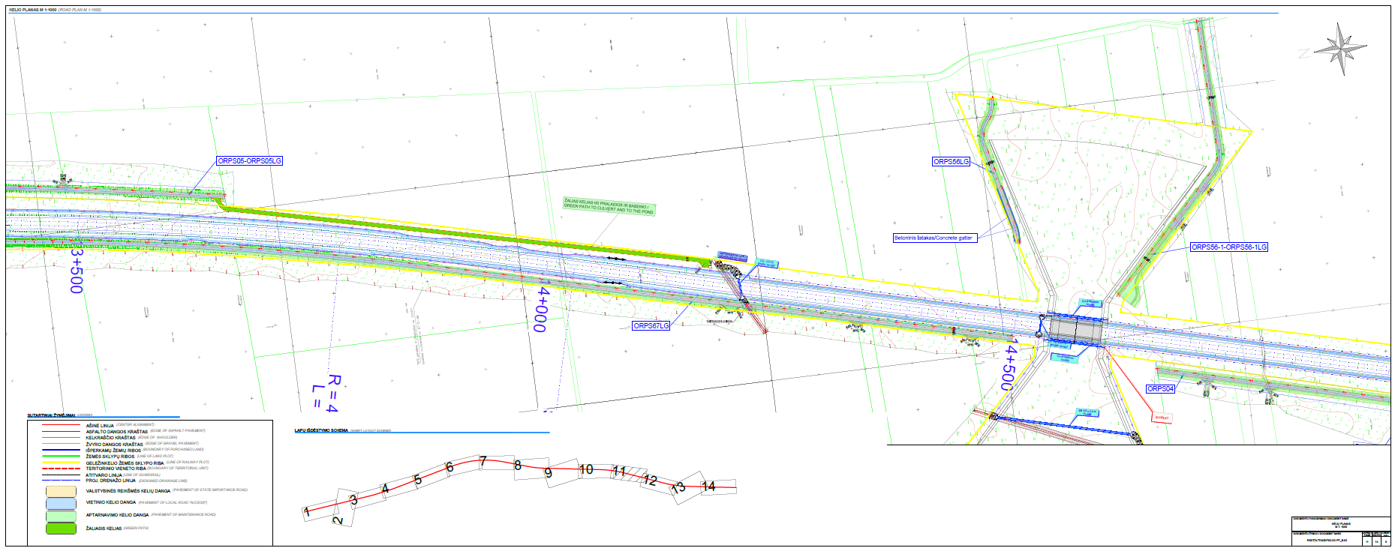
RAILWAY ALIGNMENT PLAN

Slide 21
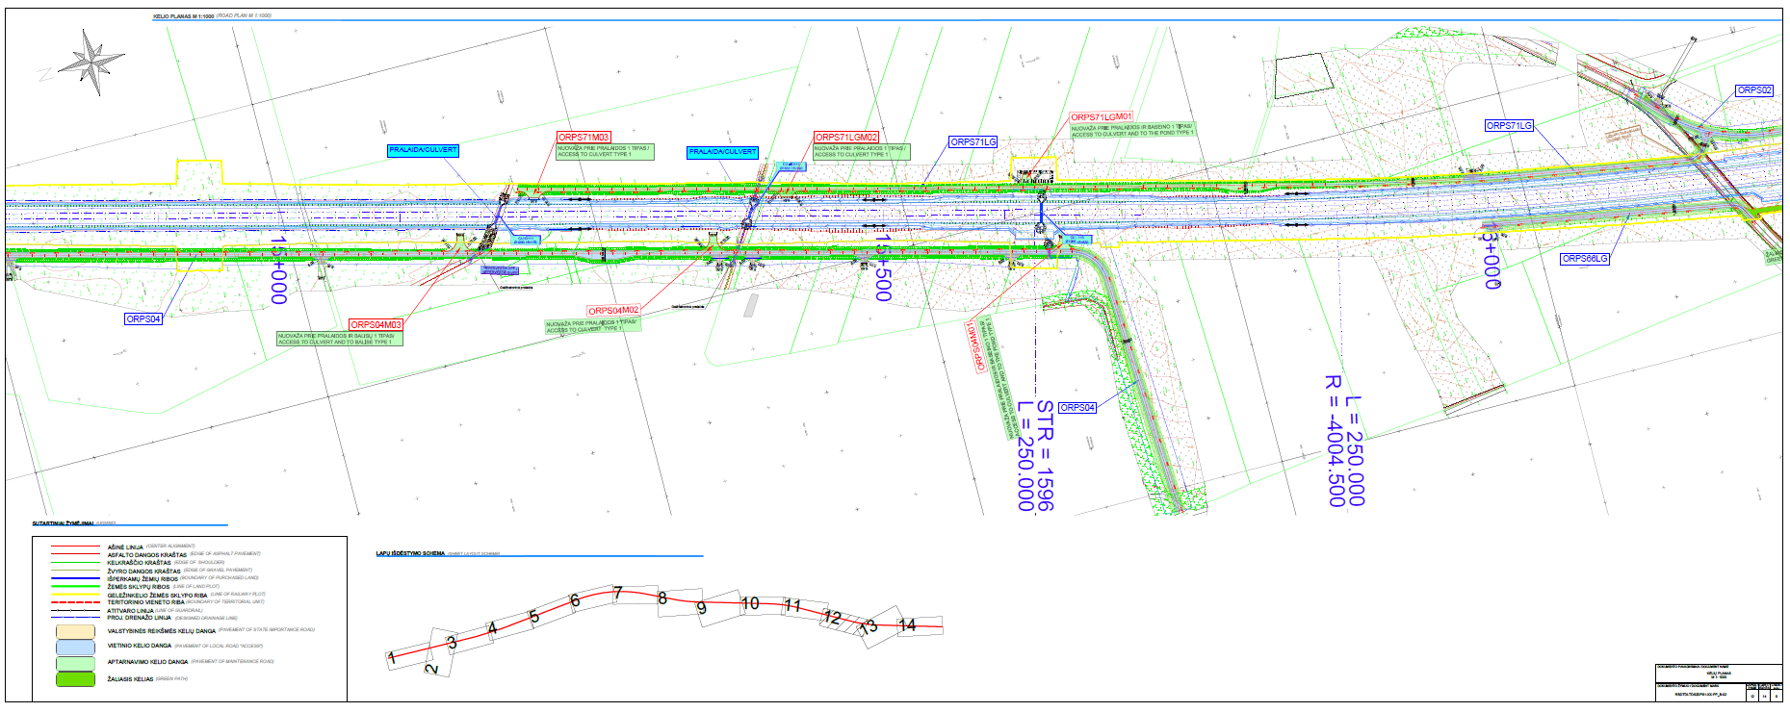
RAILWAY ALIGNMENT PLAN

Slide 22
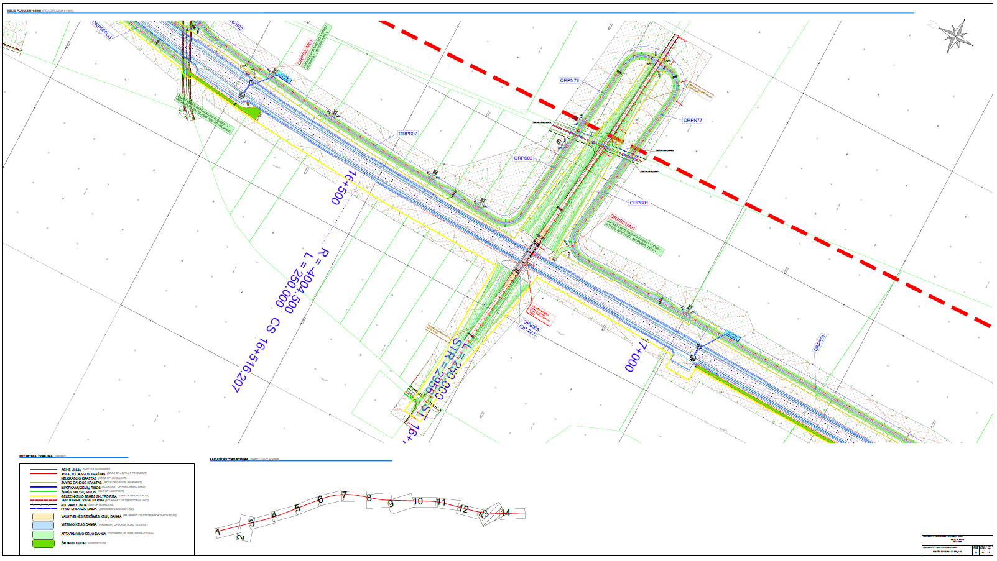
RAILWAY ALIGNMENT PLAN-END OF PASVALIS

Slide 23
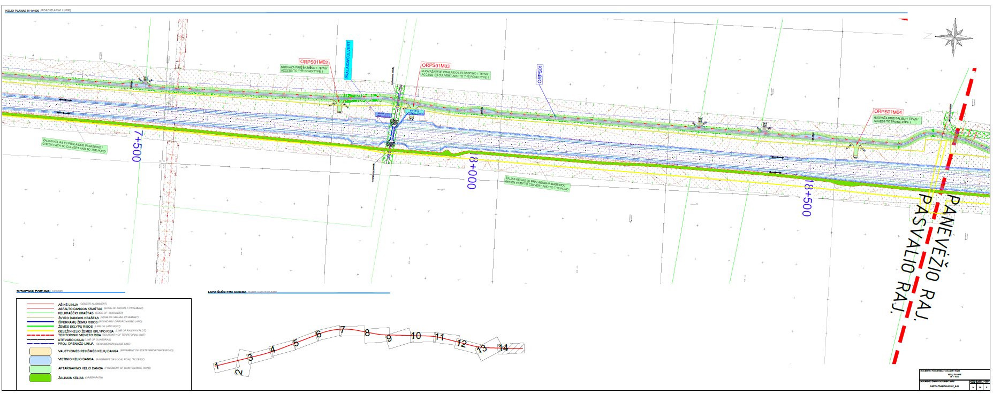
RAILWAY ALIGNMENT PLAN-END OF PASVALIS

Slide 24
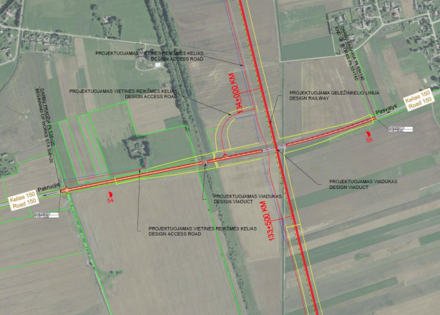
RAILWAY-ROAD 150 CROSSING LOCATION PLAN
The railway line intersects with category V regional road no. 150 Pakruojis - Pasvalys, the section from 53,81 km to 55,04 belongs to Pasvalys district municipality,
It is planned to install a road viaduct at the intersection between railway and road.
It is planned to install connecting roads to provide access to enter railway terrain form road no.: 150
To ensure safety for the users, the pedestrian path is separated from the district road by protective barriers

Slide 25
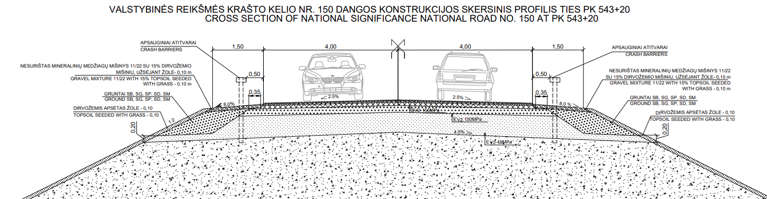
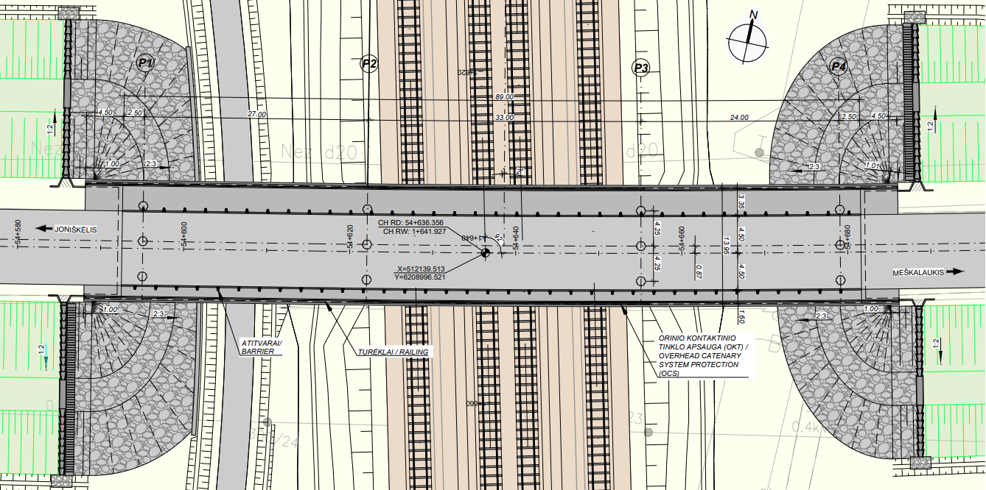
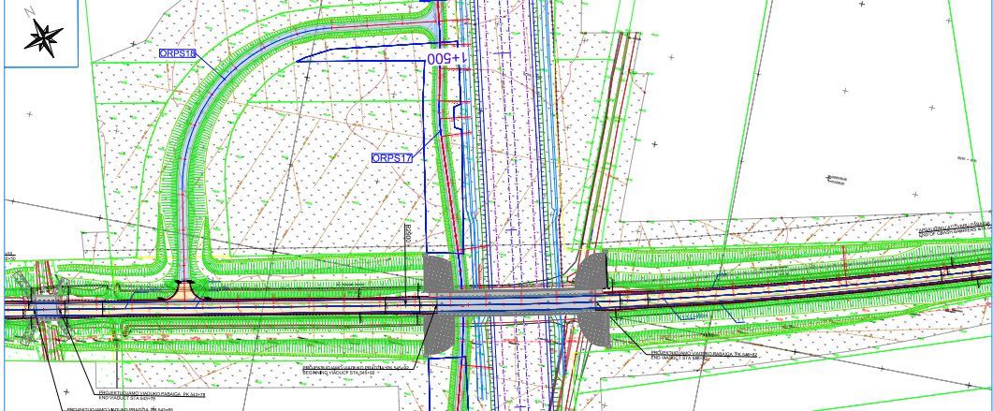
ROAD 150 PLAN
AND CROSS SECTION
ROAD CROSS SECTION
RAILWAY VIADUCT PLAN
ROAD PLAN

Slide 26
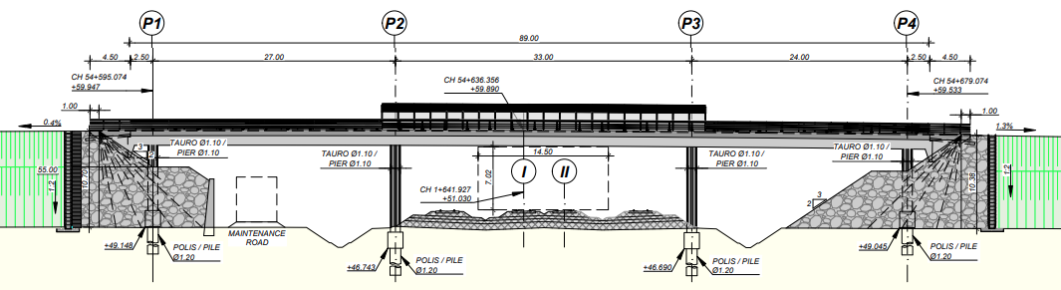
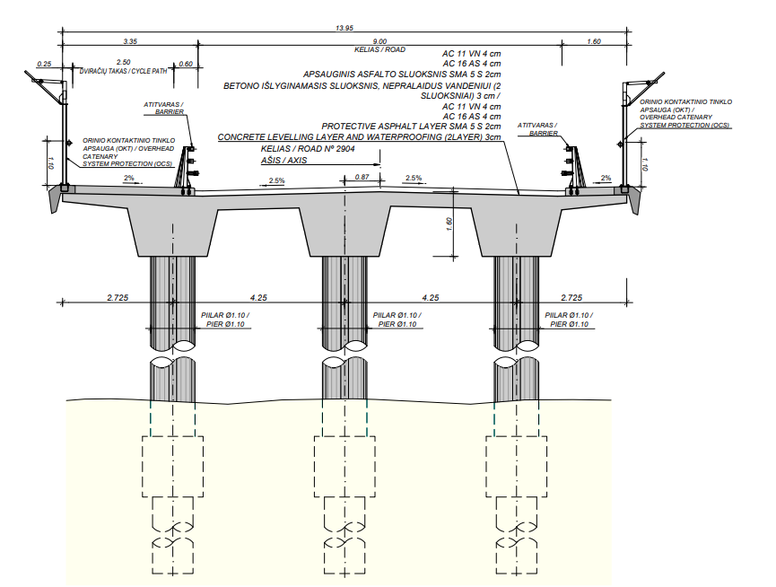
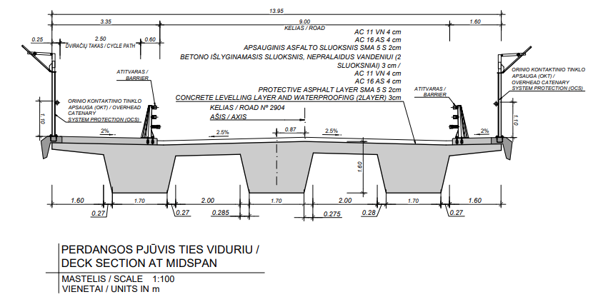
ROAD 150 CROSS SECTION UNDER RAILWAY VIADUCT
ELEVATION 1
ROAD CROSSSECTION 1 OVER RAILWAY VIADUCT
ROAD CROSSSECTION 2 OVER RAILWAY VIADUCT

Slide 27
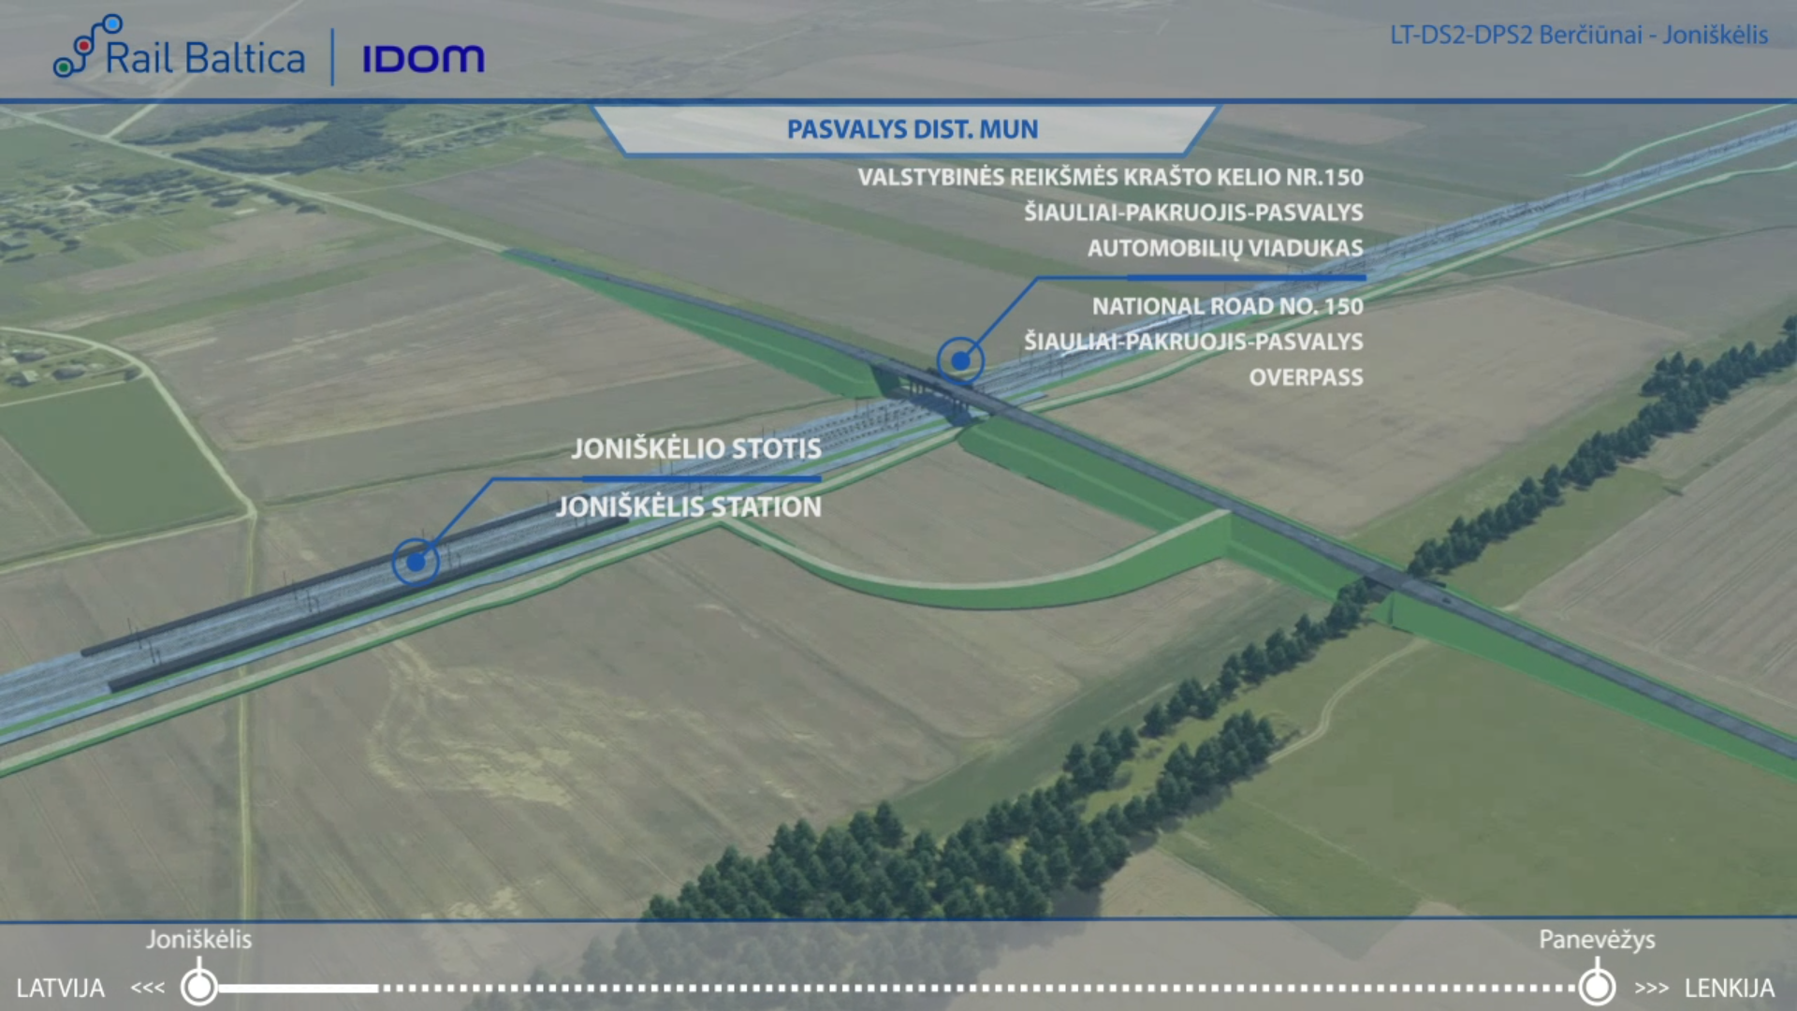
ROAD 150-VISUALIZATION

Slide 28
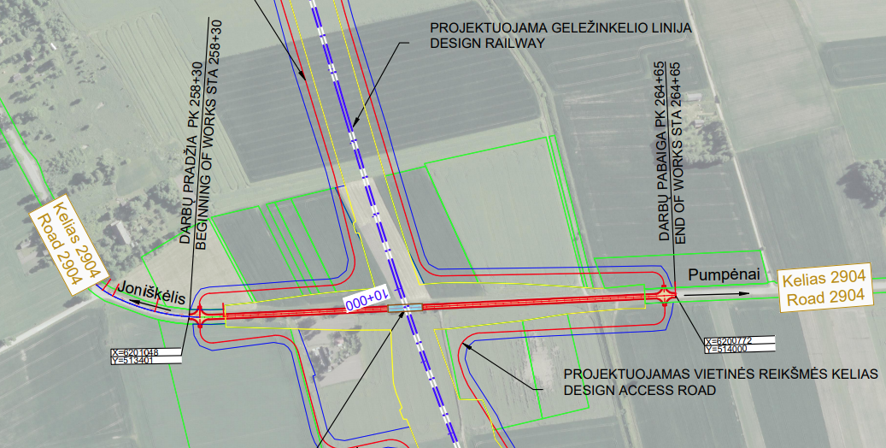
RAILWAY-ROAD 2904 CROSSING LOCATION PLAN
The railway line intersects with the category IV regional road no. 2904 Linkuva – Joniškelis – Pumpenai – Ramygala, the section from 25,83 km to 26,08 km and from 26,14 km to 26,46 km belongs to Pasvalys district municipality.
It is planned to install a road overpass at the intersection between railway and road.
It is planned to install connecting roads on both sides of the railway line to ensure the accessibility of private land plots.
On the left side of the road, a 2.70 m wide cycle path with asphalt pavement is being designed.
To ensure safety for the users, the pedestrian path is separated from the district road by protective barriers.

Slide 29
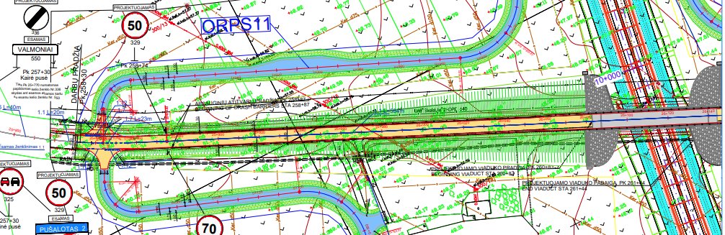
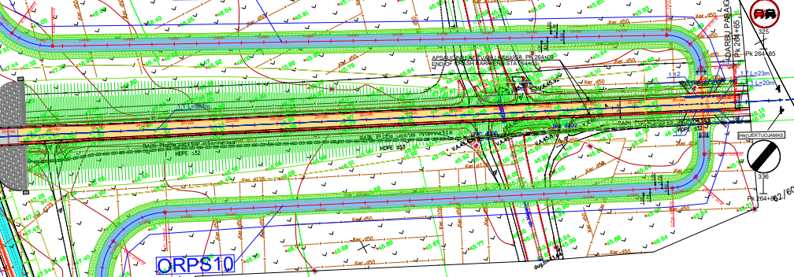
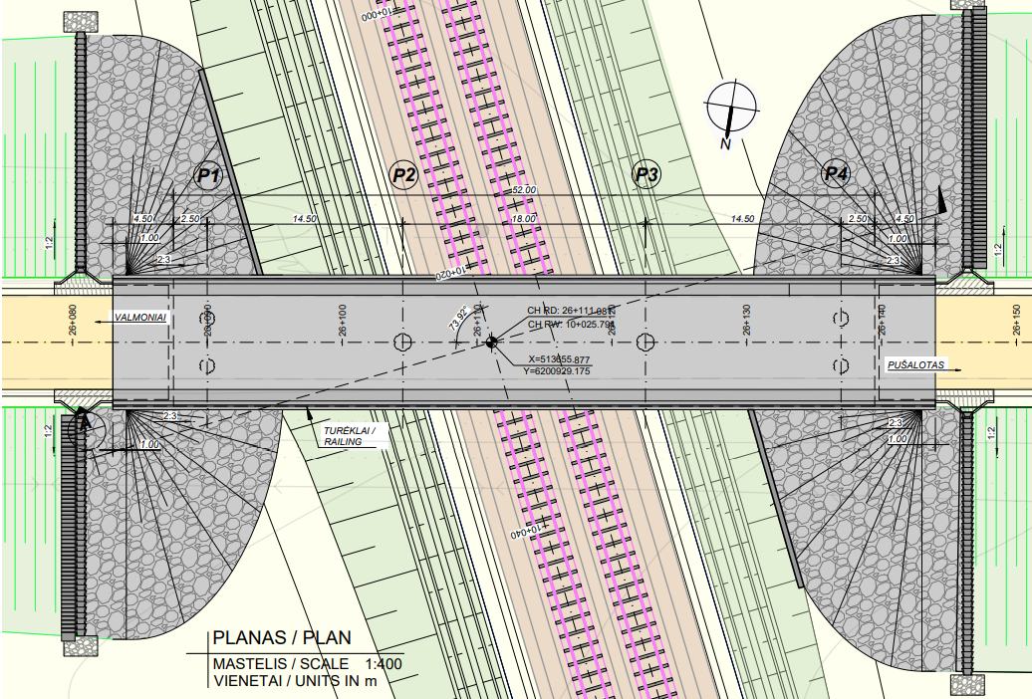
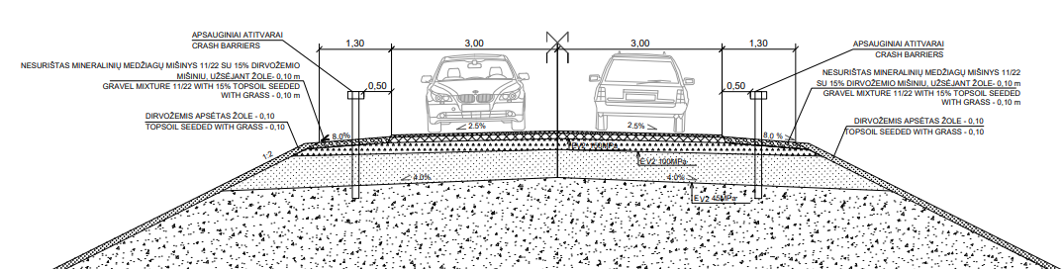
ROAD 2904 PLAN AND CROSS SECTION
ROAD PLAN
ROAD CROSS SECTION
OVERPASS PLAN

Slide 30
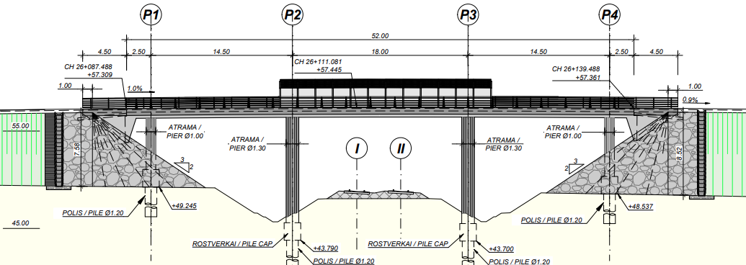
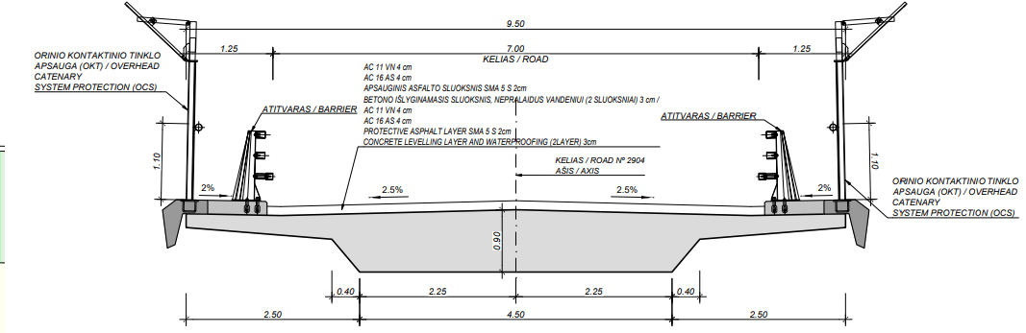
ROAD 2904 - OVERPASS ELEVATION AND CROSS SECTION
OVERPASS ELEVATION
ROAD CROSS SECTION ON VIADUCT
ROAD CROSS SECTION ON EMBANKMENT

Slide 31
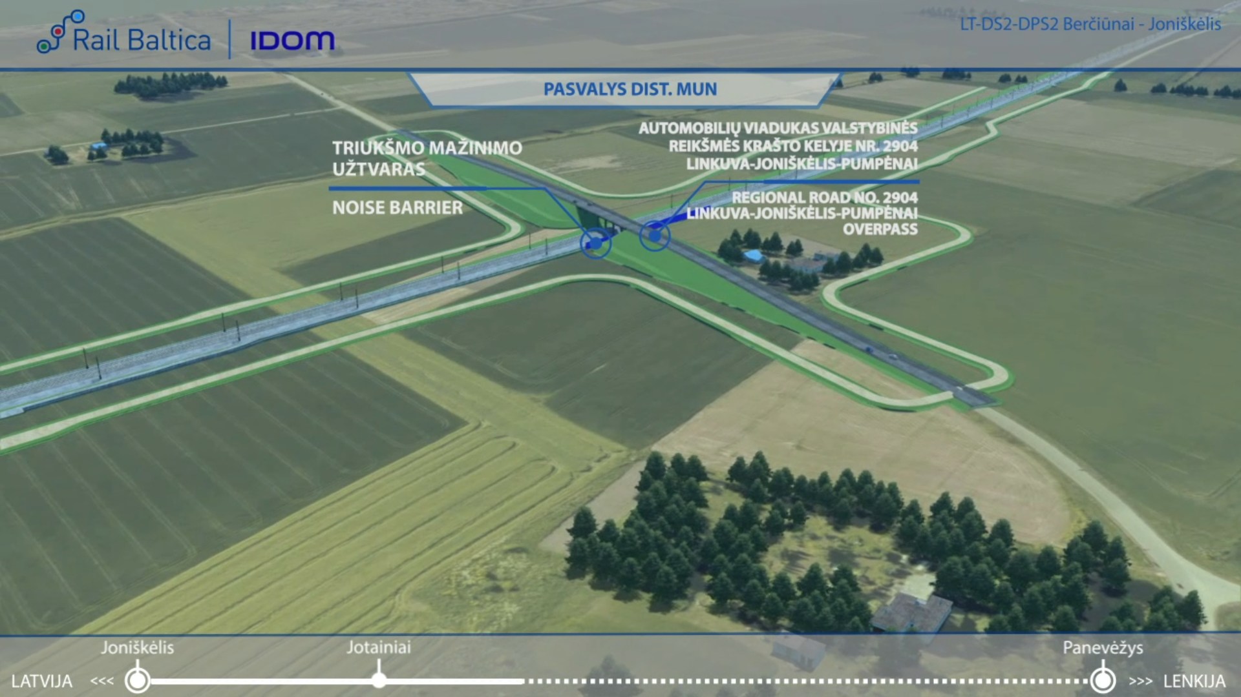
ROAD 2904-VISUALIZATION

Slide 32
ENVIRONMENTAL PROTECTION MEASURES
No Natura 2000 sites have been identified along this stretch
Migration studies were conducted during the research phase - in accordance with the results, 1 green bridges (ecoduct) plus 1 animal passages have been proposed.
Several noise mitigation measures are proposed in the vicinity of settlements:
Noise reduction barriers;

Slide 33
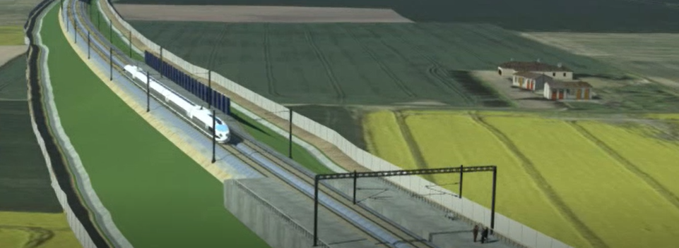
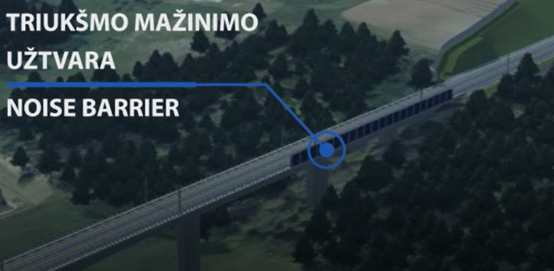
NOISE MITIGATION MEASURES
Residential area | Location | Noise mitigation measure
Pasvalys district municipality | 6+560 – 6+650 10+000 – 10+100 | Noise Barriers
Example of Noise barrier
Example of Noise barrier

Slide 34
JONIŠKĖLIS -VAŠKAI SECTION GENERAL DESCRIPTION
ROAD NR. xxx
DPS3 Section
Notes:
This section connects two main population áreas, Šėta, to the northeast of Kedainiai District Municipality, and Ramygala, in Panevezys District Municipality.
The alignment of this section has been designed within the boundaries of the approved Special Plan, running in close proximity to: Jotainiai,Daniūnai, Pauslajys and Pagiriai.
The stretch intersects several existing transport infrastructure, for which new grade separated junctions have been designed, avoiding level crossings that represent one of the rail sector´s biggest safety concerns.
Access roads parallel to the new railway line have been designed, ensuring connectivity among the adjacent private landplot owners.
NOTE: For the purpose of this presentation, we´ll be showing only the infrastructure within the boundaries of Panevezys Municipality

Slide 35
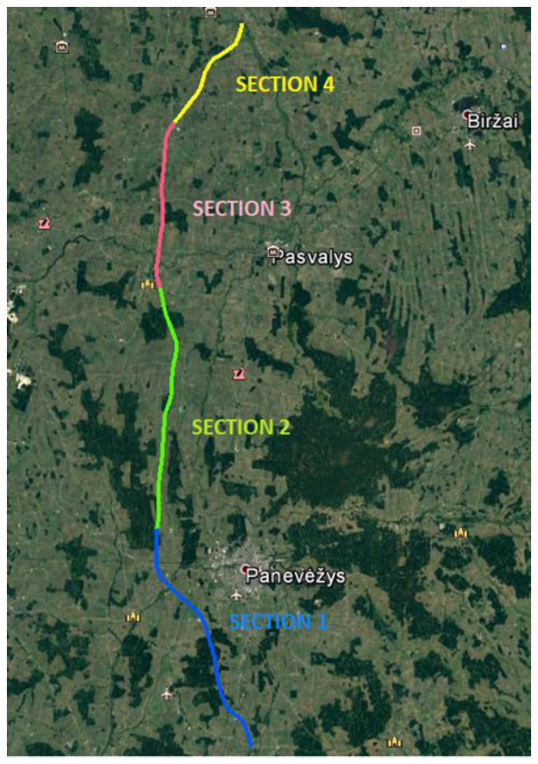
JONIŠKĖLIS -VAŠKAI SECTION GENERAL DESCRIPTION
This section connects two main population áreas, Joniškėlis, in the south of Pasvalys District Municipality, and Vaškai , in the north of Pasvalys District Municipality.
The alignment of this section has been designed within the boundaries of the approved Special Plan, running in close proximity to: Joniškėlis,Narteikiai, Paliepiai and Vaškai.
The stretch intersects several existing transport infrastructure, for which new grade separated junctions have been designed, avoiding level crossings that represent one of the rail sector´s biggest safety concerns.
Access roads parallel to the new railway line have been designed, ensuring connectivity among the adjacent private landplot owners.
NOTE: For the purpose of this presentation, we´ll be showing only the infrastructure within the boundaries of Panevezys Municipality.
ROAD NR. xxx
Notes:
This section connects two main population áreas, Šėta, to the northeast of Kedainiai District Municipality, and Ramygala, in Panevezys District Municipality.
The alignment of this section has been designed within the boundaries of the approved Special Plan, running in close proximity to: Jotainiai,Daniūnai, Pauslajys and Pagiriai.
The stretch intersects several existing transport infrastructure, for which new grade separated junctions have been designed, avoiding level crossings that represent one of the rail sector´s biggest safety concerns.
Access roads parallel to the new railway line have been designed, ensuring connectivity among the adjacent private landplot owners.
NOTE: For the purpose of this presentation, we´ll be showing only the infrastructure within the boundaries of Panevezys Municipality

Slide 36
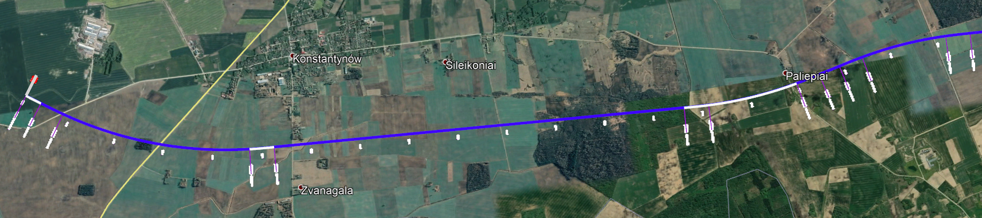
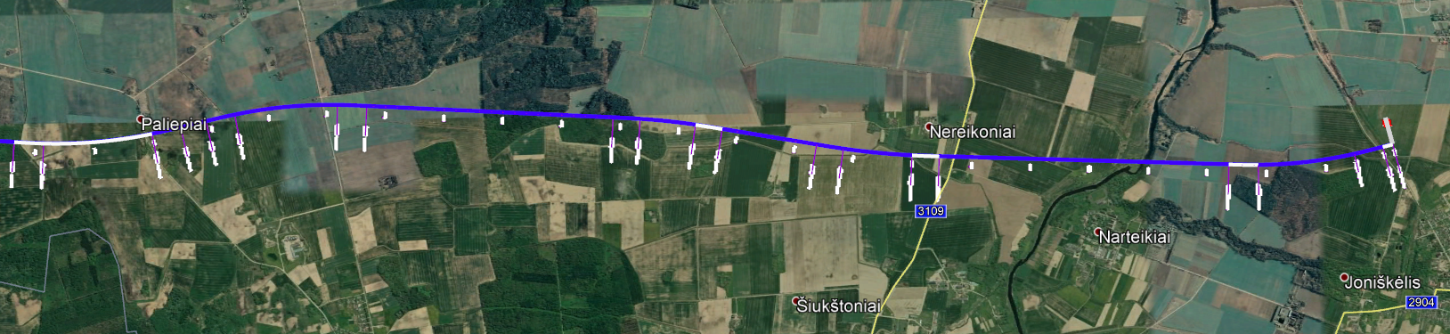
MUNICIPALITY BORDER
JONIŠKELIS -VAŠKAI SECTION GENERAL DESCRIPTION
ROAD NO. 3104
PASVALYS
ROAD NO. 209
ROAD NO. 3107
ROAD NO. 2925
LOCAL ROAD
BRIDGE OVER MŪŠA RIVER
NARROW-GAUGE VIADUCT
PASVALYS
ROAD NO. 2925
ROAD NO. 3109
ECODUCT
LOCAL ROAD
Notes:
This section connects two main population áreas, Šėta, to the northeast of Kedainiai District Municipality, and Ramygala, in Panevezys District Municipality.
The alignment of this section has been designed within the boundaries of the approved Special Plan, running in close proximity to: Jotainiai,Daniūnai, Pauslajys and Pagiriai.
The stretch intersects several existing transport infrastructure, for which new grade separated junctions have been designed, avoiding level crossings that represent one of the rail sector´s biggest safety concerns.
Access roads parallel to the new railway line have been designed, ensuring connectivity among the adjacent private landplot owners.
NOTE: For the purpose of this presentation, we´ll be showing only the infrastructure within the boundaries of Panevezys Municipality

Slide 37
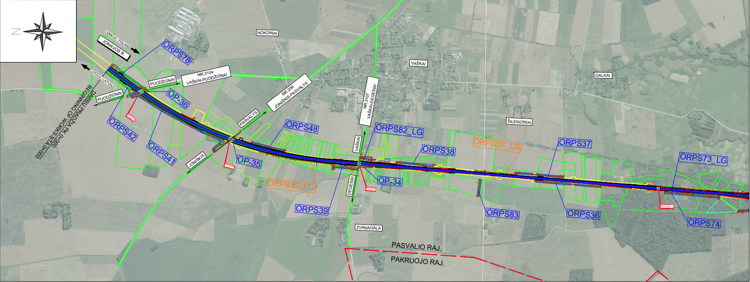
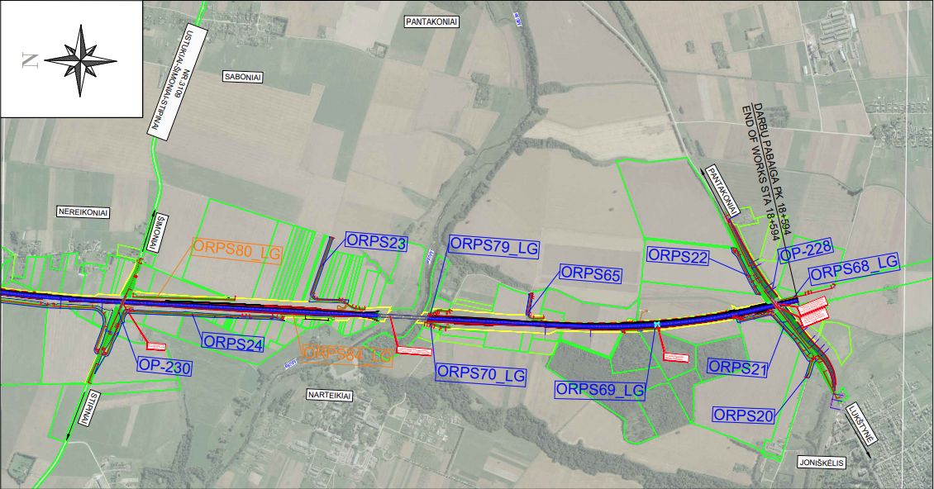
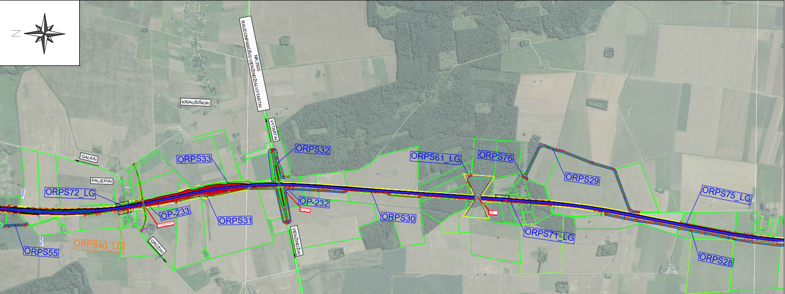
RAILWAY LOCATION PLAN

Slide 38
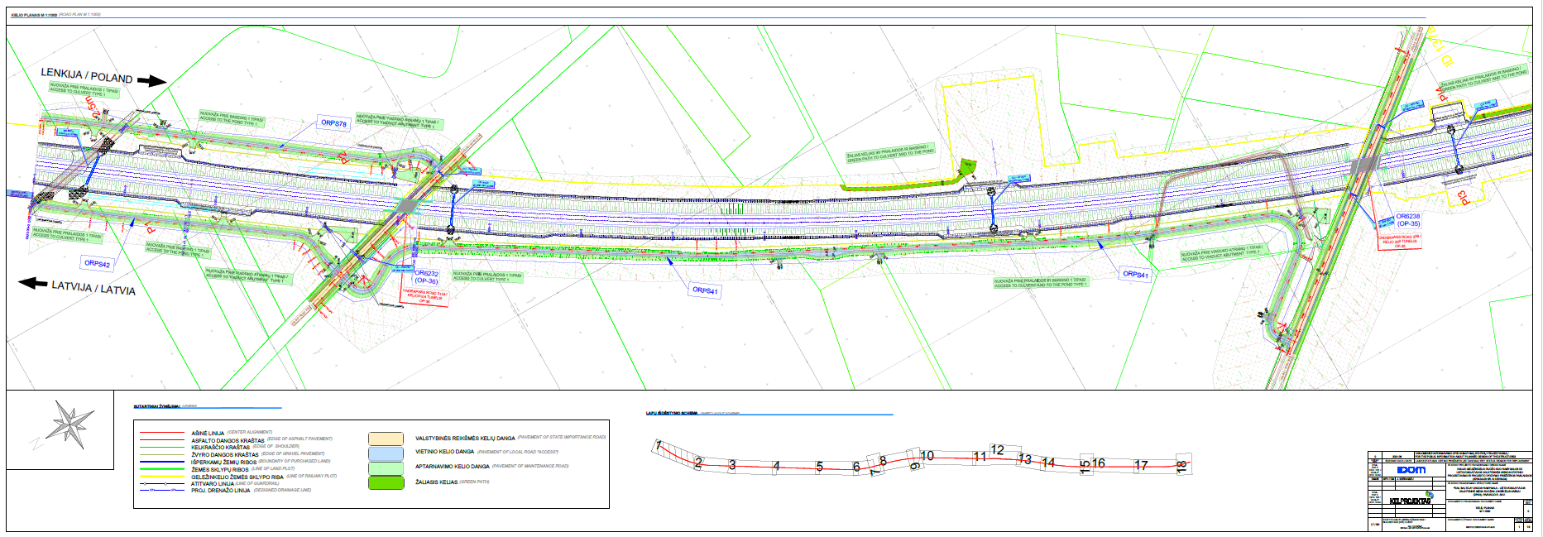
RAILWAY ALIGNMENT PLAN

Slide 39
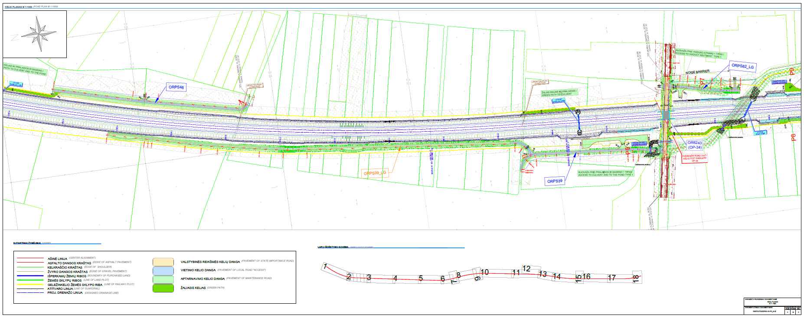
RAILWAY ALIGNMENT PLAN

Slide 40
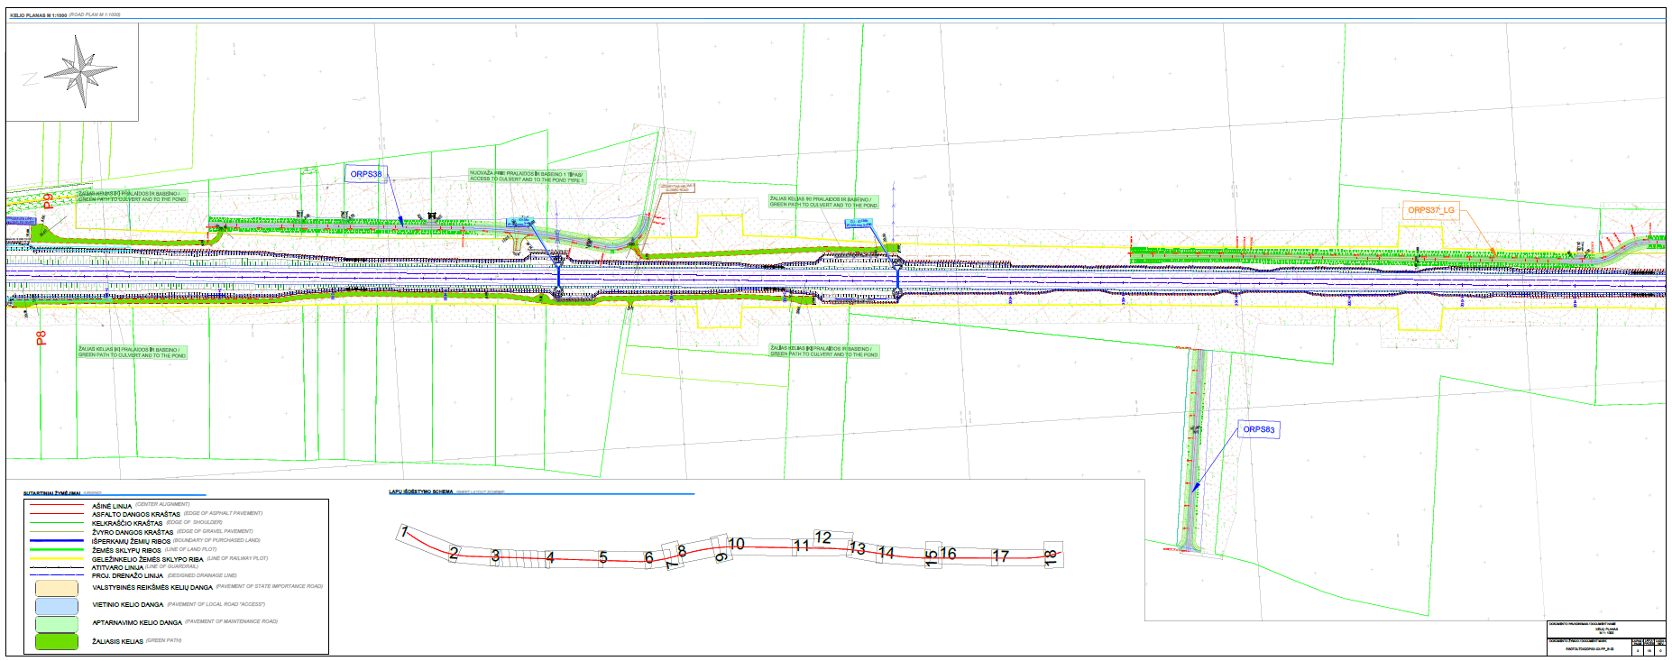
RAILWAY ALIGNMENT PLAN

Slide 41
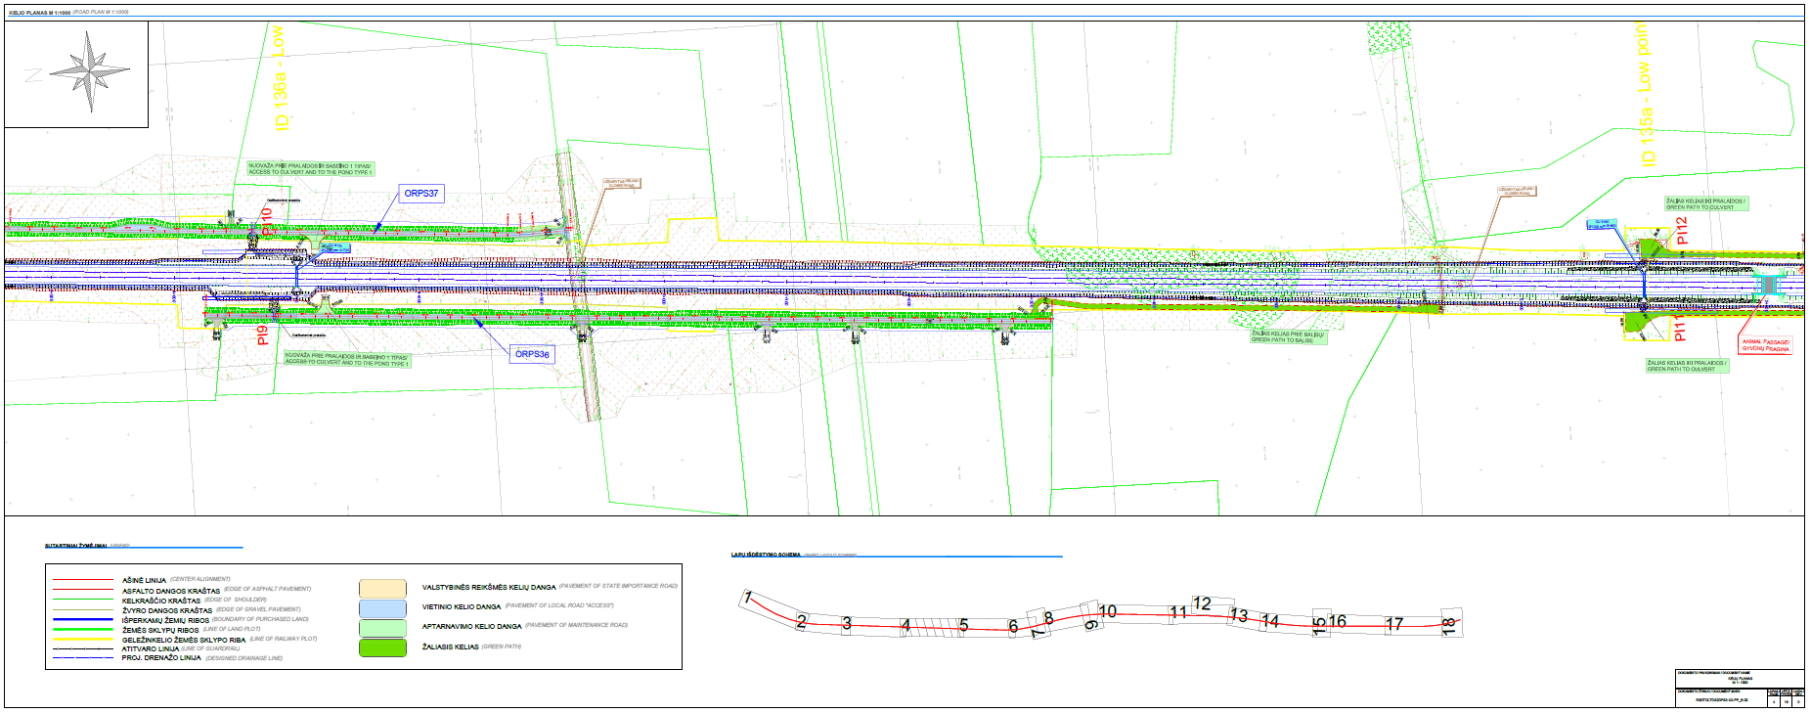
RAILWAY ALIGNMENT PLAN

Slide 42
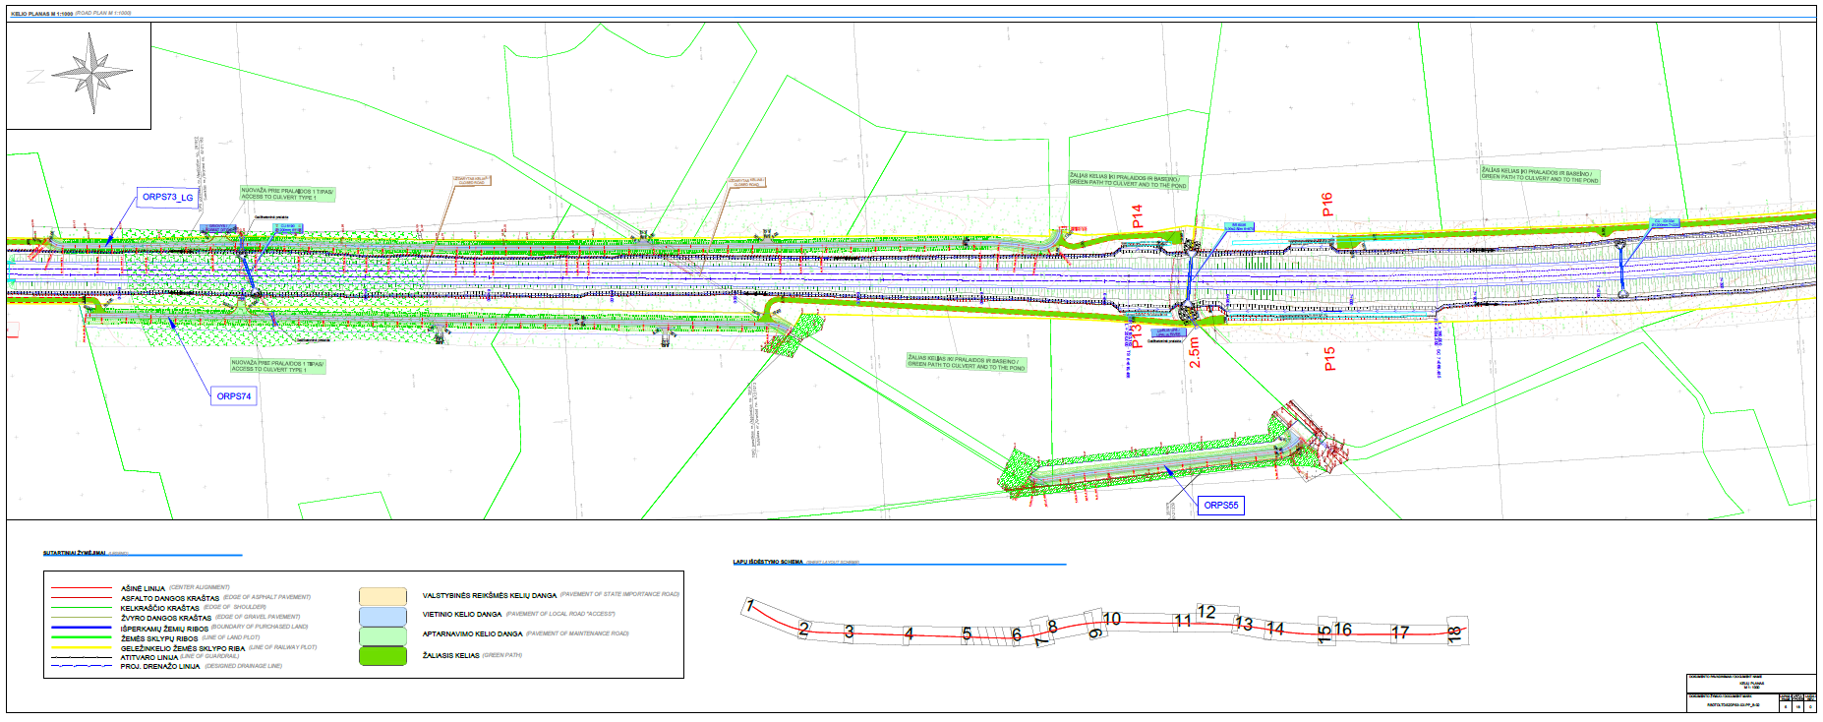
RAILWAY ALIGNMENT PLAN

Slide 43

RAILWAY ALIGNMENT PLAN

Slide 44

RAILWAY ALIGNMENT PLAN

Slide 45

RAILWAY ALIGNMENT PLAN

Slide 46

RAILWAY ALIGNMENT PLAN

Slide 47

RAILWAY ALIGNMENT PLAN

Slide 48

RAILWAY ALIGNMENT PLAN

Slide 49

RAILWAY ALIGNMENT PLAN

Slide 50

RAILWAY ALIGNMENT PLAN

Slide 51

RAILWAY ALIGNMENT PLAN

Slide 52

RAILWAY ALIGNMENT PLAN

Slide 53

RAILWAY ALIGNMENT PLAN

Slide 54

RAILWAY ALIGNMENT PLAN

Slide 55

RAILWAY ALIGNMENT PLAN

Slide 56

RAILWAY-ROAD 3104 CROSSING LOCATION PLAN
The railway line intersects with the category IV regional road no. 3104 Vaškai-Puodžūnai, , the section from 2.320 km to 2.551 km belongs to Pasvalys district municipality
It is planned to install a railway viaduct at the intersection between railway and road.
It is planned to install connecting roads on both sides of the railway line to ensure the accessibility of private land plots.

Slide 57



RAILWAY VIADUCT PLAN AND ELEVATION
ROAD PLAN
ROAD CROSS SECTION
RAILWAY VIADUCT PLAN

Slide 58



RAILWAY VIADUCT PLAN AND ELEVATION
RAIL CROSS SECTION OVER RAILWAY VIADUCT
ROAD CROSS SECTION UNDER RAILWAY VIADUCT
ELEVATION

Slide 59

ROAD 3104-VISUALIZATION

Slide 60

RAILWAY-ROAD 209 CROSSING LOCATION PLAN
The railway line intersects with the category IV regional road no. 209 Joniškis-Žeimelis-Pasvalys, the section from 47.155 km to 47.505 km belongs to Pasvalys district municipality.
It is planned to install a railway viaduct at the intersection between railway and road.
It is planned to install connecting roads on both sides of the railway line to ensure the accessibility of private land plots.
The pedestrian and bicykle infrustructure will be provided

Slide 61



RAILWAY VIADUCT PLAN AND ELEVATION
ROAD PLAN
ROAD CROSS SECTION
RAILWAY VIADUCT PLAN

Slide 62



RAILWAY VIADUCT PLAN AND ELEVATION
RAIL CROSSSECTION OVER VIADUCT
ROAD CROSS SECTION UNDER RAILWAY VIADUCT
ELEVATION

Slide 63

ROAD 209-VISUALIZATION

Slide 64

RAILWAY-ROAD 3107 CROSSING LOCATION PLAN
The railway line intersects with the category IV regional road no. 3107 Vaškai-Degėsiai, the section from 1.396 km to 1.547 km belongs to Pasvalys district municipality.
It is planned to install a railway viaduct at the intersection between railway and road.
It is planned to install connecting roads on both sides of the railway line to ensure the accessibility of private land plots.
The pedestrian and bicykle infrustructure will be provided

Slide 65



RAILWAY VIADUCT PLAN AND ELEVATION
ROAD PLAN
ROAD CROSS SECTION
RAILWAY VIADUCT PLAN

Slide 66


RAILWAY VIADUCT PLAN AND ELEVATION
ELEVATION 1
ROAD CROSS SECTION UNDER RAILWAY VIADUCT
ELEVATION 2

Slide 67

ROAD 3107-VISUALIZATION

Slide 68

RAILWAY-ROAD 2925 CROSSING LOCATION PLAN
The railway line intersects with the category IV regional road no. 2925 Raudonpamūšis-Vienžindžiai-Vytartai, the section from 9.070 km to 9.439 km and from 9.496 km to 9.830 km belongs to Pasvalys district municipality.
It is planned to install a road overpass at the intersection between railway and road.
It is planned to install connecting roads on both sides of the railway line to ensure the accessibility of private land plots.
On the left side of the road, a 2.4 m wide cycle path with asphalt pavement is being designed.
To ensure safety for the users, the pedestrian path is separated from the district road by protective barriers
The pedestrian and bicykle infrustructure will be provided

Slide 69




ROAD 2925 PLAN AND CROSS SECTION
ROAD PLAN
ROAD CROSS SECTION
OVERPASS PLAN

Slide 70



ROAD 2925 - OVERPASS ELEVATION AND CROSS SECTION
OVERPASS ELEVATION
ROAD CROSS SECTION ON VIADUCT
ROAD CROSS SECTION ON EMBANKMENT

Slide 71

ROAD 2925-VISUALIZATION

Slide 72

RAILWAY-ROAD 3109 CROSSING LOCATION PLAN
The railway line intersects with the category IV regional road no. 3109 Ustukiai–Šimoniai–Stipinai, the section from 13.232 km to 13.463 km and from 13.520 km to13.980 km belongs to Pasvalys district municipality.
It is planned to install a road overpass at the intersection between railway and road.
It is planned to install connecting roads on both sides of the railway line to ensure the accessibility of private land plots.
On the left side of the road, a 2.4 m wide cycle path with asphalt pavement is being designed.
To ensure safety for the users, the pedestrian path is separated from the district road by protective barriers
The pedestrian and bicykle infrustructure will be provided

Slide 73




ROAD 2925 PLAN AND CROSS SECTION
ROAD PLAN
OVERPASS PLAN
ROAD CROSS SECTION

Slide 74


ROAD 2925 - OVERPASS ELEVATION AND CROSS SECTION
OVERPASS ELEVATION
ROAD CROSS SECTION ON VIADUCT
ROAD CROSS SECTION ON EMBANKMENT

Slide 75

ROAD 3109-VISUALIZATION

Slide 76
ENVIRONMENTAL PROTECTION MEASURES
Area „Natura 2000” do not exist along this section
Migration studies were conducted during the research phase - in accordance with the results, 1 green bridges (ecoduct) plus 2 animal passages have been proposed.
Several noise mitigation measures are proposed in the vicinity of settlements:
Noise reduction barriers;

Slide 77
NOISE MITIGATION MEASURES
Residential area | Location | Noise mitigation measure
Pasvalys district municipality, Zvangla village | 2+828 – 2+935 | Noise Barriers
Pasvalys district municipality, Paliepiai village | 7+841 – 7+960 | Noise Barriers
Pasvalys district municipality, Kelmučiai village | 11+586 – 11+715 | Noise Barriers
Pasvalys district municipality, Narteikiai village | 15+842 – 15+980 | Noise Barriers
Example of Noise barrier
Example of Noise barrier

Slide 78
QUESTIONS?

Slide 79
THANK YOU

