Slide 1
Rail Baltica section
Vaškai -LT/LV State Border (DPS4),
Pasvalys district municipality
PUBLIC HEARING
Jakub Sokoliński, Consultant Representative from IDOM Consulting, Engineering and Architecture
2021/09/08

Slide 2
Design and design supervision services for the construction of the new line from
Ramygala to Lithuanian / Latvian state broder

Slide 4
INFORMATION OF THE PUBLIC MEETING
Chairman of the public meeting – Jakub Sokoliński, Consultant Representative from IDOM Consulting, Engineering and Architecture
The secretary of the public meeting is Šarūnė Tučinskaitė, Project Administrator from UAB Kelprojektas
The customer is the RB Rail AS Lietuvos filialas
The builder is the AB„LTG Infra“
Proposals from the public concerned could be submitted before and during the public meeting.
Participants in the public meeting are registered.
The statements of the participants of the public meeting shall be recorded in the minutes.
The minutes of the public meeting will be prepared after the meeting in 3 working days.
The designer publishes the minutes with annexes in IS Infostatyba in 5 working days .
The designer submits the application for approval of the project proposals together with the project proposals, report with annexes, protocol, sound recording, directly to the civil servant of the municipal administration through the IS Infostatyba.
Pursuant to Article 36 of the Law on Public Administration of the Republic of Lithuania, a decision made by a civil servant of the municipal administration performing the functions of the chief architect of the municipality may be appealed to the Administrative Disputes Commission or an administrative court in accordance with the law.

Slide 5
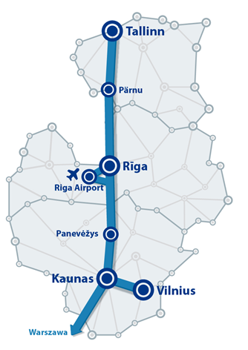
BACKGROUND
Existing Baltics connection with EU via Poland difficult, high cost
Rail Baltica joint project of three EU Member States – Estonia, Latvia and Lithuania.
New High Speed Railway Line fast-conventional double track 1435mm gauge
Symbolic return of the Baltic States to Europe.
Rail Baltica to become part of the EU TEN-T North Sea – Baltic Core Network Corridor:
linking Europe´s largest ports (Rotterdam, Hamburg and Antwerp) through the Netherlands, Belgium, Germany and Poland, with the three Baltic States.
Estonia, Latvia and Lithuania full integration into European railway area.
BACKGROUND

Slide 6
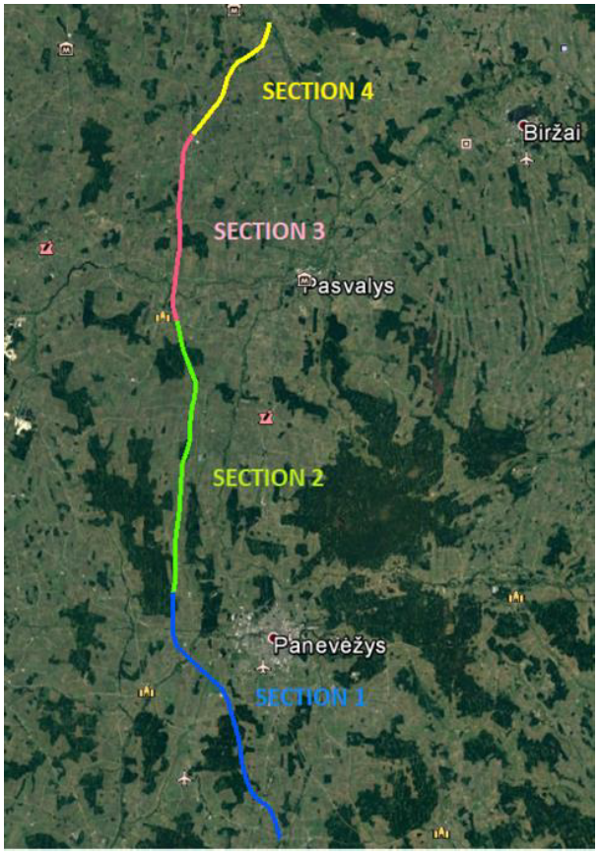
Vaškai -LT/LV State Border
SECTION GENERAL DESCRIPTION
This section connects population áreas, Vaškai, and Lithuanian / Latvian State border, in Pasvalys District Municipality.
The alignment of this section has been designed within the boundaries of the approved Special Plan, running in close proximity to:, Grudžiai, Kiemėnai,, Dagiai and Lithuanian / Latvian state border.
The stretch intersects several existing transport infrastructure, for which new grade separated junctions have been designed, avoiding level crossings that represent one of the rail sector´s biggest safety concerns.
Access roads parallel to the new railway line have been designed, ensuring connectivity among the adjacent private landplot owners.
NOTE: For the purpose of this presentation, we´ll be showing only the infrastructure within the boundaries of Pasvalys Municipality.
ROAD NR. 1204
ROAD NR. 3023
ROAD NR. 3022

Slide 7
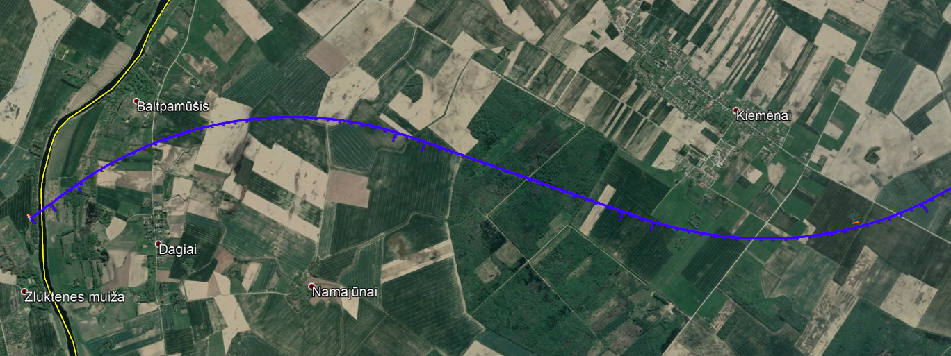
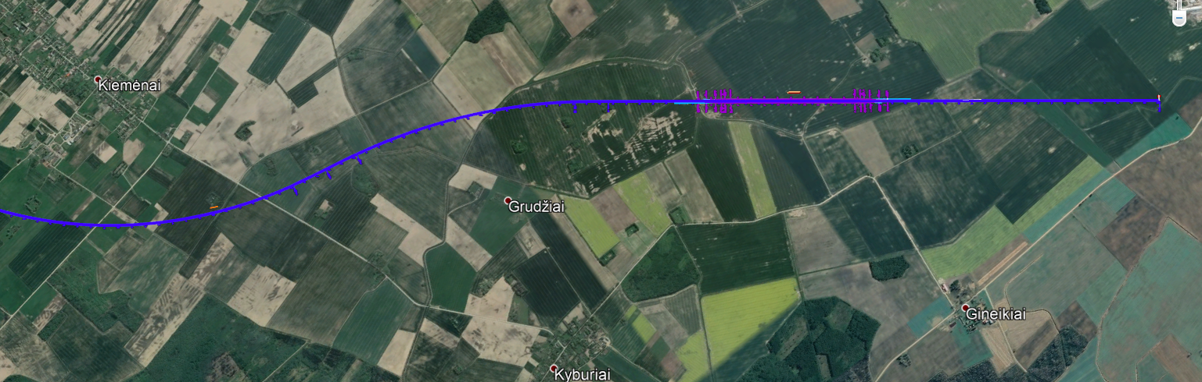
BERČIŪNAI-JONIŠKĖLIS
SECTION GENERAL DESCRIPTION
ROAD NO.: 3120
ECODUCT
LT / LV STATE BORDER
MŪŠA RIVER
LOCAL ROAD
PSAVALYS
PASVALYS
ROAD NO.: 3105
PASVALYS
ROAD NR. 3023
ROAD NO.: 3105
VAŠKAI PASSING LOOP
ROAD NR. 3022

Slide 8
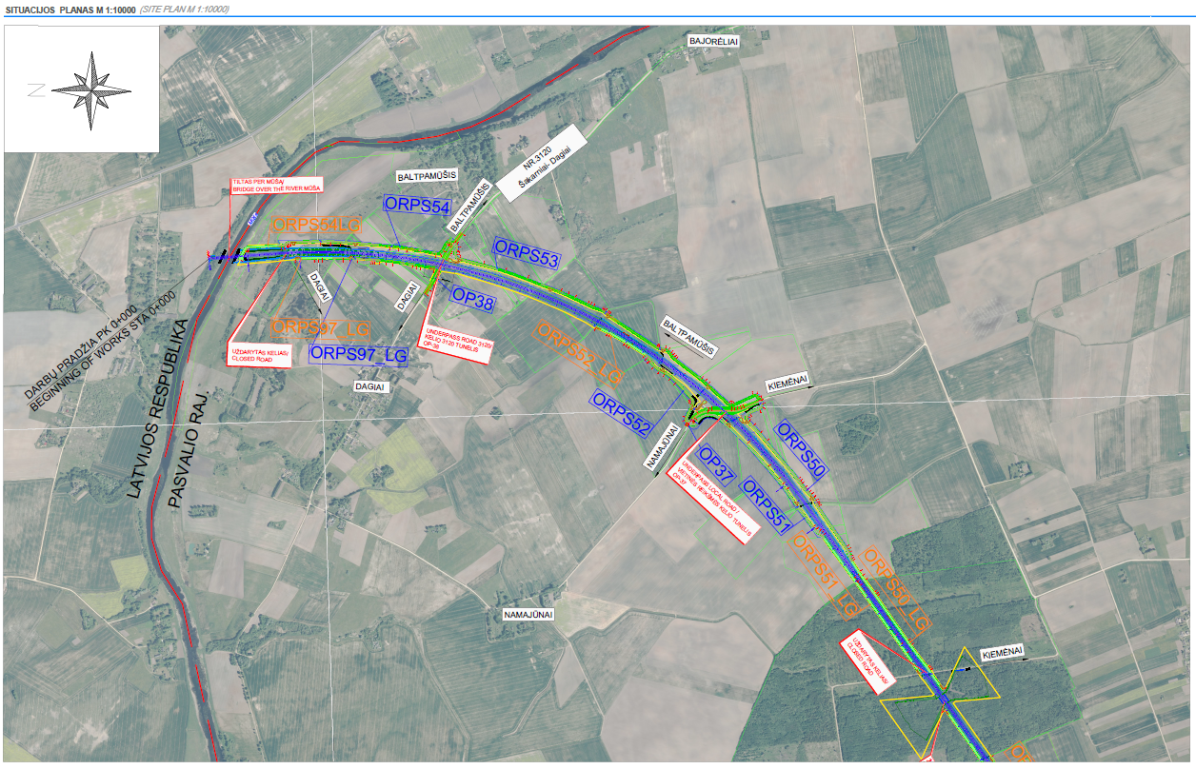
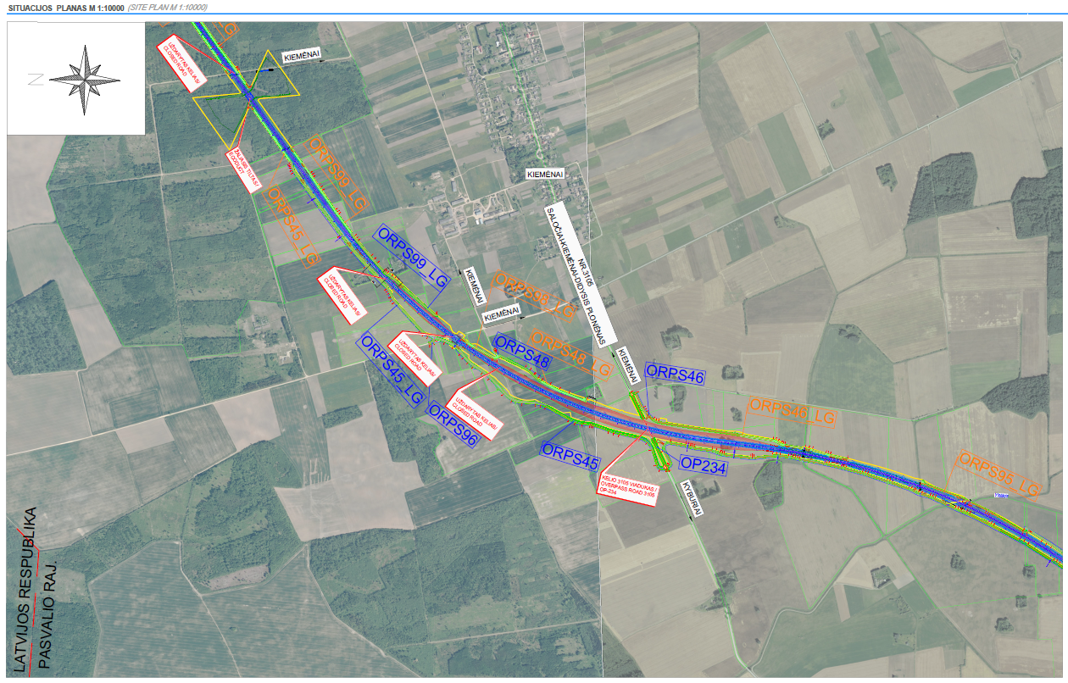
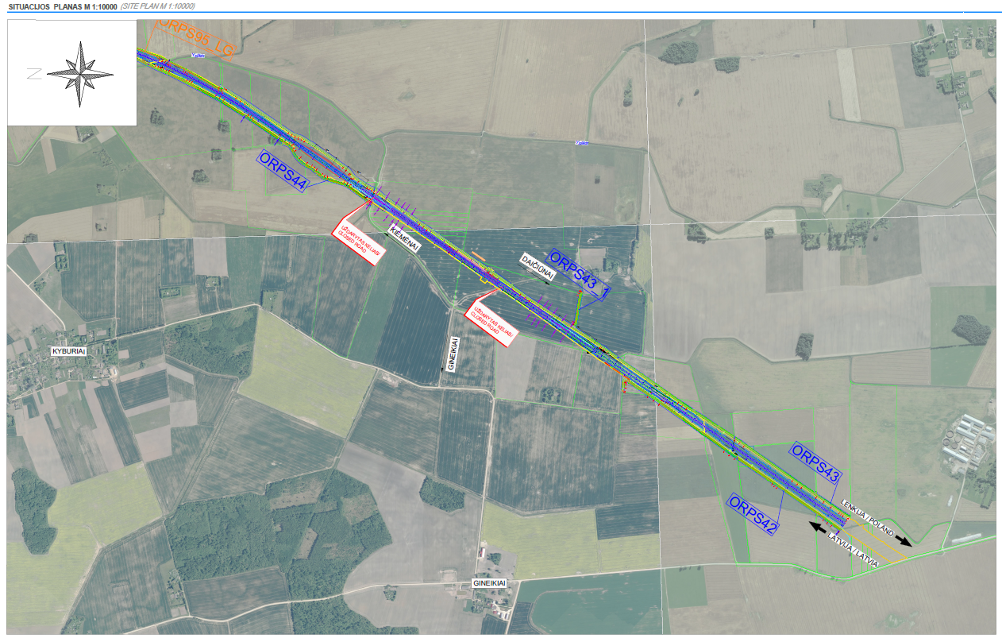
RAILWAY LOCATION PLAN-PASVALYS

Slide 9
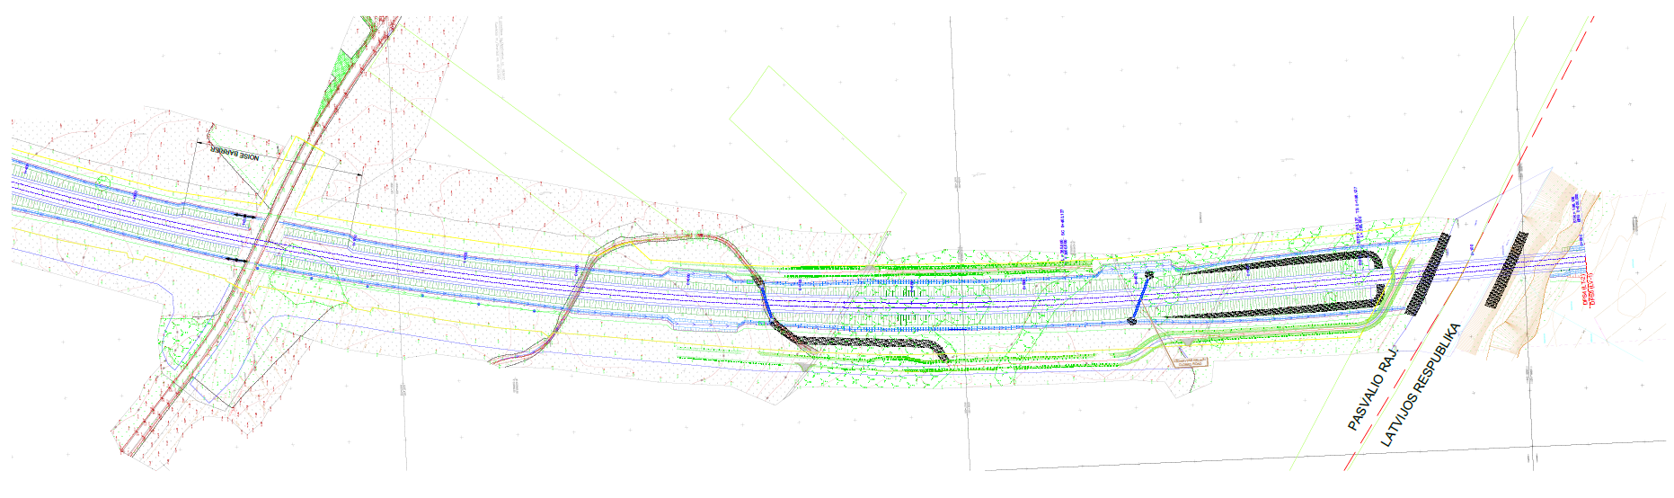
RAILWAY ALIGNMENT PLAN

Slide 10
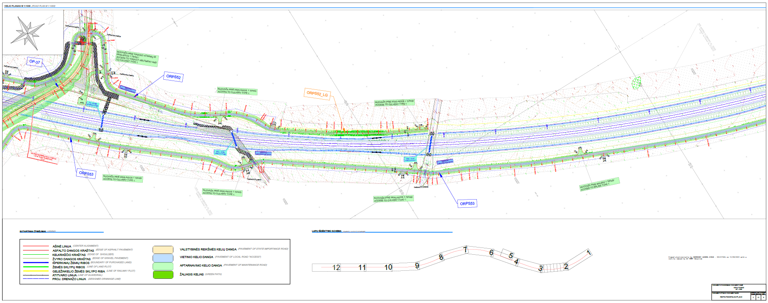
RAILWAY ALIGNMENT PLAN

Slide 11
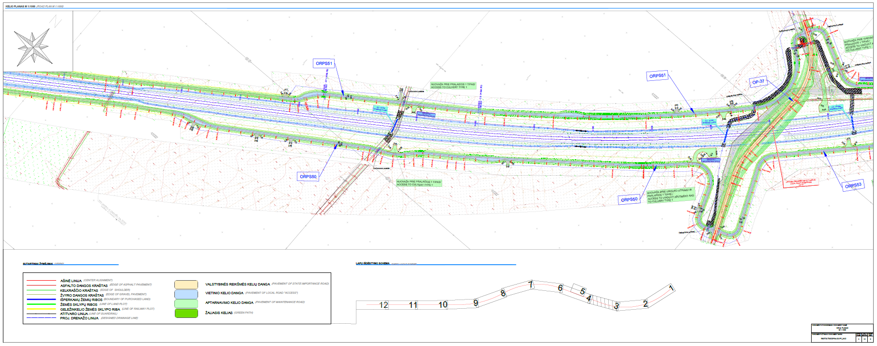
RAILWAY ALIGNMENT PLAN

Slide 12
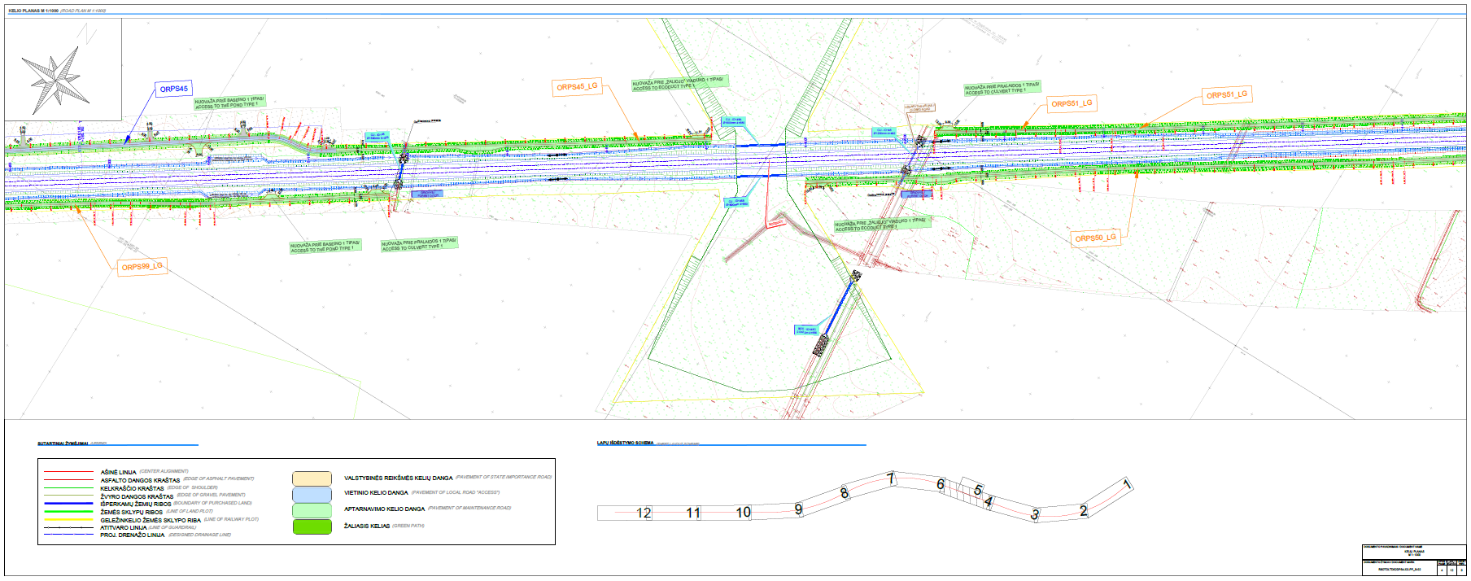
RAILWAY ALIGNMENT PLAN

Slide 13
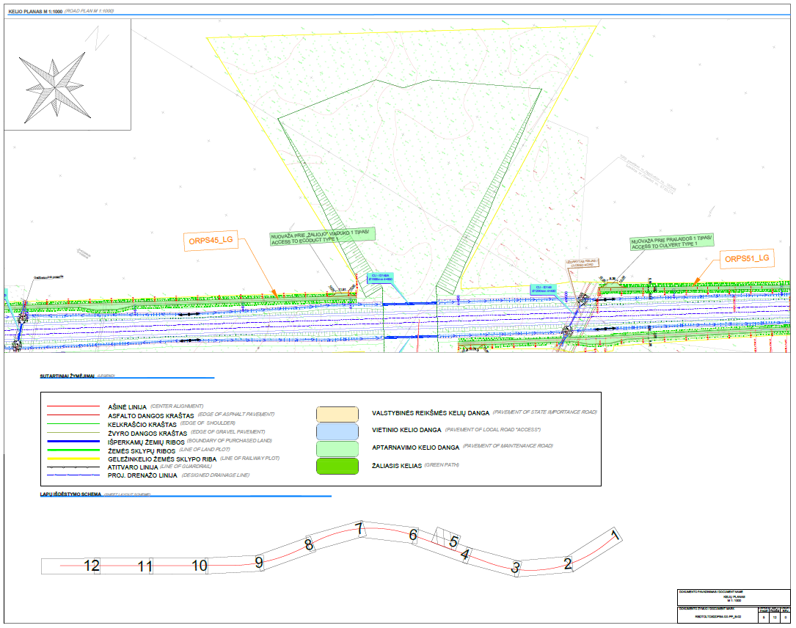
RAILWAY ALIGNMENT PLAN

Slide 14
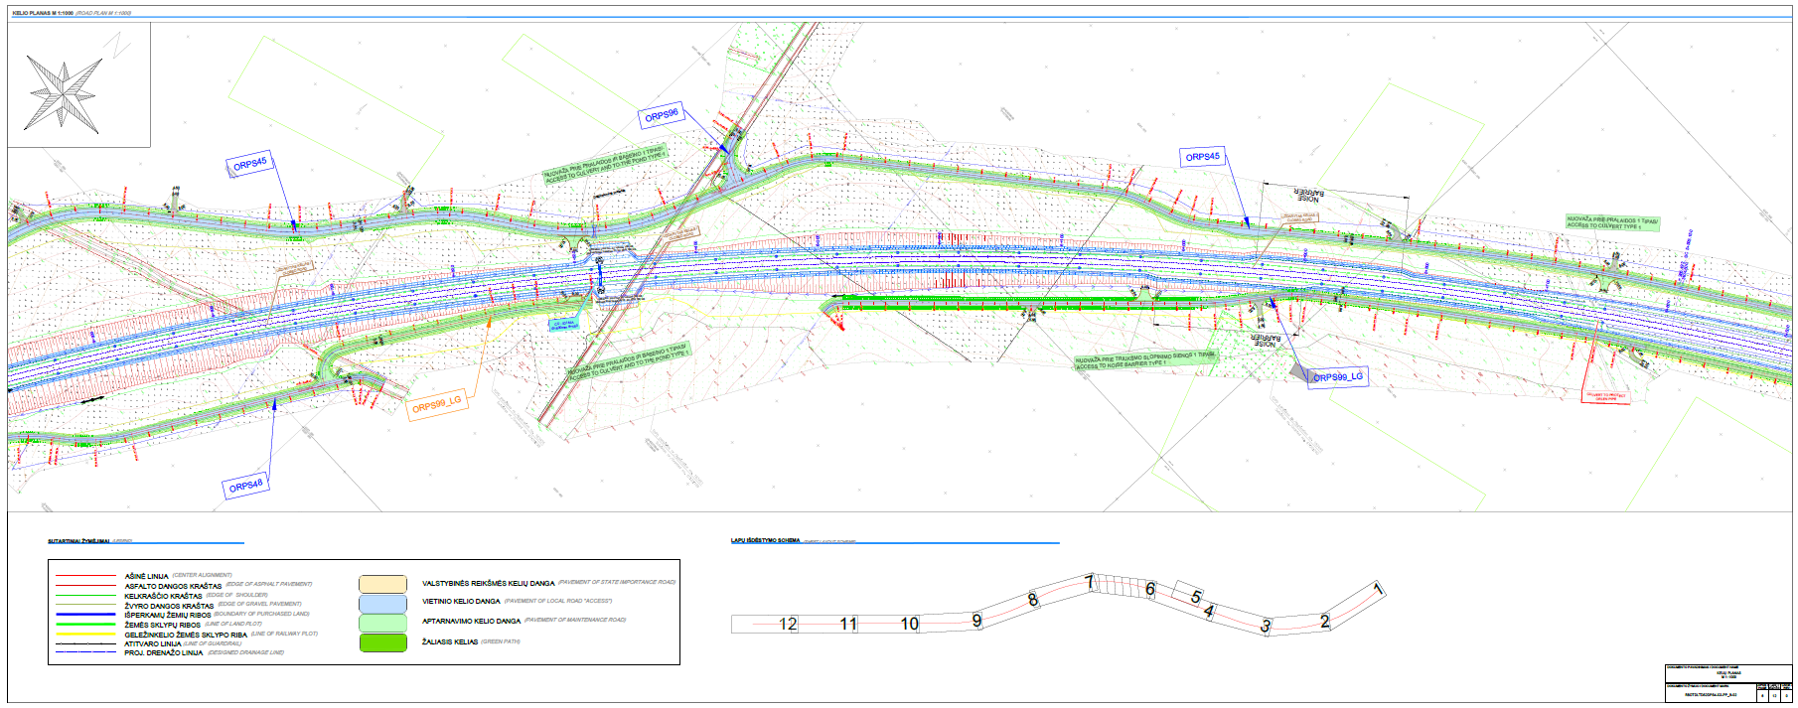
RAILWAY ALIGNMENT PLAN

Slide 15
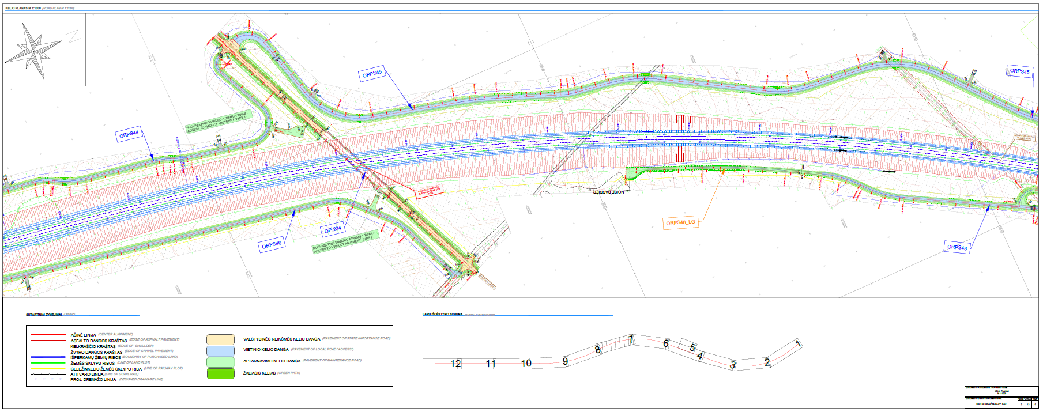
RAILWAY ALIGNMENT PLAN

Slide 16
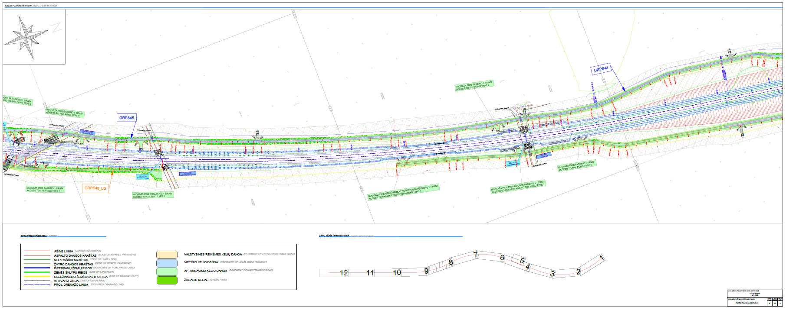
RAILWAY ALIGNMENT PLAN

Slide 17
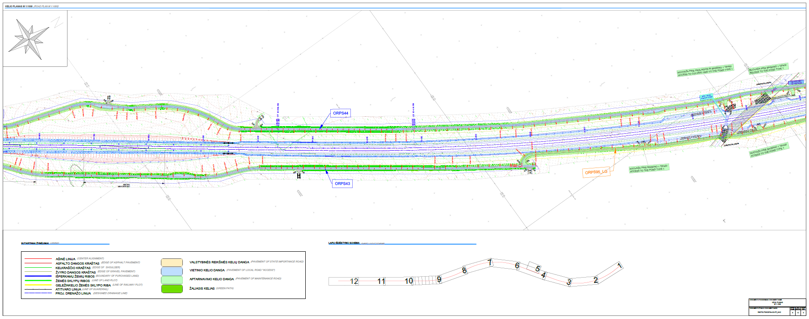
RAILWAY ALIGNMENT PLAN

Slide 18
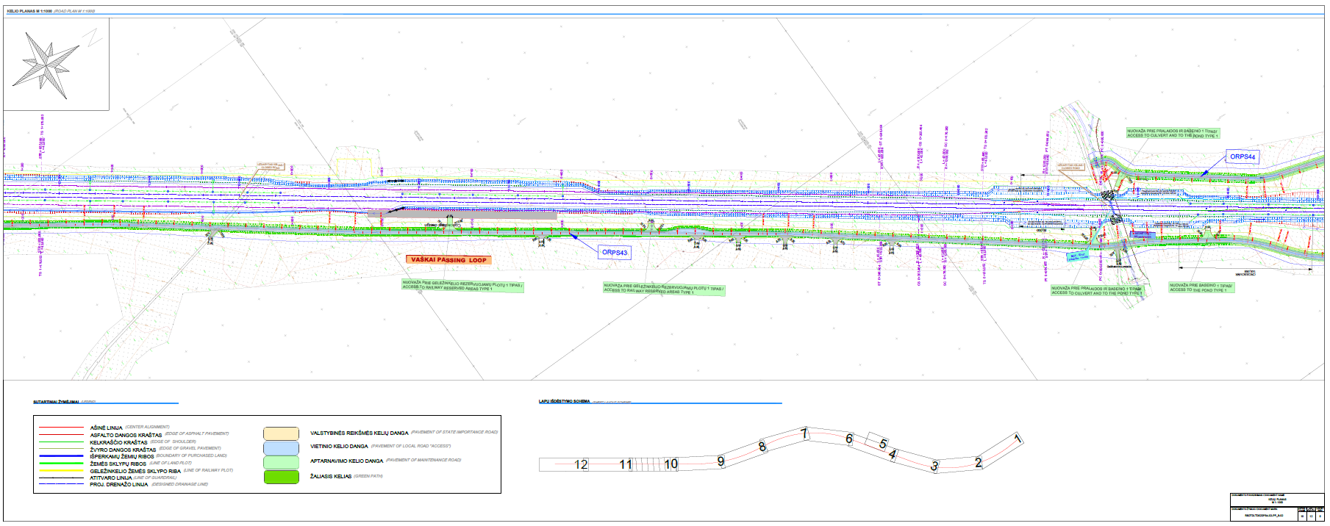
RAILWAY ALIGNMENT PLAN

Slide 19
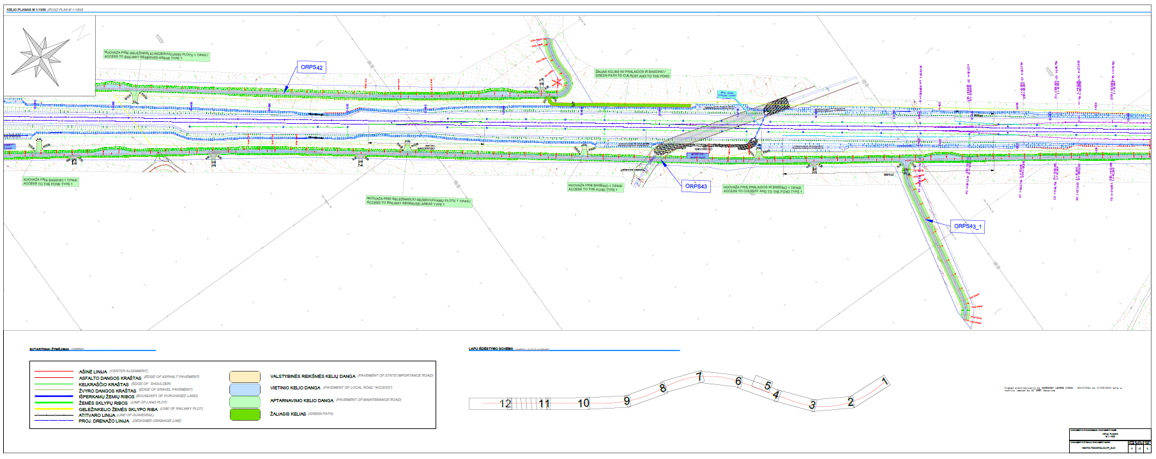
RAILWAY ALIGNMENT PLAN

Slide 20
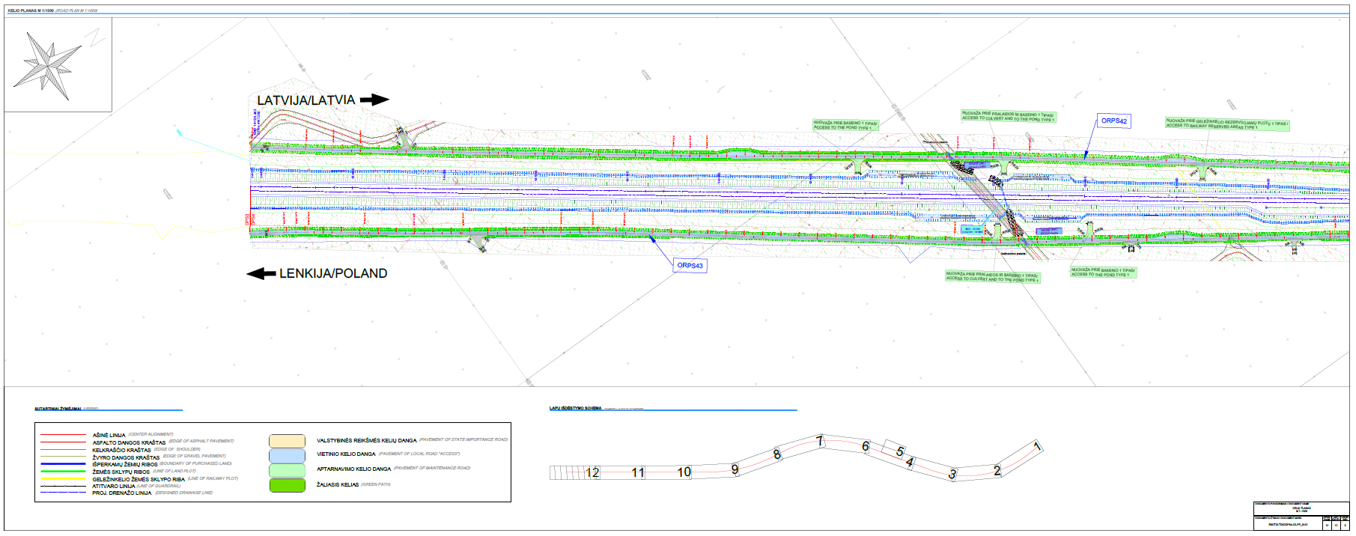
RAILWAY ALIGNMENT PLAN

Slide 21
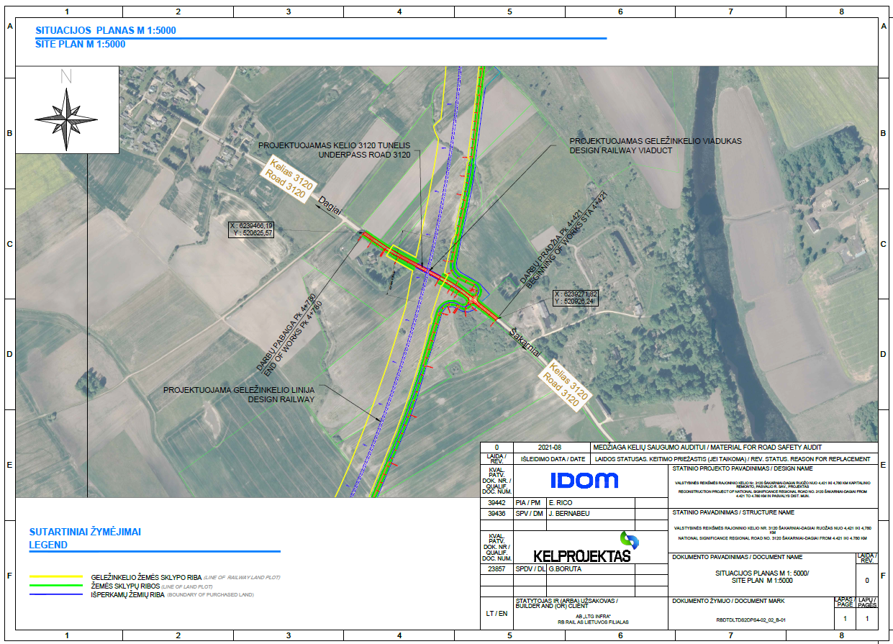
RAILWAY-ROAD 3120 CROSSING LOCATION PLAN
The railway line intersects with road no. 3120 Šakarniai - Dagiai, the section from 4+421 km to 4+780 belongs to Pasvalys district municipality,
It is planned to install a railway viaduct at the intersection between railway and road.
It is planned to install connecting roads to provide access to enter railway terrain form road no.: 3120
Possibility of developing future pedestrian and bicycle traffic will be provided – requirement of Lithuanian Road Administration

Slide 22
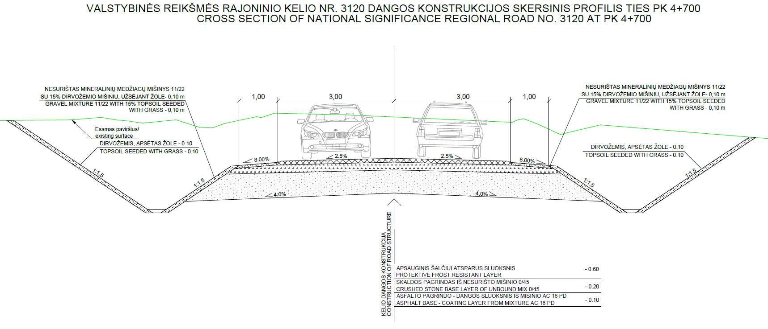
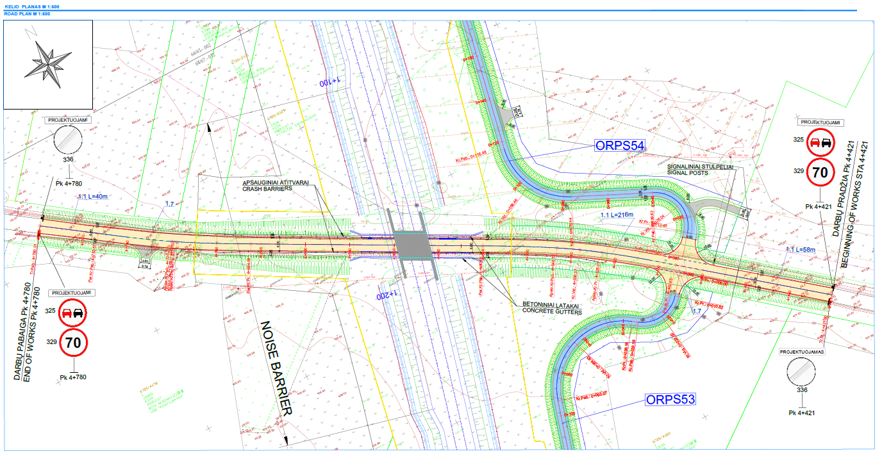
ROAD 3120
AND CROSS SECTION
ROAD PLAN
ROAD CROSS SECTION

Slide 23
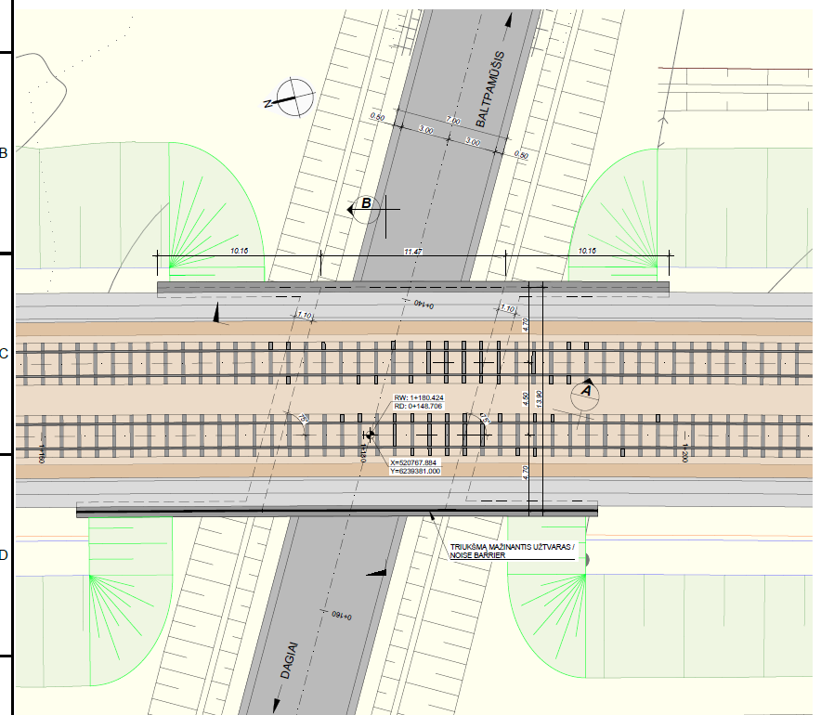
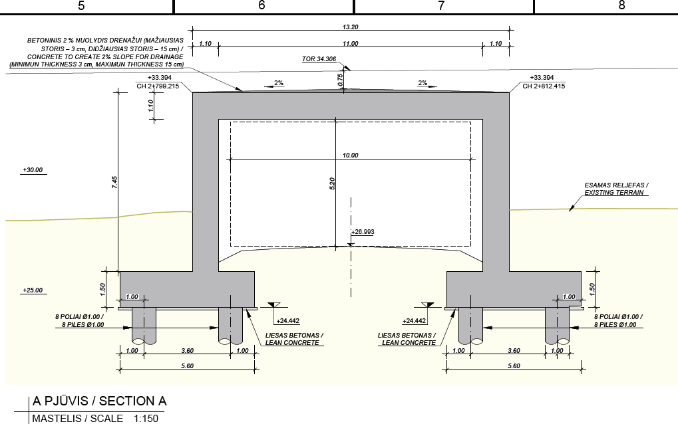
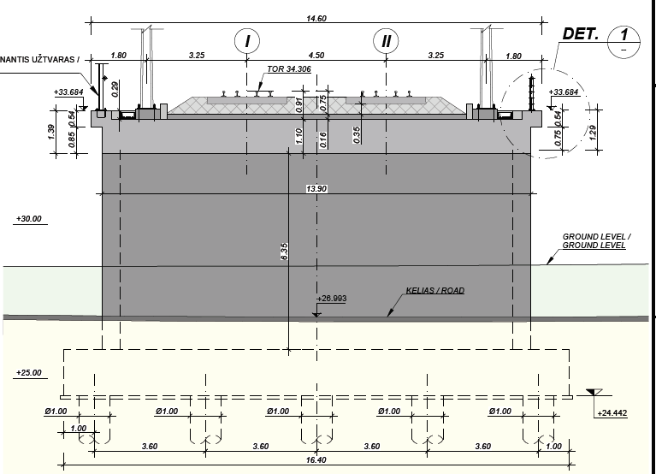
ROAD 3120 CROSS SECTION UNDER RAILWAY VIADUCT
ELEVATION 1
RAILWAY VIADUCT PLAN
CROSSSECTION OF RAILWAY VIADUCT

Slide 24
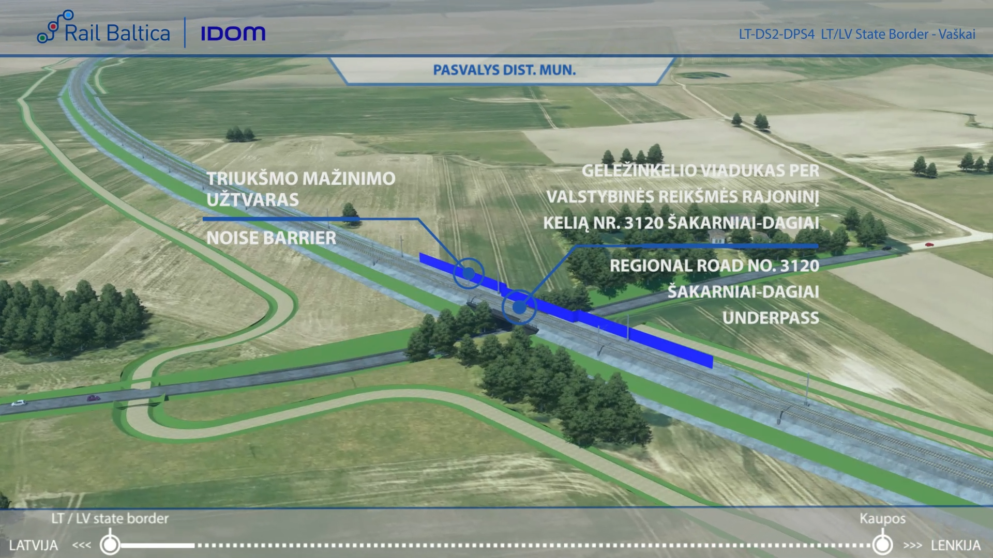
ROAD 3120 -VISUALIZATION

Slide 25
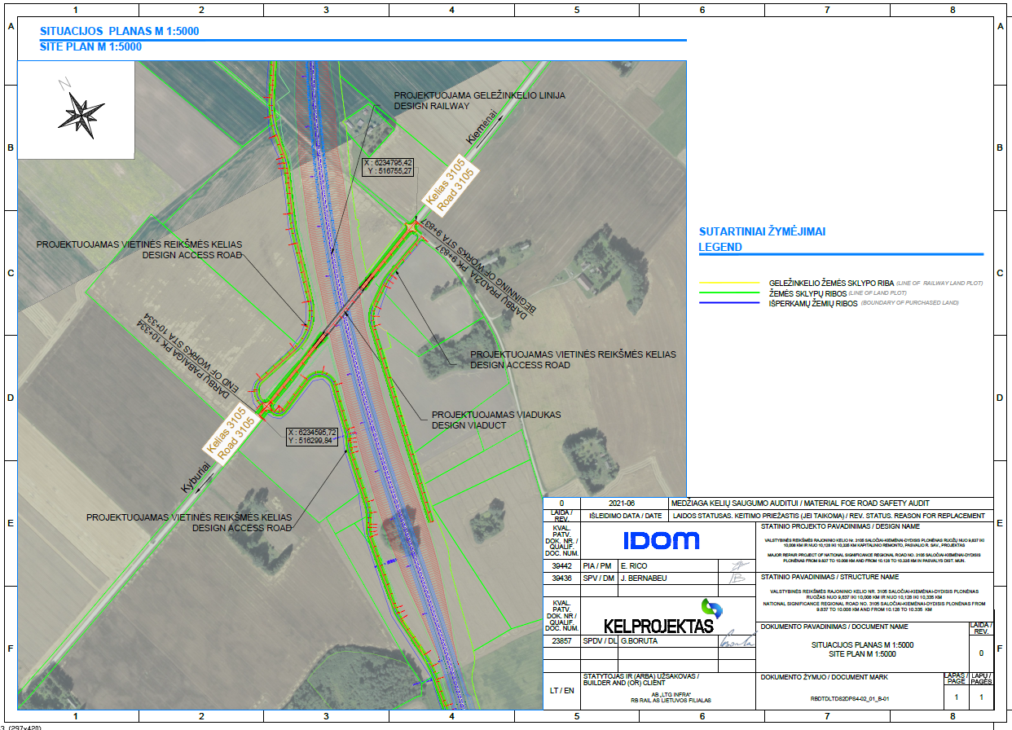
RAILWAY-ROAD 3105 ROAD CROSSING LOCATION PLAN
The railway line intersects road no. 3105 Saločiai – Kiemėnai – Didysis Plonėnas, the section from 9,837 km to 10,008 km and from 10,128 km to 10,335. In km 10,068 viaduct will be instaled.
It is planned to install a road overpass at the intersection between railway and road.
It is planned to install connecting roads on both sides of the railway line to ensure the accessibility of private land plots.
No requirements about future bicycle or pedestrian traffic were provided by Lithuanian Road Administration.
To ensure safety for the users, the pedestrian path is separated from the district road by protective barriers.

Slide 26
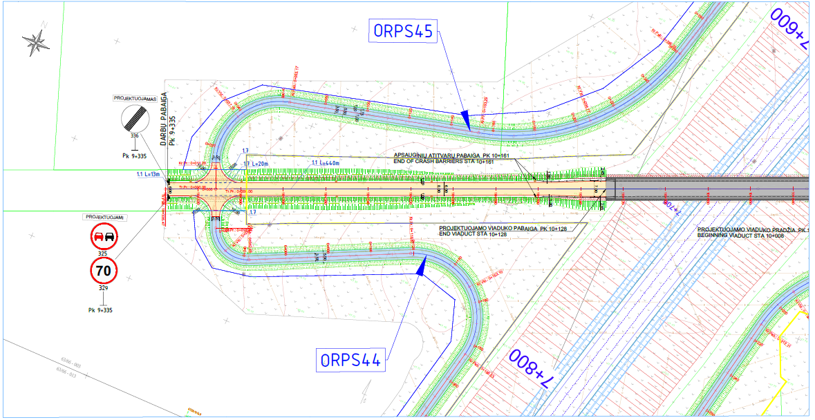
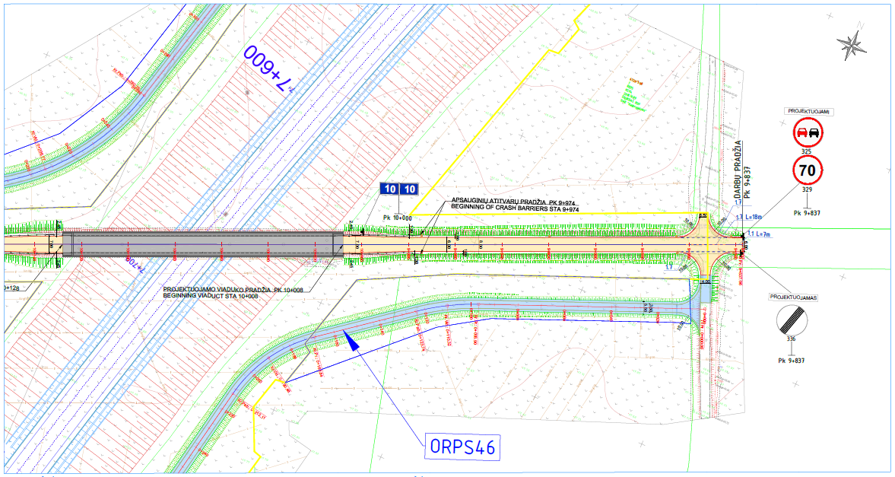
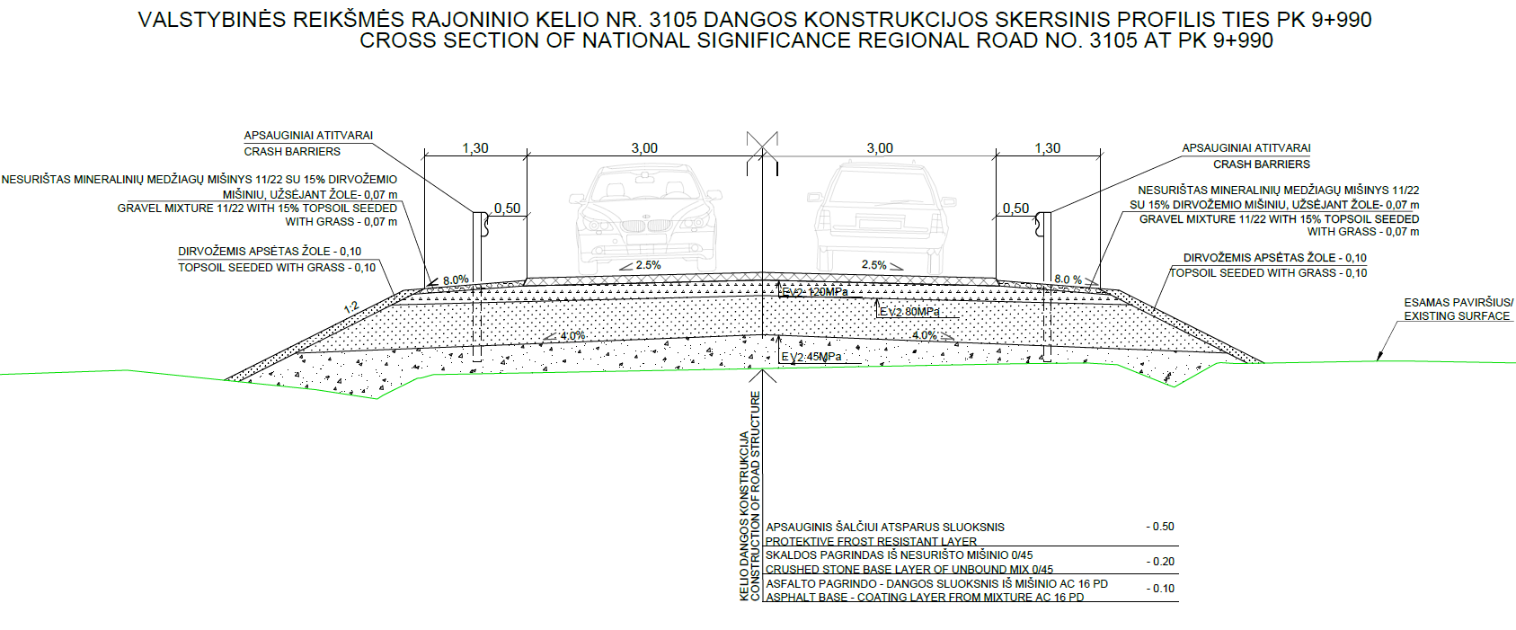
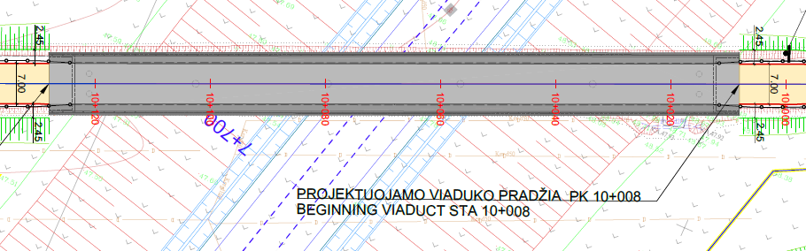
ROAD 3105 PLAN AND CROSS SECTION
ROAD PLAN
ROAD PLAN
OVERPASS PLAN
ROAD CROSS SECTION

Slide 27
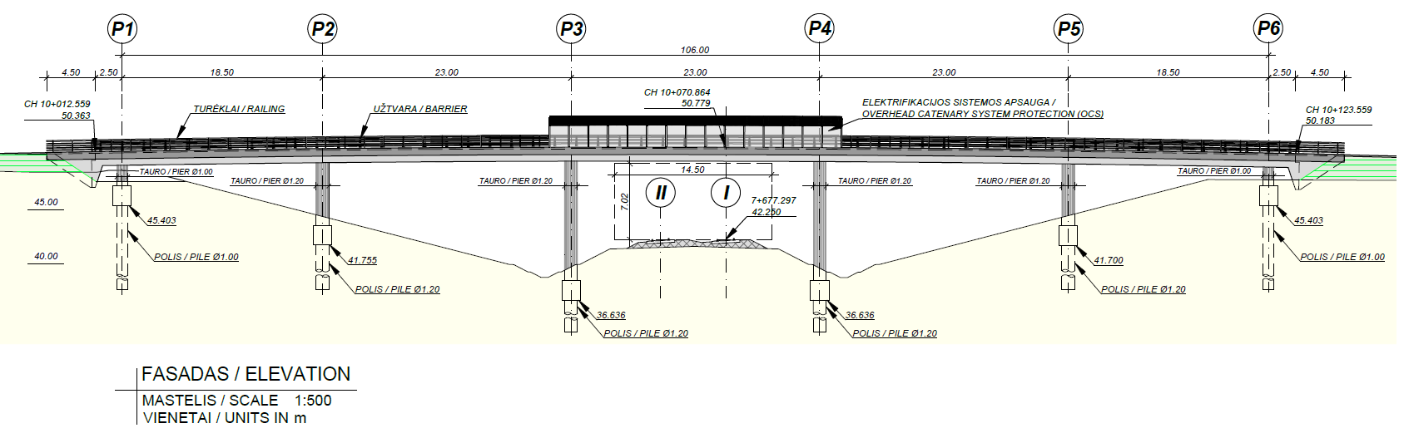
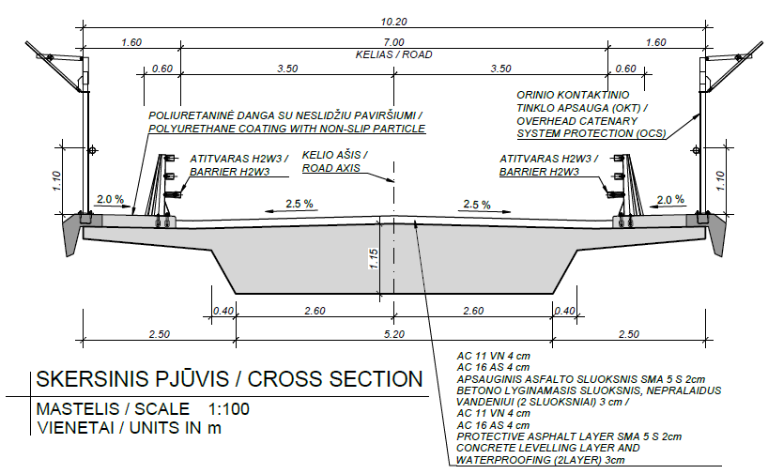
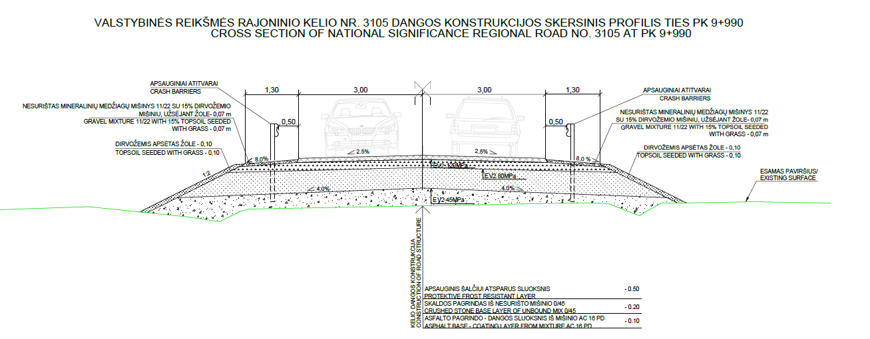
ROAD 3105- OVERPASS ELEVATION AND CROSS SECTION
OVERPASS ELEVATION
ROAD CROSS SECTION ON VIADUCT
ROAD CROSS SECTION ON EMBANKMENT

Slide 28
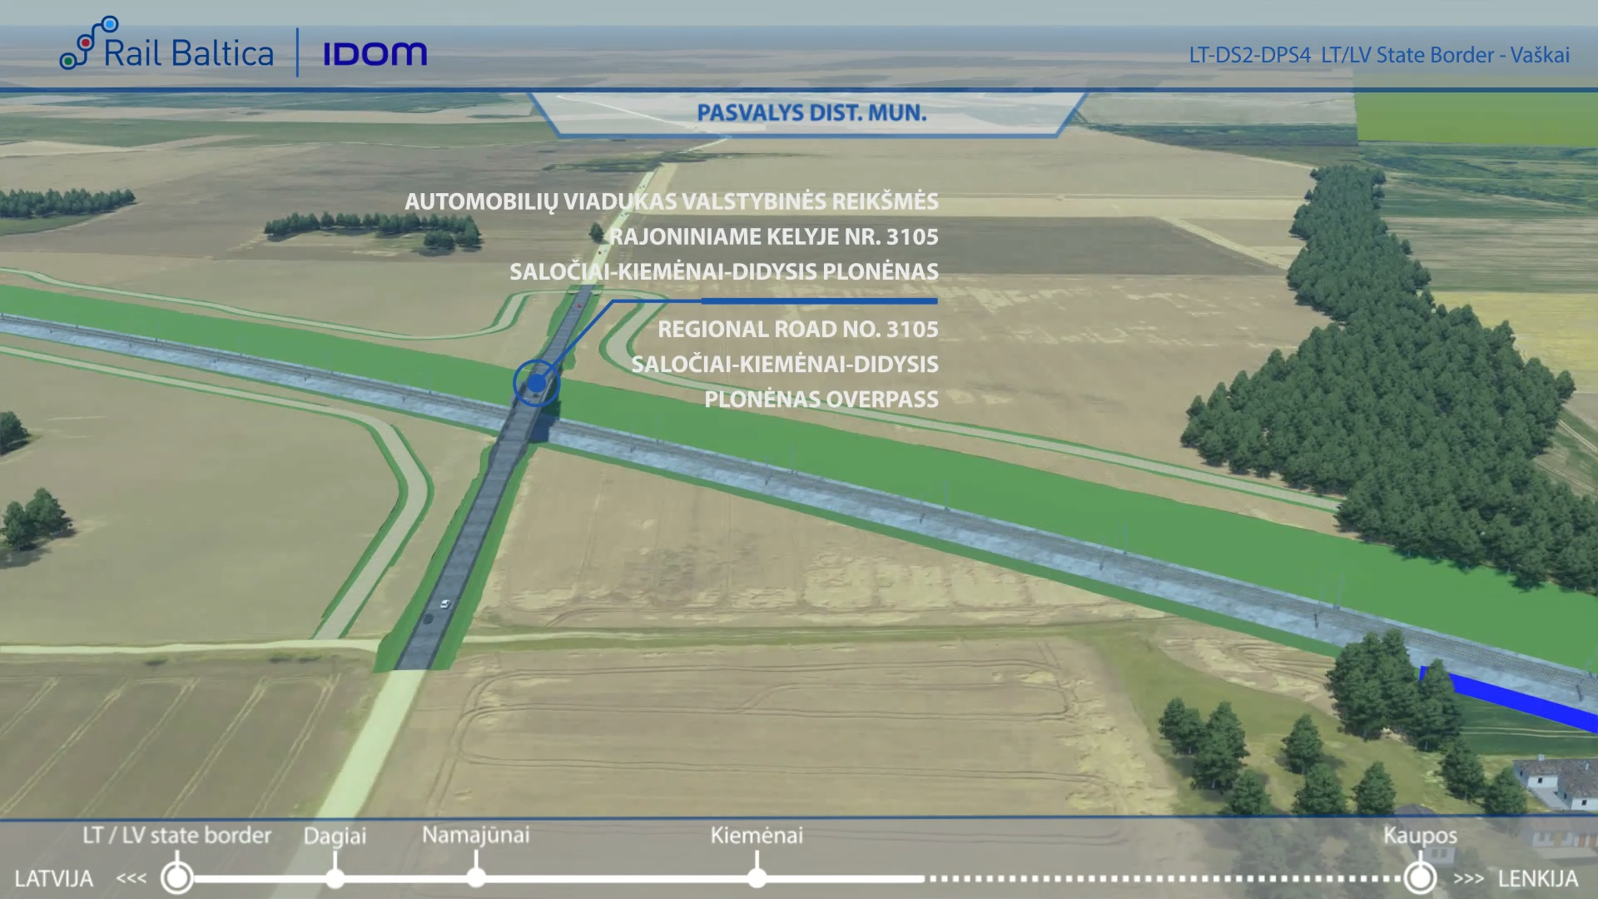
ROAD 3105 -VISUALIZATION

Slide 29
ENVIRONMENTAL PROTECTION MEASURES
No Natura 2000 sites have not been identified along this stretch
Migration studies were conducted during the research phase - in accordance with the results, 1 green bridges (ecoduct)
Several noise mitigation measures are proposed in the vicinity of settlements:
Noise reduction barriers;

Slide 30
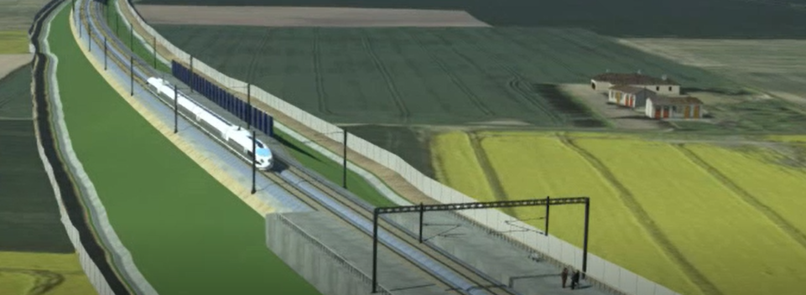
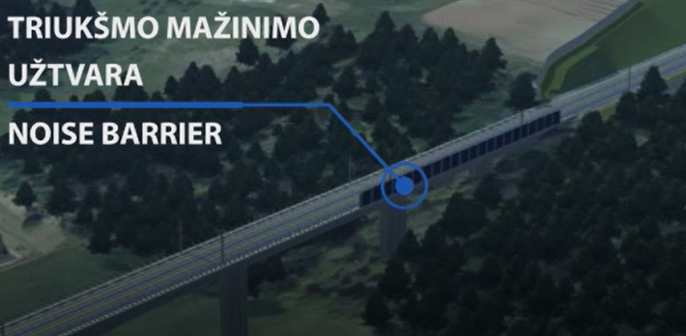
NOISE MITIGATION MEASURES
Residential area | Location | Noise mitigation measure
Pasvalys district municipality | 1+105 – 1+214 5+820 – 5+940 5+900 – 6+020 7+283 – 7+343 | Noise Barriers
Example of Noise barrier
Example of Noise barrier

Slide 31
QUESTIONS?

Slide 32
THANK YOU

