Slide 1
Rail Baltica section Kaunas - Šveicarija, Jonava District Municipality PUBLIC HEARING
Enrique Rico, Consultant Representative from IDOM Consulting, Engineering and Architecture
2021/10/23

Slide 2
Design and design supervision services for the construction of the new line from Kaunas to Ramygala Kaunas-Šveicarija

Slide 4
INFORMATION OF THE PUBLIC MEETING
Chairman of the public meeting – Enrique Rico, Consultant Representative from IDOM Consulting, Engineering and Architecture
The secretary of the public meeting is Šarūnė Tučinskaitė, Project Administrator from UAB Kelprojektas
The customer is the RB Rail AS Lietuvos filialas
The builder is the AB„LTG Infra“under the Ministry of Transport and Communications
Proposals from the public concerned could be submitted before and during the public meeting.
Participants in the public meeting are registered.
The statements of the participants of the public meeting shall be recorded in the minutes.
The minutes of the public meeting will be prepared after the meeting in 3 working days.
The designer publishes the minutes with annexes in IS Infostatyba in 5 working days .
The designer submits the application for approval of the project proposals together with the project proposals, report with annexes, protocol, sound recording, directly to the civil servant of the municipal administration through the IS Infostatyba.
Pursuant to Article 36 of the Law on Public Administration of the Republic of Lithuania, a decision made by a civil servant of the municipal administration performing the functions of the chief architect of the municipality may be appealed to the Administrative Disputes Commission or an administrative court in accordance with the law.

Slide 5
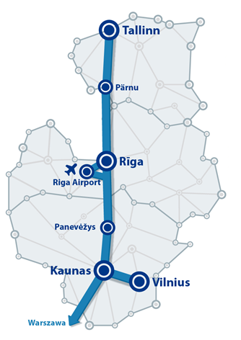
BACKGROUND
Existing Baltics connection with EU via Poland difficult, high cost
Rail Baltica joint project of three EU Member States – Estonia, Latvia and Lithuania.
New High Speed Railway Line fast-conventional double track 1435mm gauge
Symbolic return of the Baltic States to Europe.
Rail Baltica to become part of the EU TEN-T North Sea – Baltic Core Network Corridor:
linking Europe´s largest ports (Rotterdam, Hamburg and Antwerp) through the Netherlands, Belgium, Germany and Poland, with the three Baltic States.
Estonia, Latvia and Lithuania full integration into European railway area.
BACKGROUND
Notes:
Today most freight traffic transported by railway in Baltic states originates from CIS countries, especially from Russia, and rail transport services are mainly provided on East – West axis using existing 1520 mm gauge system which makes it difficult and costly to interconnect the Baltics with the rest of EU via Poland.
The Rail Baltica project is a joint project of three EU Member States – Estonia, Latvia and Lithuania – and concerns the building of a fast-conventional double track 1435mm gauge electrified railway line, meaning a symbolic return of the Baltic States to Europe.
Rail Baltica has been therefore designed to become part of the EU TEN-T North Sea – Baltic Core Network Corridor, which links Europe´s largest ports of Rotterdam, Hamburg and Antwerp through the Netherlands, Belgium, Germany and Poland, with the three Baltic States, ensuring full integration of Estonia, Latvia and Lithuania into the single European railway area.

Slide 6
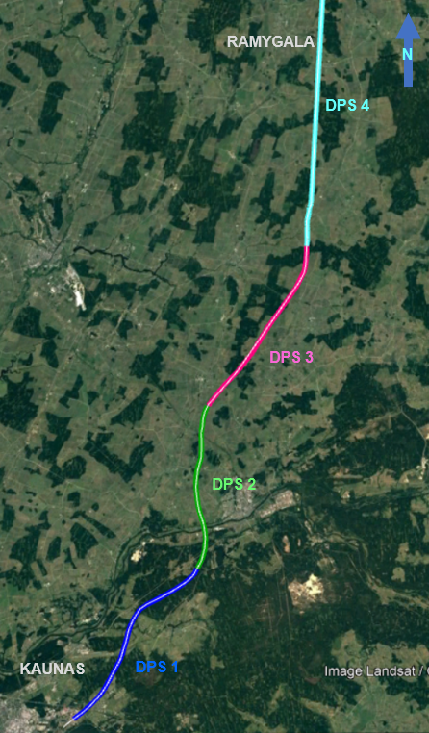
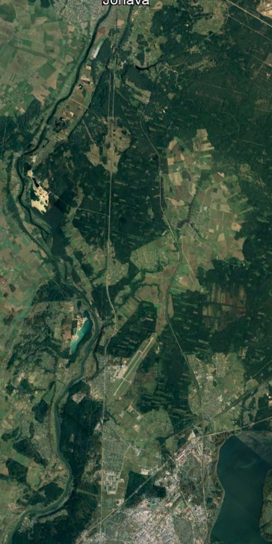
KAUNAS-ŠVEICARIJA SECTION GENERAL DESCRIPTION
This section connects one of the most populated áreas, Kaunas, to the southwest of Jonava District Municipality, in Šveicarija.
The alignment of this section has been designed within the boundaries of the approved Special Plan, running in close proximity to: Gumbiškiai, Šafárka, and Išorai.
The stretch intersects several existing transport infrastructure, for which new infrastructures solutions have been designed, avoiding level crossings that represent one of the rail sector´s biggest safety concerns.
Access roads parallel to the new railway line have been designed, ensuring connectivity among the adjacent private landplot owners.
NOTE: For the purpose of this presentation, we´ll be showing only the infrastructure within the boundaries of Jonava Municipality.
ŠVEICARIJA
HIGHWAY A6
LOCAL ROAD
ROAD NR. 1504
SESUVA RIVER
LOCAL ROAD
KAUNAS
Notes:
This section connects one of the most populated áreas, Kaunas, to the southwest of Jonava District Municipality, in Šveicarija.
The alignment of this section has been designed within the boundaries of the approved Special Plan, running in close proximity to: Gumbiškiai, Šafárka, and Išorai.
The stretch intersects several existing transport infrastructure, for which new grade separated junctions have been designed, avoiding level crossings that represent one of the rail sector´s biggest safety concerns.
Access roads parallel to the new railway line have been designed, ensuring connectivity among the adjacent private landplot owners.
NOTE: For the purpose of this presentation, we´ll be showing only the infrastructure within the boundaries of Jonava Municipality

Slide 7
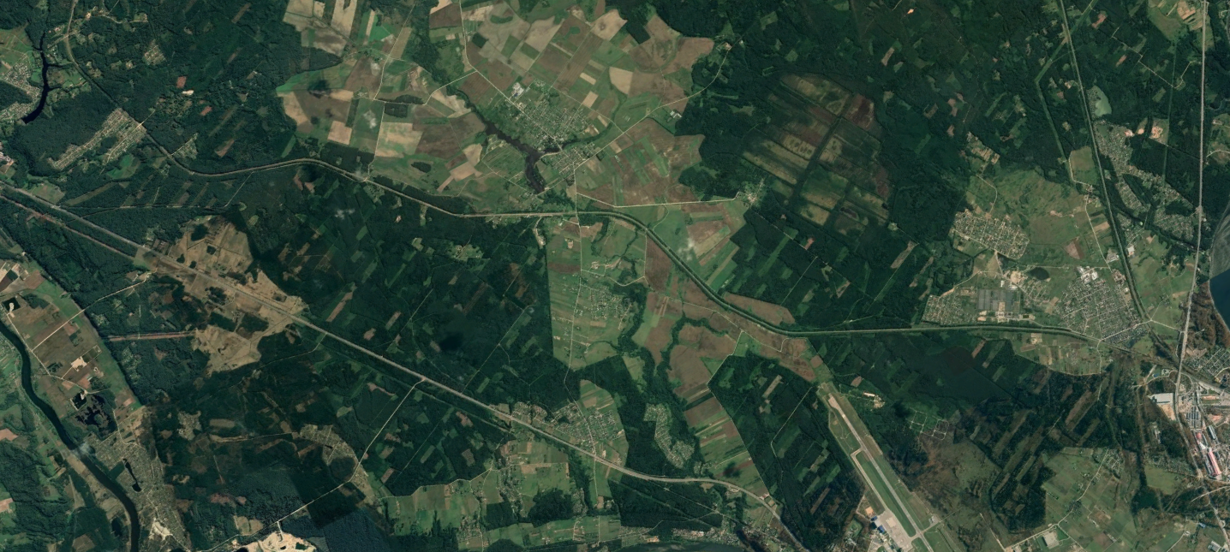

CHARACTERISTICS (DPS1 Kaunas-Šveicarija)
KAUNAS
ECODUCT
RAILWAY VIADUCT OVER VESA AND SESUVA RIVERS
RAILWAY VIADUCT OVER Rd A6
RAILWAY VIADUCT OVER GRAVEL ROAD
RAILWAY VIADUCT OVER Rd 1504
RAILWAY VIADUCT OVER GRAVEL ROAD
ŠVEICARIJA
SUSTAINABILITY
CONNECTIVITY
SAFETY
ENVIRONMENT
Notes:
We´ve implemented a sustainable solution that provides CONNECTIVITY:
Its a TOTAL LENGTH OF 17.9 km FROM WHICH 14,6 KM run ALONG JONAVA
The line will COMBINE FREIGHT + PASSENGER TRAFFIC
MAXIMUM SPEED:249km/h
Parallel ACCESSS ROADS have been designed among private landplots
Ensures SAFETY:
4 RAIL ROAD INTERSECTIONS have been SOLVED.
and protects the ENVIRONMENT by:
NOISE MITIGATION MEASURES: NOISE BARRIERS
ANIMAL MIGRATION ENSURED BY:
1 ECODUCTS (GREEN BRIDGES)
3 ANIMAL CROSSINGS

Slide 8
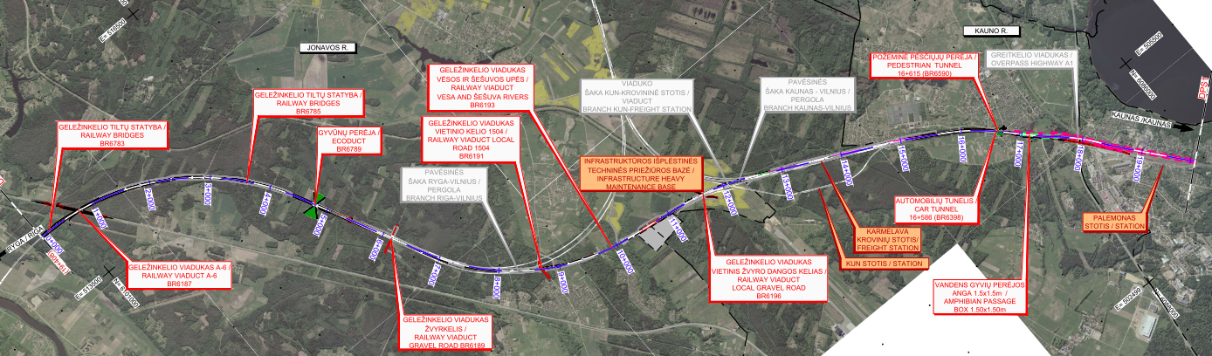
RAILWAY LOCATION PLAN
JONAVA
MUNICIPALITY BORDER
MUNICIPALITY BORDER
KAUNAS

Slide 9

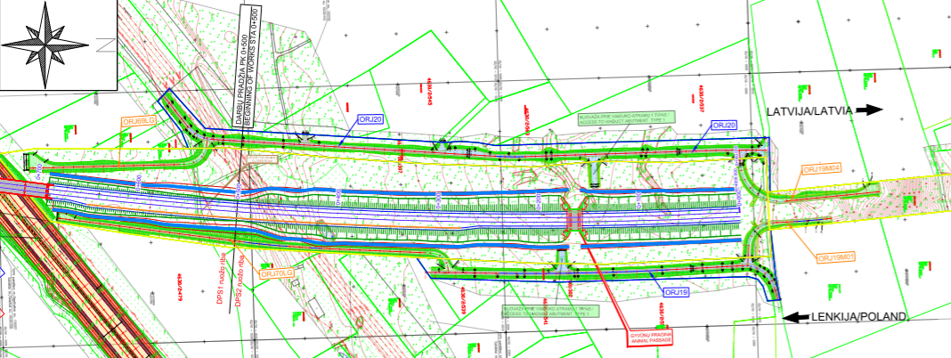
RAILWAY ALIGNMENT PLAN

Slide 10
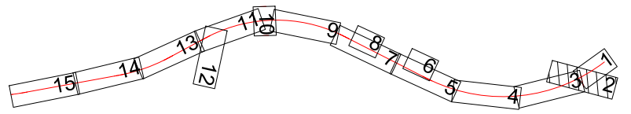
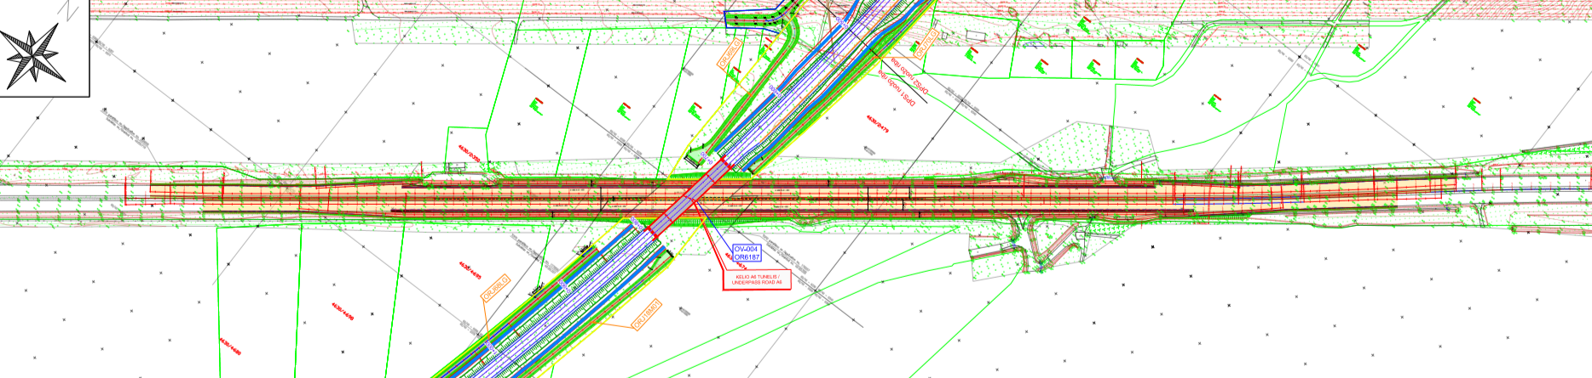
RAILWAY ALIGNMENT PLAN

Slide 11
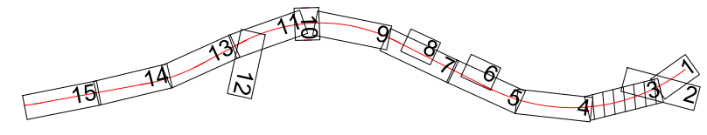
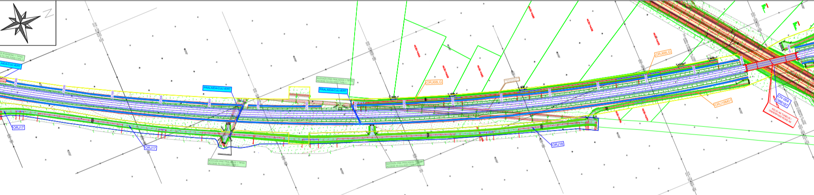
RAILWAY ALIGNMENT PLAN

Slide 12
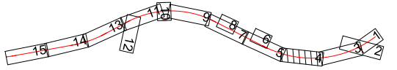
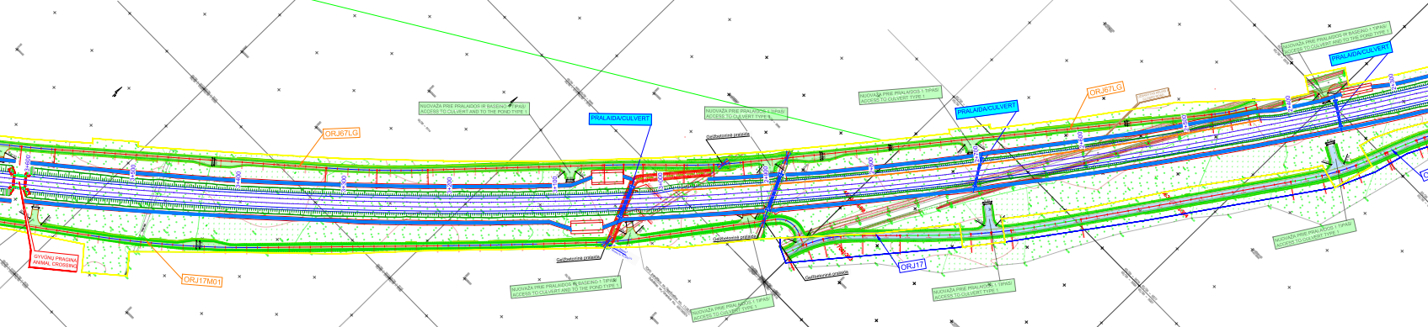
RAILWAY ALIGNMENT PLAN

Slide 13

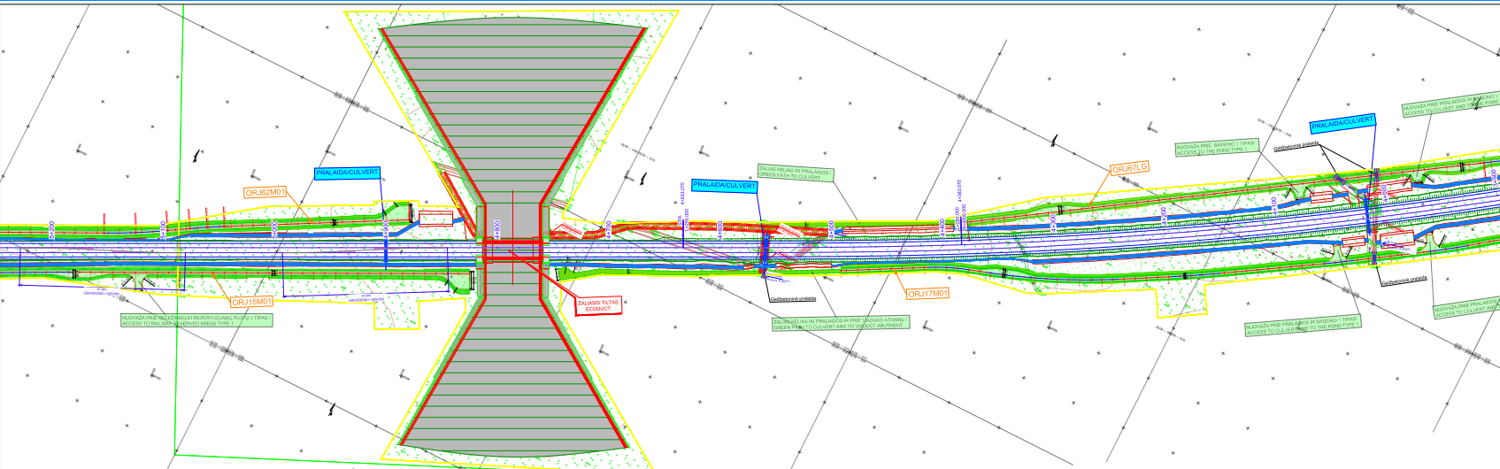
RAILWAY ALIGNMENT PLAN

Slide 14
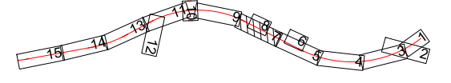
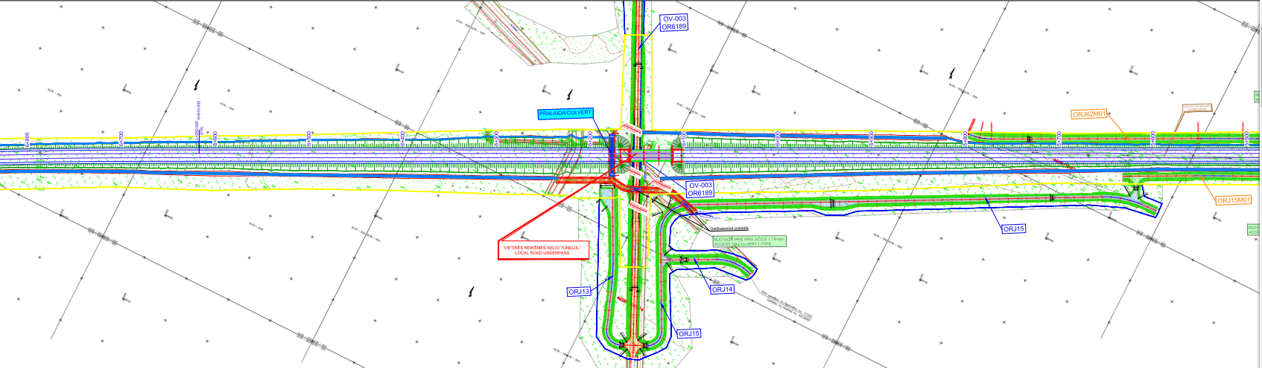
RAILWAY ALIGNMENT PLAN

Slide 15

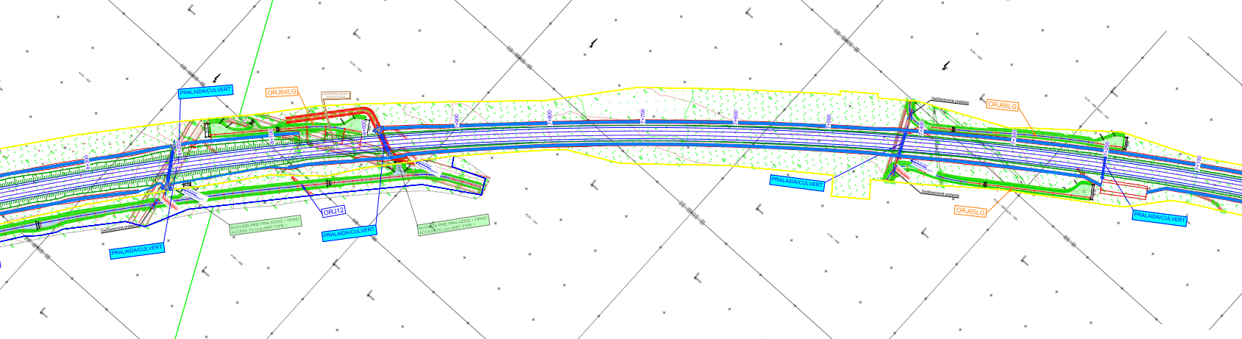
RAILWAY ALIGNMENT PLAN

Slide 16
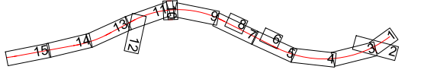
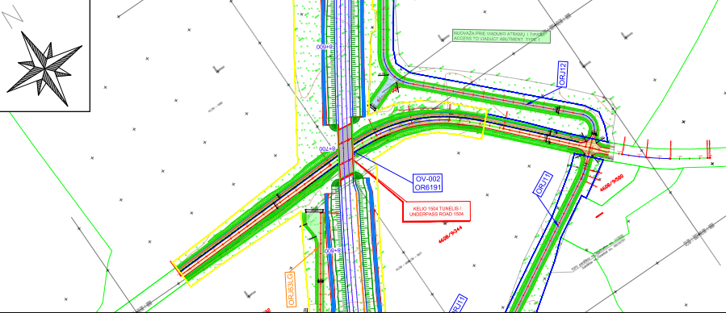
RAILWAY ALIGNMENT PLAN

Slide 17

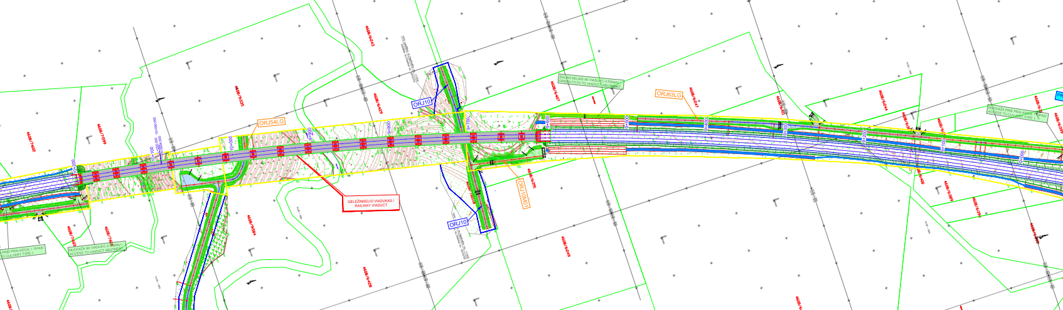
RAILWAY ALIGNMENT PLAN

Slide 18
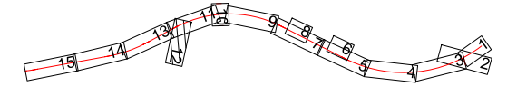
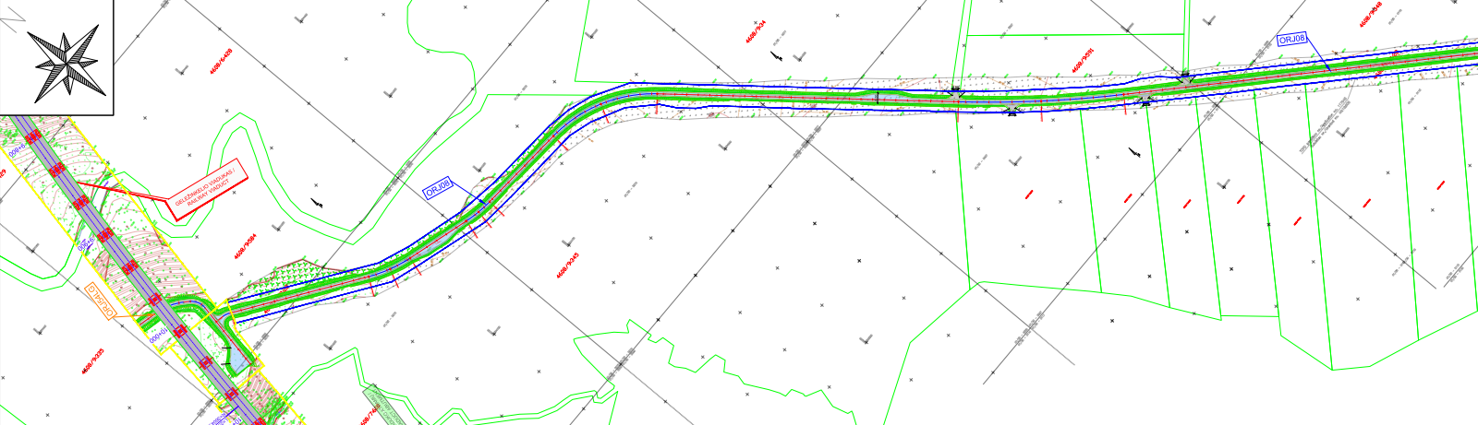
RAILWAY ALIGNMENT PLAN

Slide 19
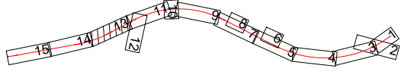
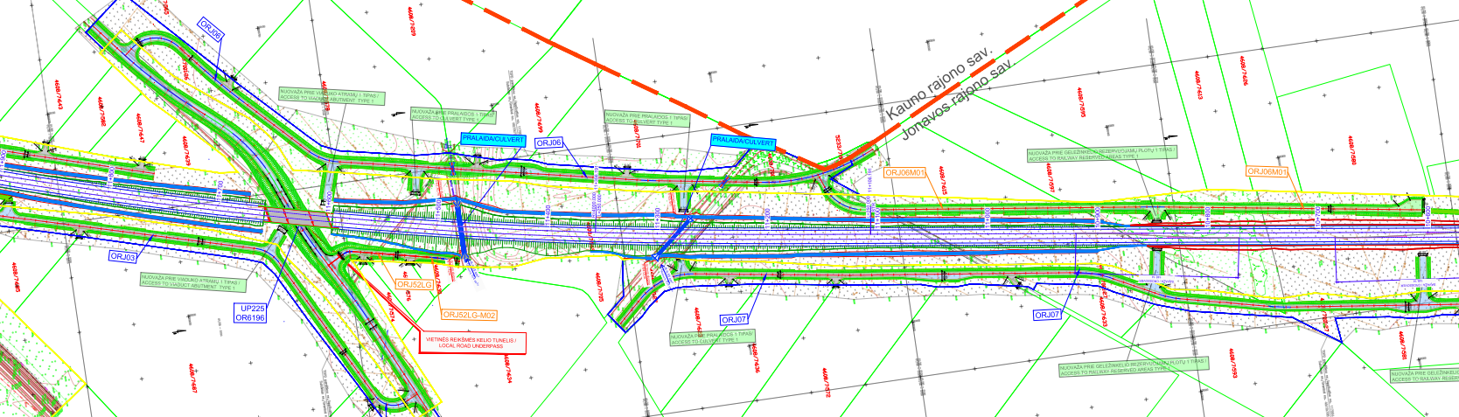
RAILWAY ALIGNMENT PLAN

Slide 20

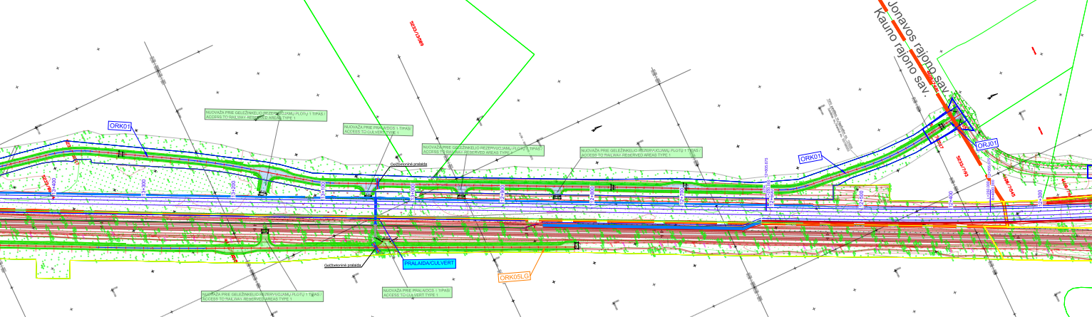
RAILWAY ALIGNMENT PLAN

Slide 21
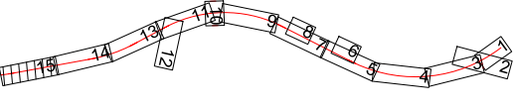
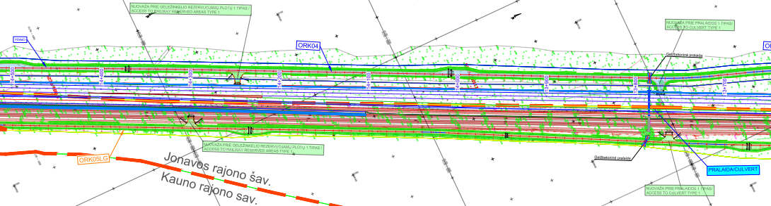
RAILWAY ALIGNMENT PLAN

Slide 22
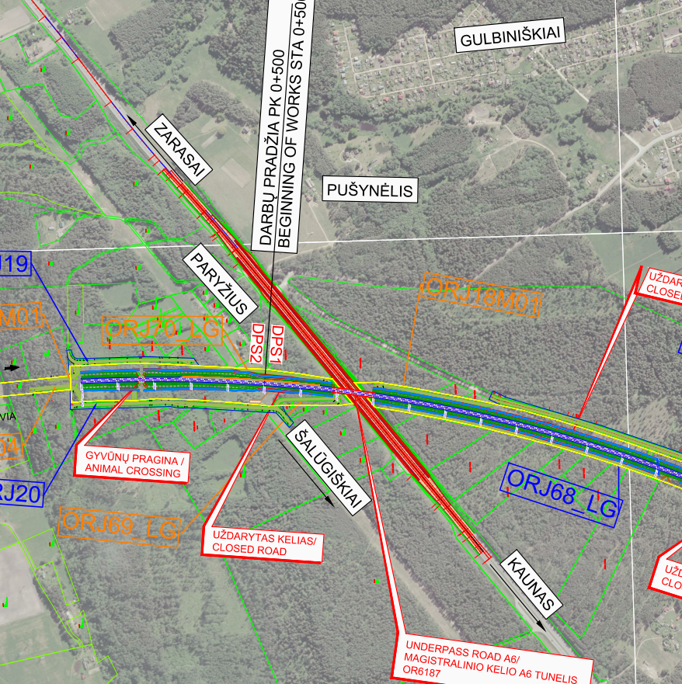
RAILWAY-HIGHWAY A6 CROSSING LOCATION PLAN
The railway line intersects with the category I highway road no. A6 Kaunas–Zarasai–Daugpilis at 0+745km, the section belongs to Jonava district municipality.
It is planned to install a railway viaduct to solve the intersection between the railway alignment and the road.
The length and spans of the railway viaduct were selected according to 2 + 2 traffic lanes and the installation of connecting roads.
It is planned to install side roads along the road mainline in order to remove direct accesses to the highway, reducing the risks this implies.
In order to preserve private landplots adjacent to the road, retaining walls will be installed at both sides.

Slide 23
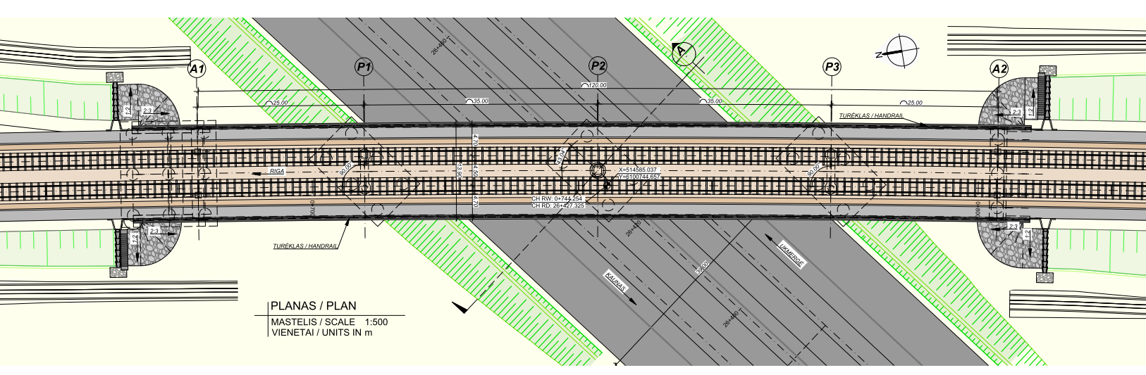
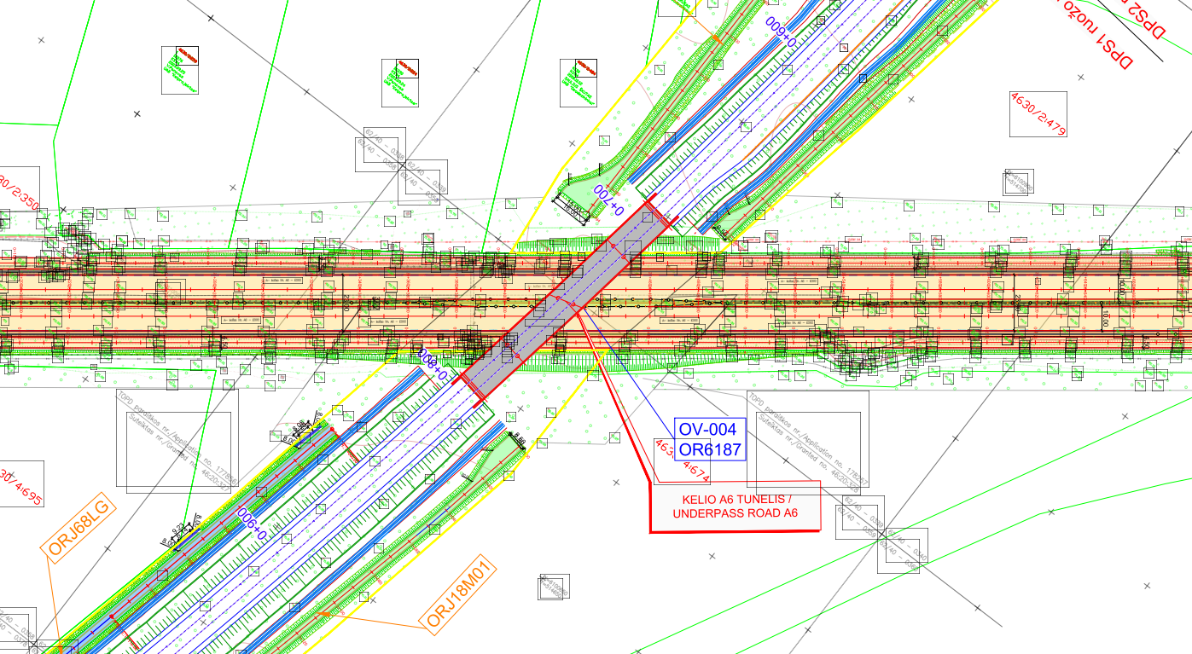
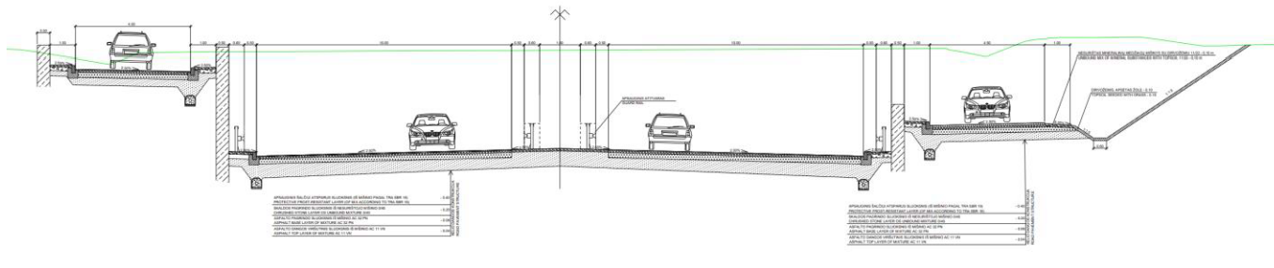
RAILWAY VIADUCT PLAN AND ELEVATION
RAILWAY VIADUCT PLAN
ROAD PLAN
ROAD CROSS SECTION

Slide 24
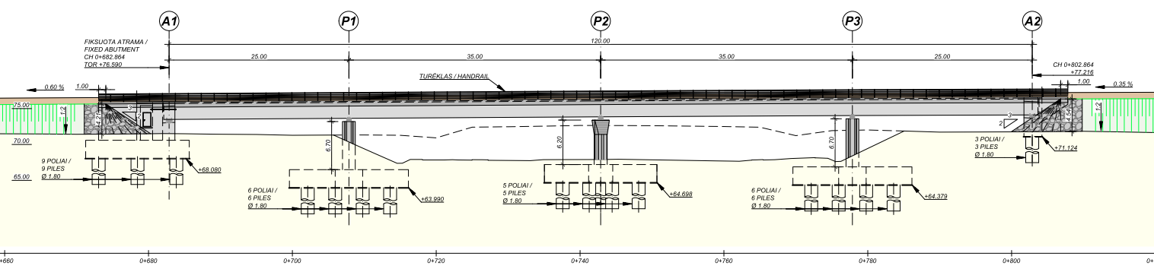
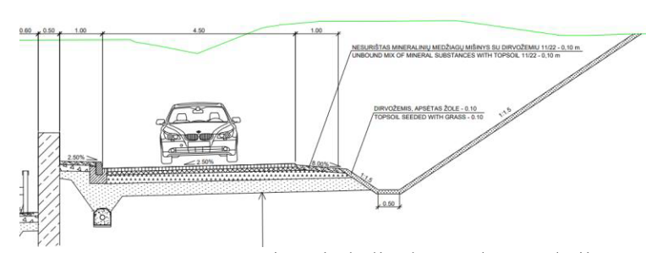
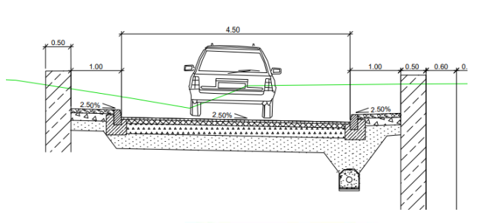
RAILWAY VIADUCT PLAN AND ELEVATION
ELEVATION
ROAD CROSS SECTION UNDER RAILWAY VIADUCT

Slide 25
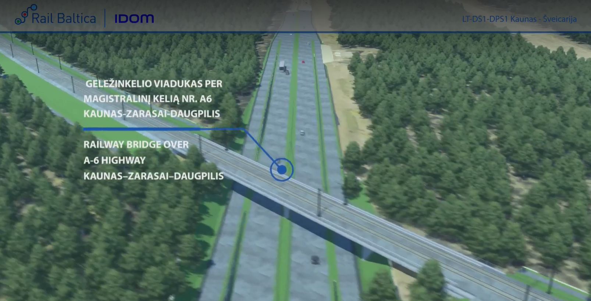
HIGHWAY A6-VISUALIZATION

Slide 26
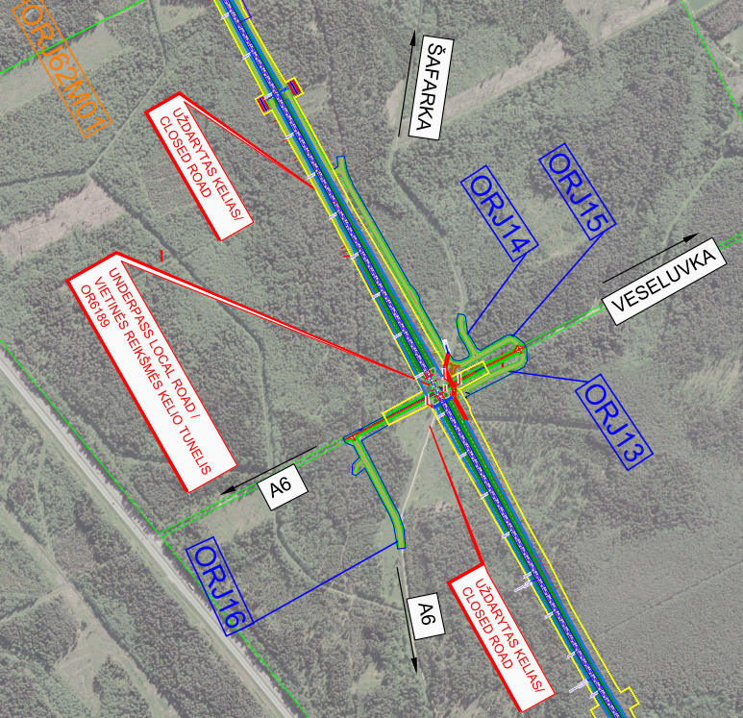
RAILWAY-LOCAL ROAD CROSSING
LOCATION PLAN
The railway line intersects with local road Veseluvka-Šafarka-Rudmėnai (UZ068) at 6,150 km, the section belongs to Jonava district municipality.
It is planned to install a railway viaduct to solve the intersection between the railway alignment and the road.
On the right side under the viaduct, a 6.00 m wide road is being designed.
On the left side under the viaduct is being designed a large animal passage.

Slide 27
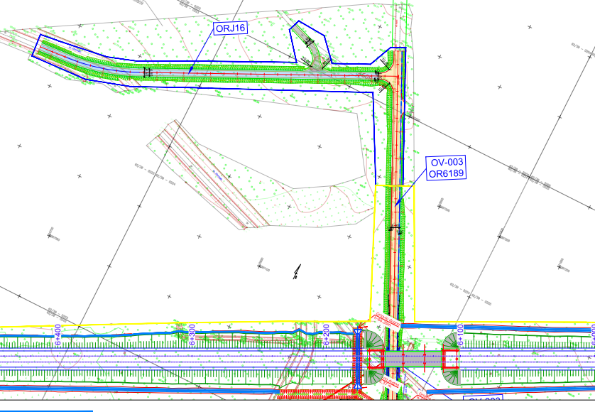
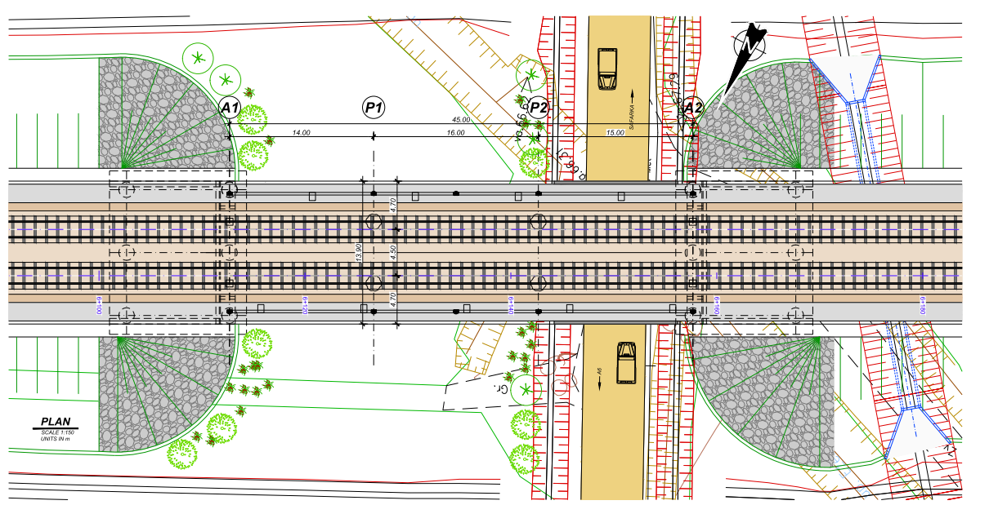
LOCAL ROAD-GRAVEL ROAD PLAN
ROAD PLAN
RAILWAY VIADUCT PLAN

Slide 28
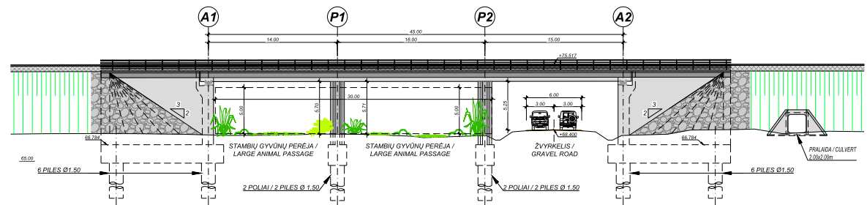
GRAVEL ROAD
UNDER RAILWAY VIADUCT
ELEVATION

Slide 29
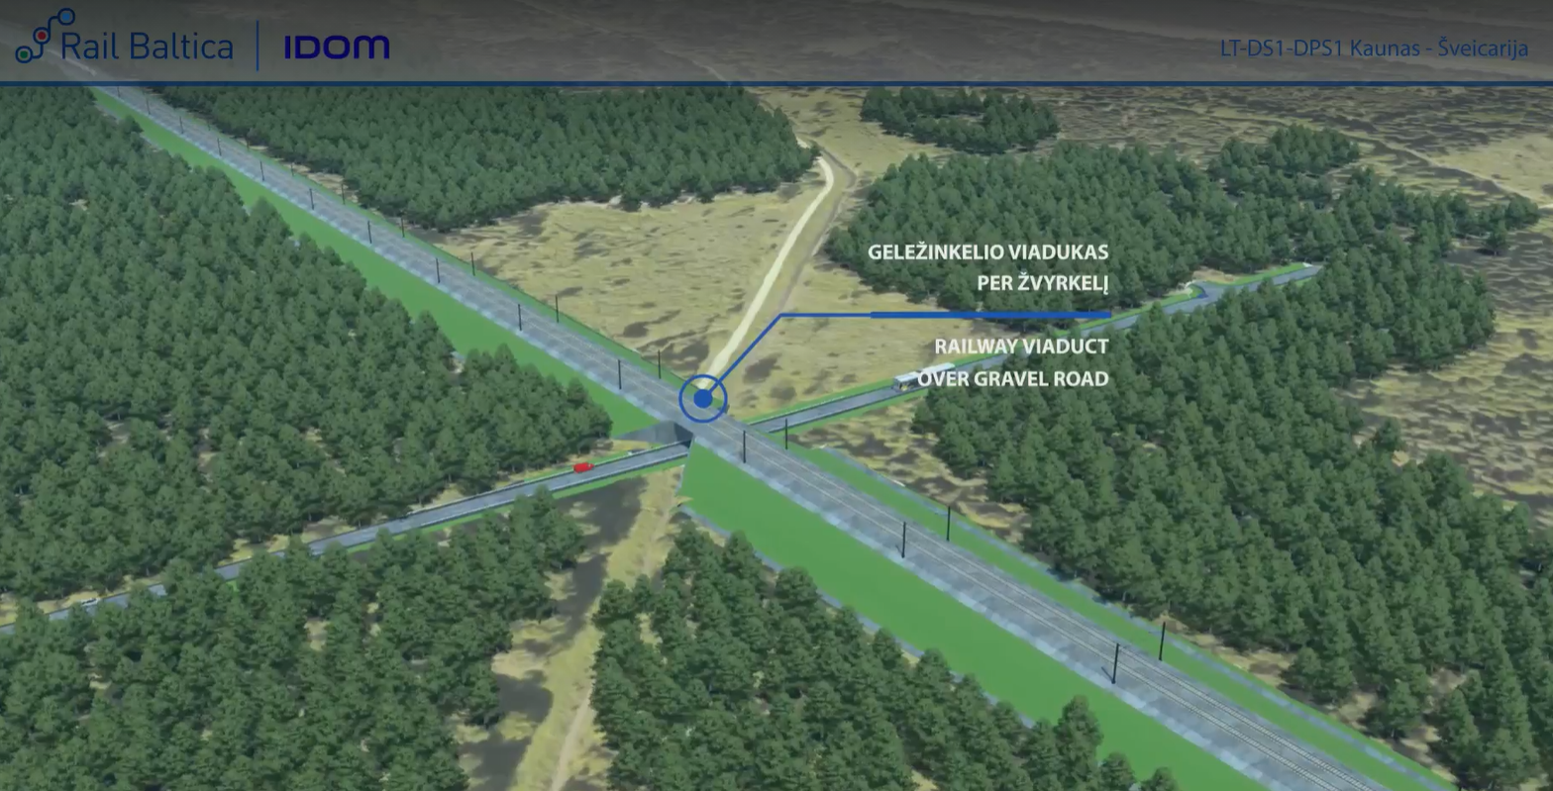
GRAVEL ROAD-
PRELIMINARY SOLUTION VISUALIZATION

Slide 30
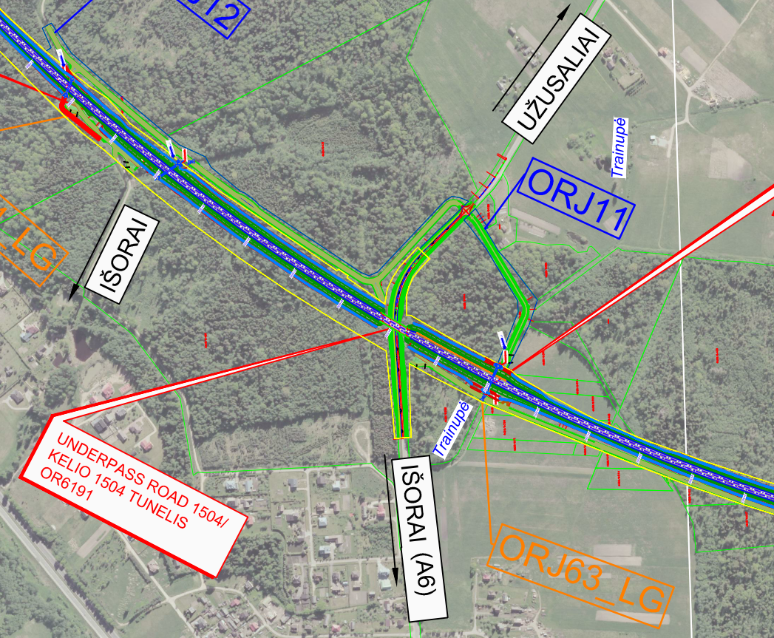
RAILWAY-ROAD 1504 CROSSING LOCATION PLAN
The railway line intersects with the category V regional road no.1504 Išorai-Užusaliai-Būdos from 0,920 km to 1,390 km, the section belongs to Jonava district municipality.
It is planned to install a railway viaduct at the intersection between railway and road.
It is planned to install connecting roads on both sides of the railway line to ensure the accessibility of private land plots.
On the left side of the road, a 2.50 m wide pedestrian path with asphalt pavement is being designed.
To ensure safety for the users, the pedestrian path is separated from the district road by 1.75 m wide dividing strip and protective barriers.

Slide 31
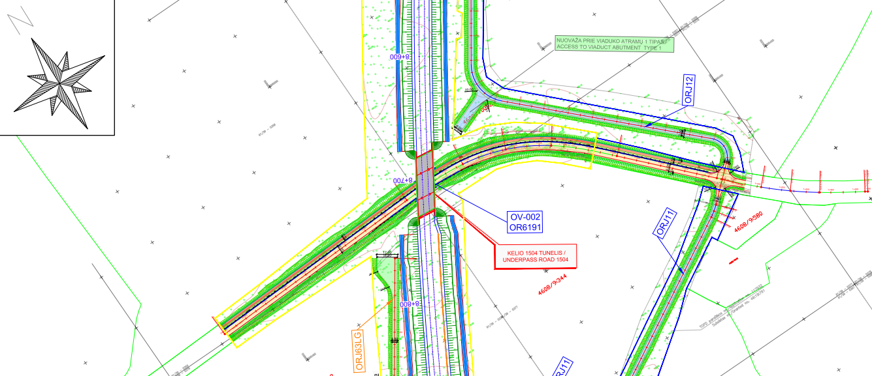
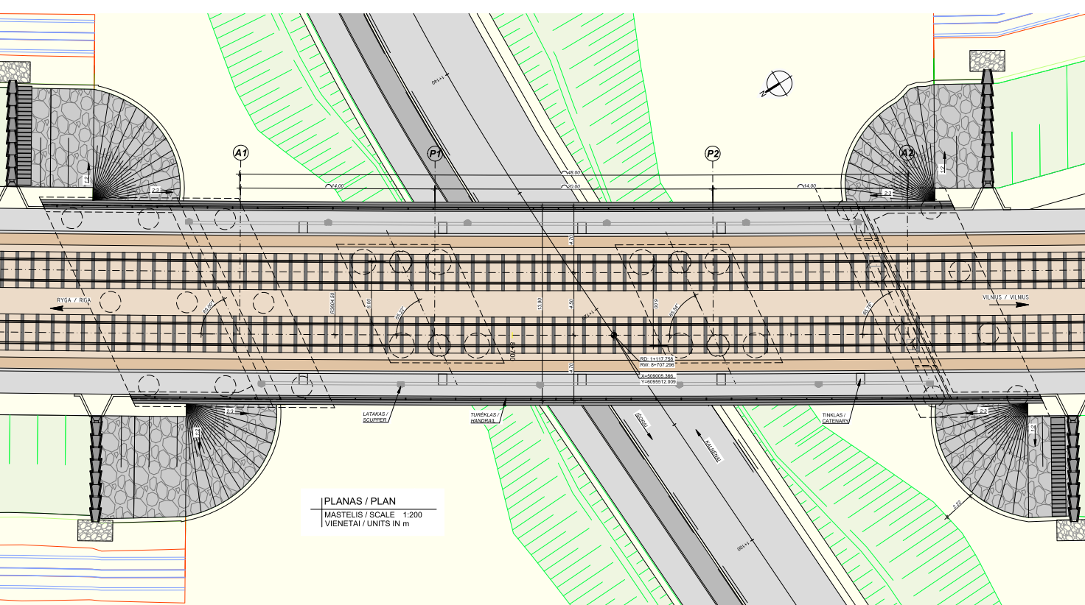
ROAD 1504 PLAN
AND CROSS SECTION
ROAD PLAN
RAILWAY VIADUCT PLAN

Slide 32
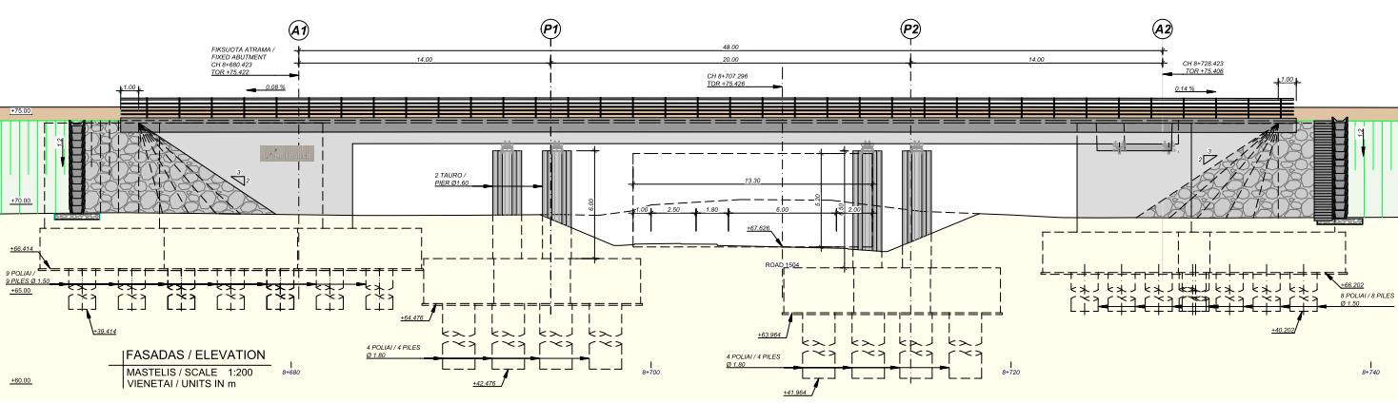
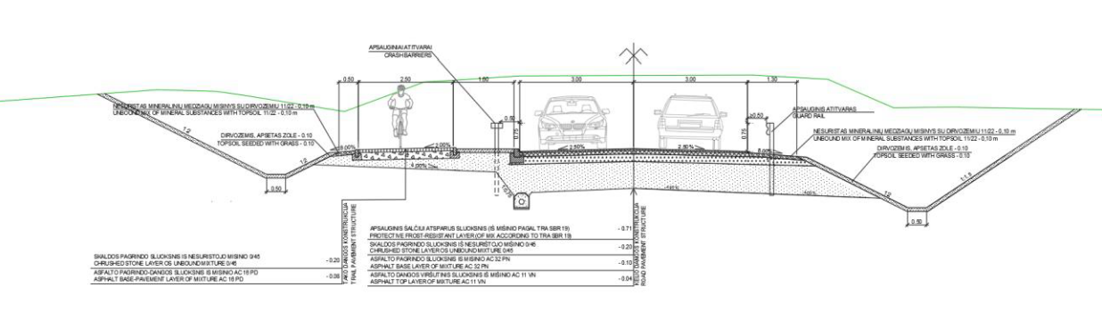
ROAD 1504 CROSS SECTION UNDER RAILWAY VIADUCT
ELEVATION
ROAD CROSS SECTION UNDER RAILWAY VIADUCT

Slide 33
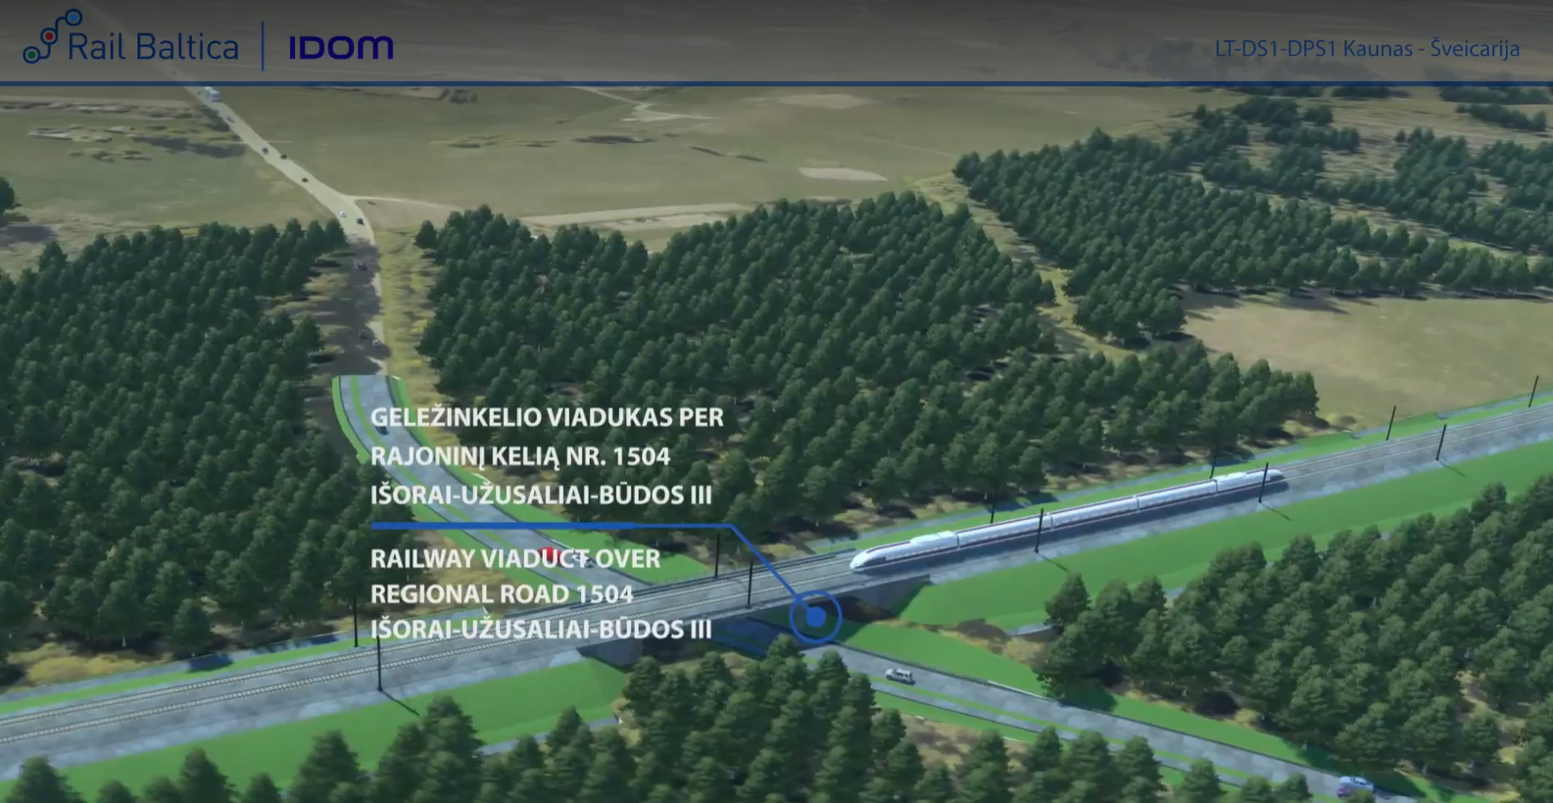
ROAD 1504 -VISUALIZATION

Slide 34
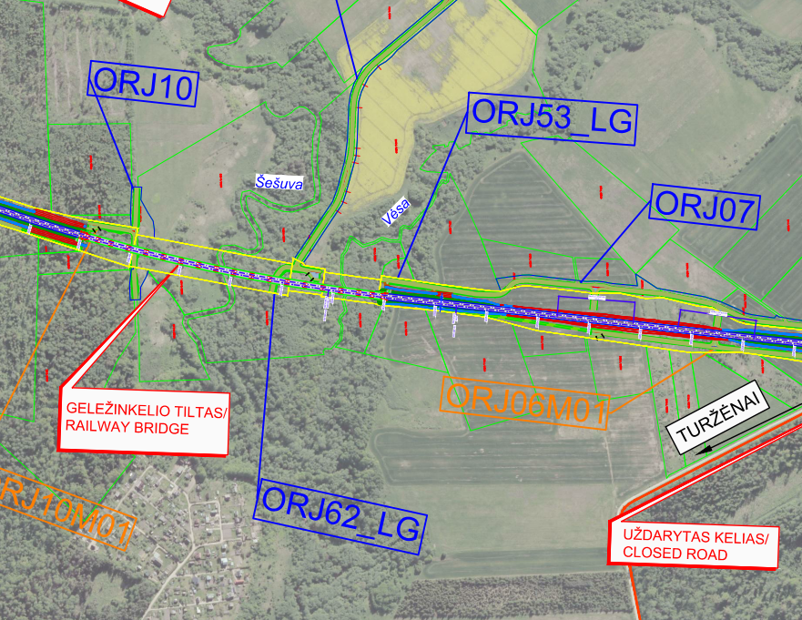
RAILWAY-VESA & SESUVA RIVERS CROSSING
LOCATION PLAN
The railway line intersects with Vesa & Sesuva rivers watercourse, the section belongs to Jonava district municipality.
It is planned to install a railway viaduct over the rivers path from 9,613 km to 10,93 km, with a total length of 582 m.

Slide 35
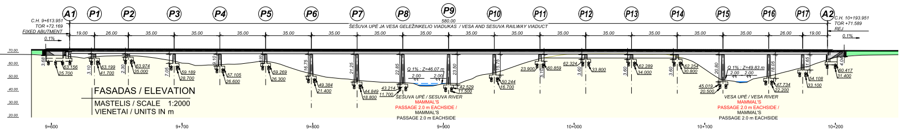
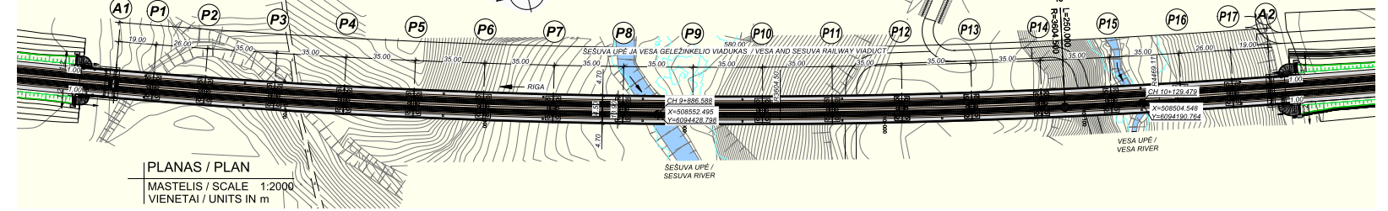
VESA & SESUVA RIVERS
RAILWAY VIADUCT
ELEVATION
RAILWAY PLAN

Slide 36
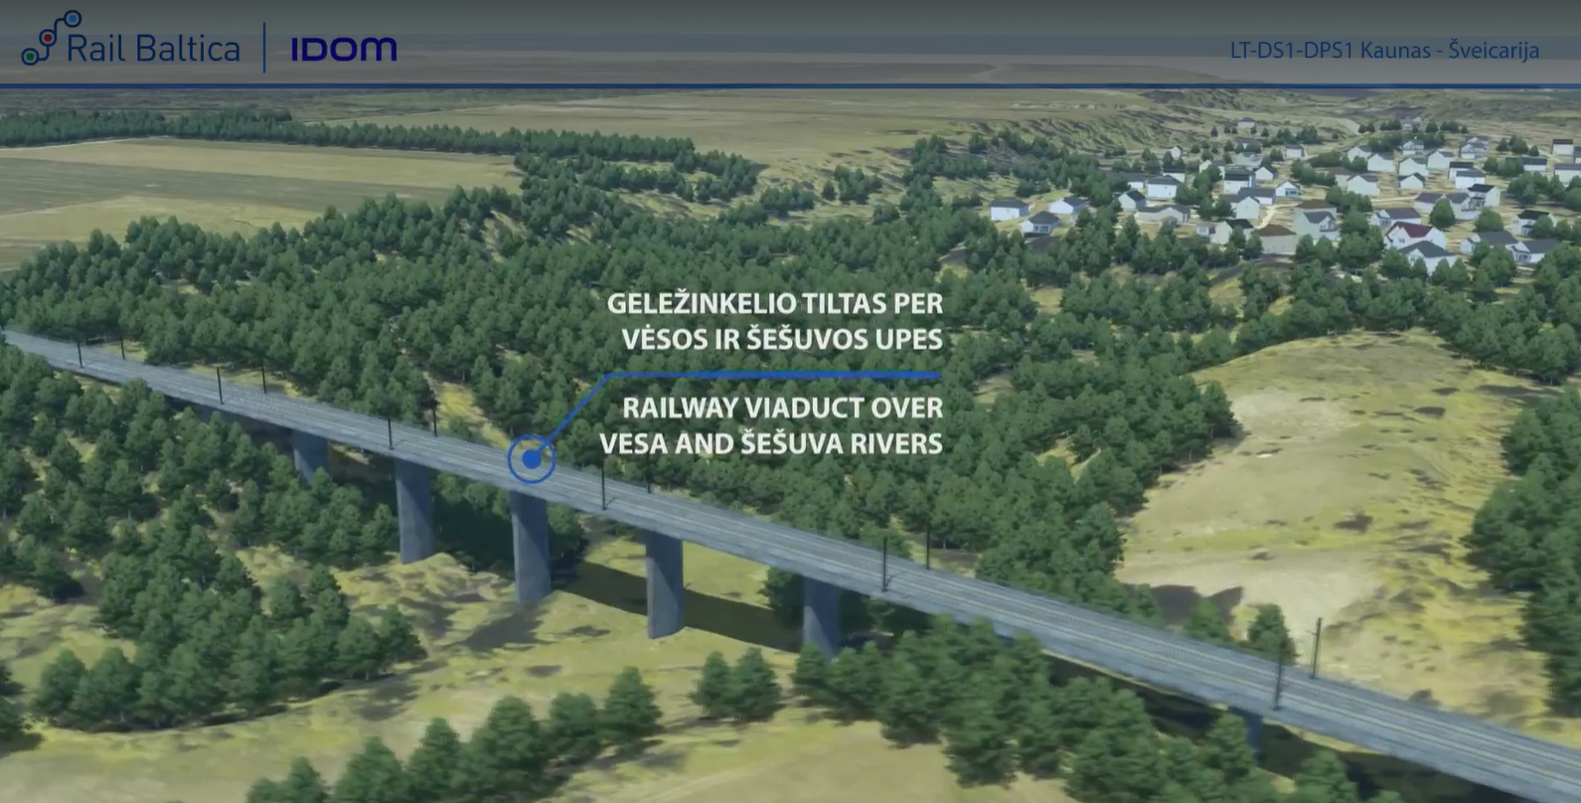
RAILWAY BRIDGE-VISUALIZATION

Slide 37
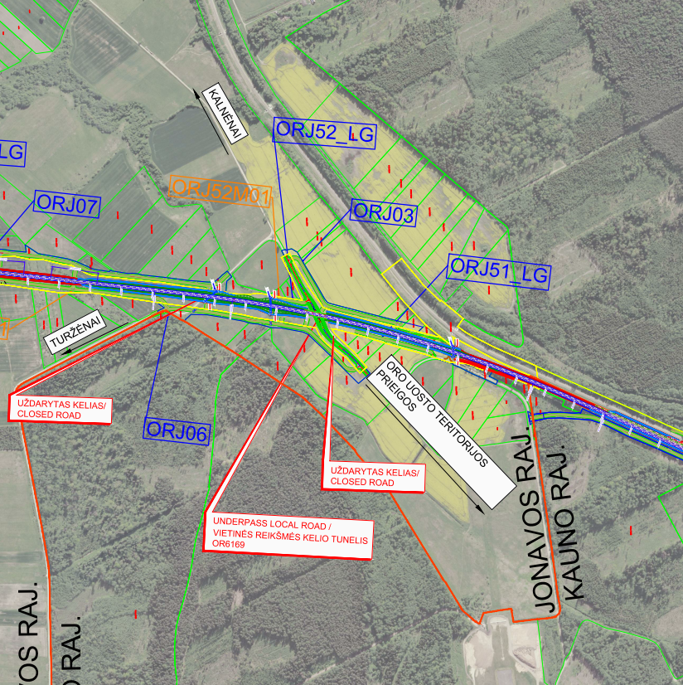
RAILWAY-LOCAL ROAD CROSSING
LOCATION PLAN
The railway line intersects with local road Kalnėnai-Mikainiai-Turžėnai (UZ087) at 11,632 km, the section belongs belongs to Jonava district municipality.
It is planned to install a railway viaduct at the intersection between railway and road.
It is planned to install connecting roads on both sides of the railway line to ensure the accessibility of private land plots.
It is planned to install a 6.00 m width asphalt pavement road under the railway.

Slide 38


LOCAL ROAD-GRAVEL ROAD PLAN
ROAD PLAN
RAILWAY VIADUCT PLAN

Slide 39

GRAVEL ROAD
UNDER RAILWAY VIADUCT
ELEVATION

Slide 40

GRAVEL ROAD-VISUALIZATION

Slide 41
ENVIRONMENTAL PROTECTION MEASURES
No„Natūra 2000“sites have been identified in this section.
Migration studies were conducted during the research phase - in accordance with the results, 1 green bridge or ecoducts plus 2 animal passages (3x10 m) and 1 large animal passage (5x30 combined with gravel local road crossing) have been proposed.
10 amphibian passages are foreseen in this section
The railway line crosses the following main watercourses:
Vesa upė/river
Sesuva upė/river
These water bodies will be subject to appropriate protection measures during construction and operation.
Several noise mitigation measures are proposed in the vicinity of settlements:

Slide 42

GREEN BRIDGE-RAILWAY CROSSING
LOCATION PLAN
At railway chainage 4,800 km, considering the Environmental Impact Assessment of the new infrastructure, in order to ensure a correct fauna migration corridor, a Green Bridge will be installed.
The section belongs to Jonava district municipality.

Slide 43



ECODUCT PLAN AND CROSS SECTION
GREEN BDRIDGE
ECODUCT PLAN
ECODUCT RAILWAY ENTRANCE

Slide 44

ECODUCT-VISUALIZATION

Slide 45


NOISE MITIGATION MEASURES
Residential area | Location | Noise mitigation measure
Jonava district municipality | 0+331 – 0+625 | Noise Barriers
Jonava district municipality | 2+477 – 2+639 | Noise Barriers
Jonava district municipality | 2+756-2+953 | Noise Barriers
Jonava district municipality | 13+983-17+597 | Noise Barriers
Example of Noise barrier
Example of Noise barrier

Slide 46
QUESTIONS?

Slide 47
THANK YOU

