Slide 1
Rail Baltica section
Ramygala -Berčiūnai (DPS1),
Panevėžys district municipality
PUBLIC HEARING
Jakub Sokoliński, Consultant Representative from IDOM Consulting, Engineering and Architecture
2021/10/12

Slide 2
Design and design supervision services for the construction of the new line from
Ramygala to Lithuanian / Latvian state broder

Slide 4
INFORMATION OF THE PUBLIC MEETING
Chairman of the public meeting – Jakub Sokoliński, Consultant Representative from IDOM Consulting, Engineering and Architecture
The secretary of the public meeting is Šarūnė Tučinskaitė, Project Administrator from UAB Kelprojektas
The customer is the RB Rail AS Lietuvos filialas
The builder is the AB„LTG Infra“
Proposals from the public concerned could be submitted before and during the public meeting.
Participants in the public meeting are registered.
The statements of the participants of the public meeting shall be recorded in the minutes.
The minutes of the public meeting will be prepared after the meeting in 3 working days.
The designer publishes the minutes with annexes in IS Infostatyba in 5 working days .
The designer submits the application for approval of the project proposals together with the project proposals, report with annexes, protocol, sound recording, directly to the civil servant of the municipal administration through the IS Infostatyba.
Pursuant to Article 36 of the Law on Public Administration of the Republic of Lithuania, a decision made by a civil servant of the municipal administration performing the functions of the chief architect of the municipality may be appealed to the Administrative Disputes Commission or an administrative court in accordance with the law.

Slide 5
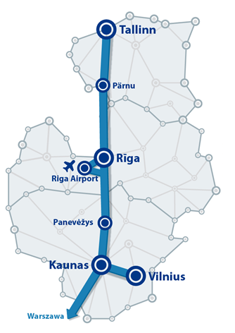
BACKGROUND
Existing Baltics connection with EU via Poland difficult, high cost
Rail Baltica joint project of three EU Member States – Estonia, Latvia and Lithuania.
New High Speed Railway Line fast-conventional double track 1435mm gauge
Symbolic return of the Baltic States to Europe.
Rail Baltica to become part of the EU TEN-T North Sea – Baltic Core Network Corridor:
linking Europe´s largest ports (Rotterdam, Hamburg and Antwerp) through the Netherlands, Belgium, Germany and Poland, with the three Baltic States.
Estonia, Latvia and Lithuania full integration into European railway area.
BACKGROUND

Slide 6
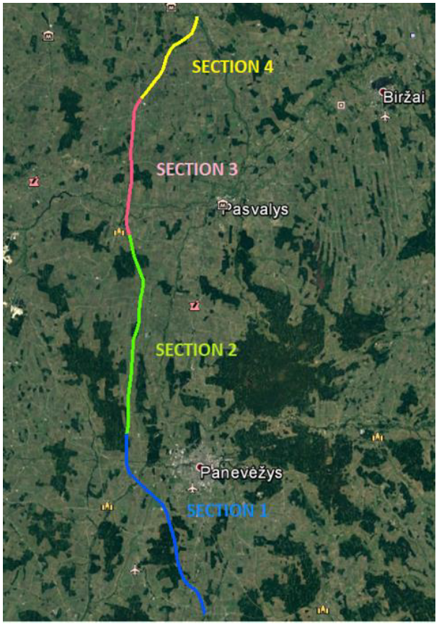
Ramygala -Berčiūnai
SECTION GENERAL DESCRIPTION
This section connects population áreas, Berčiūnai, and Ramygala, in Panevėžys District Municipality.
The alignment of this section has been designed within the boundaries of the approved Special Plan, running in close proximity to:, Berčiūnai, Upytė, Ėriškiai, Jotainiai, Ramygala
The stretch intersects several existing transport infrastructure, for which new grade separated junctions have been designed, avoiding level crossings that represent one of the rail sector´s biggest safety concerns.
Access roads parallel to the new railway line have been designed, ensuring connectivity among the adjacent private landplot owners.
NOTE: For the purpose of this presentation, we´ll be showing only the infrastructure within the boundaries of Panevėžys Municipality.
ROAD NR. 1204
ROAD NR. 3023
ROAD NR. 3022

Slide 7
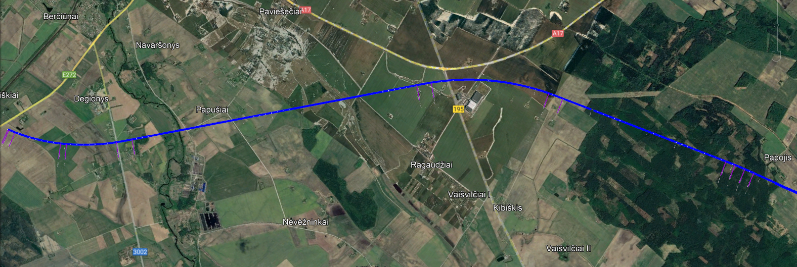
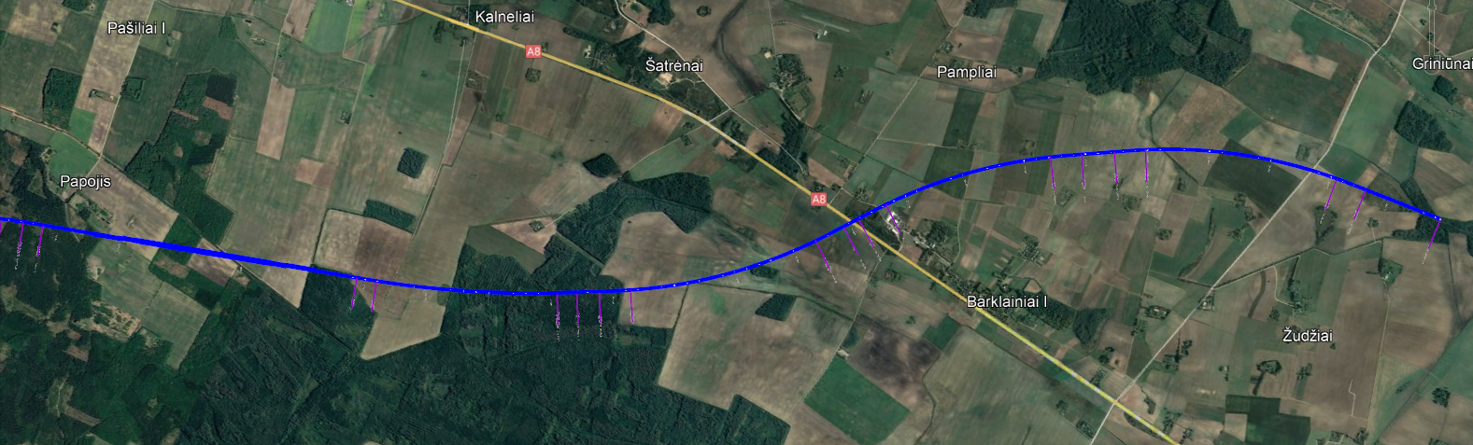
Ramygala -Berčiūnai
SECTION GENERAL DESCRIPTION
LOCAL ROAD
ROAD NO.: A17
PANEVĖŽYS
ROAD NO.: 3002
ECODUCT
LOCAL ROAD
BRIGDE OVER NEVEZYS RIVER
ROAD NO.: 195
LOCAL ROAD
ROAD NO.: A8
LOCAL ROAD
PANEVĖŽYS
ROAD NR. 3023
LOCAL ROAD
ROAD NR. 3022

Slide 8
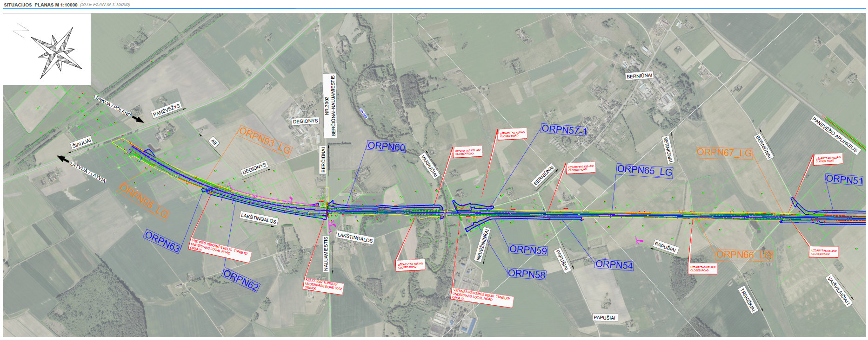
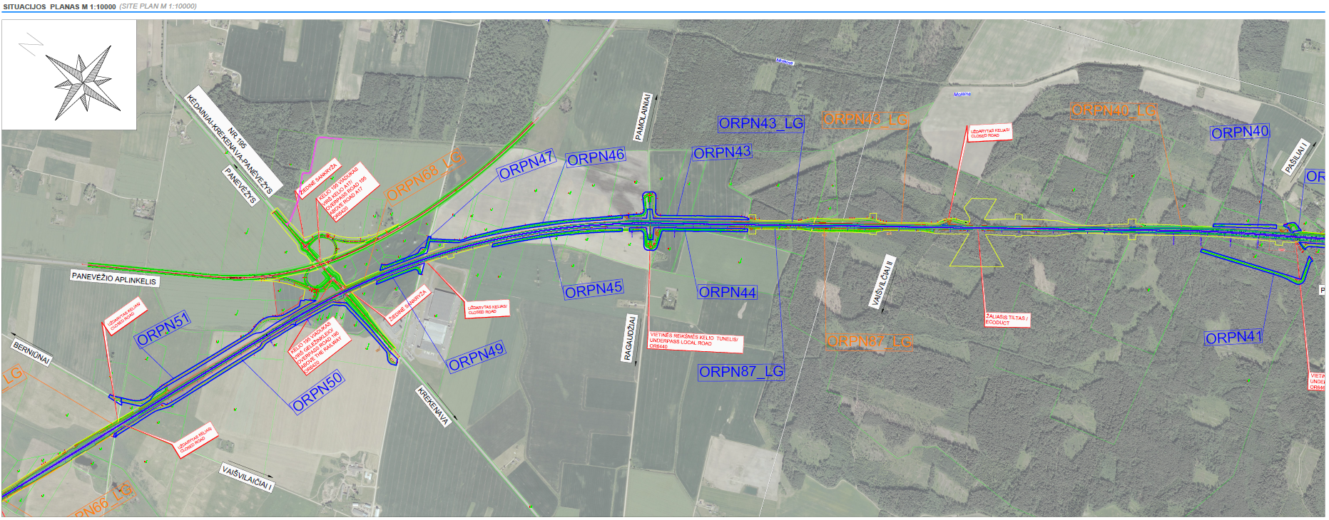
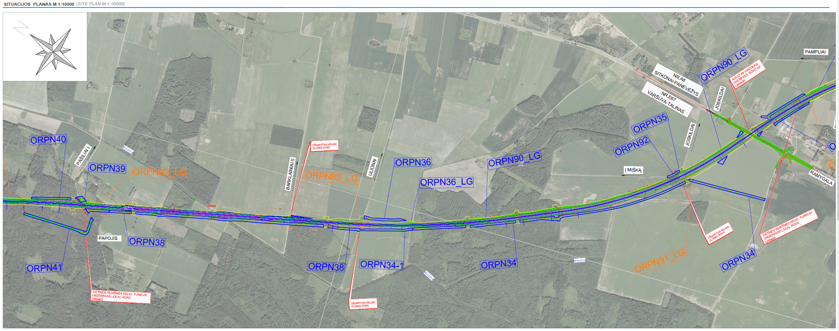
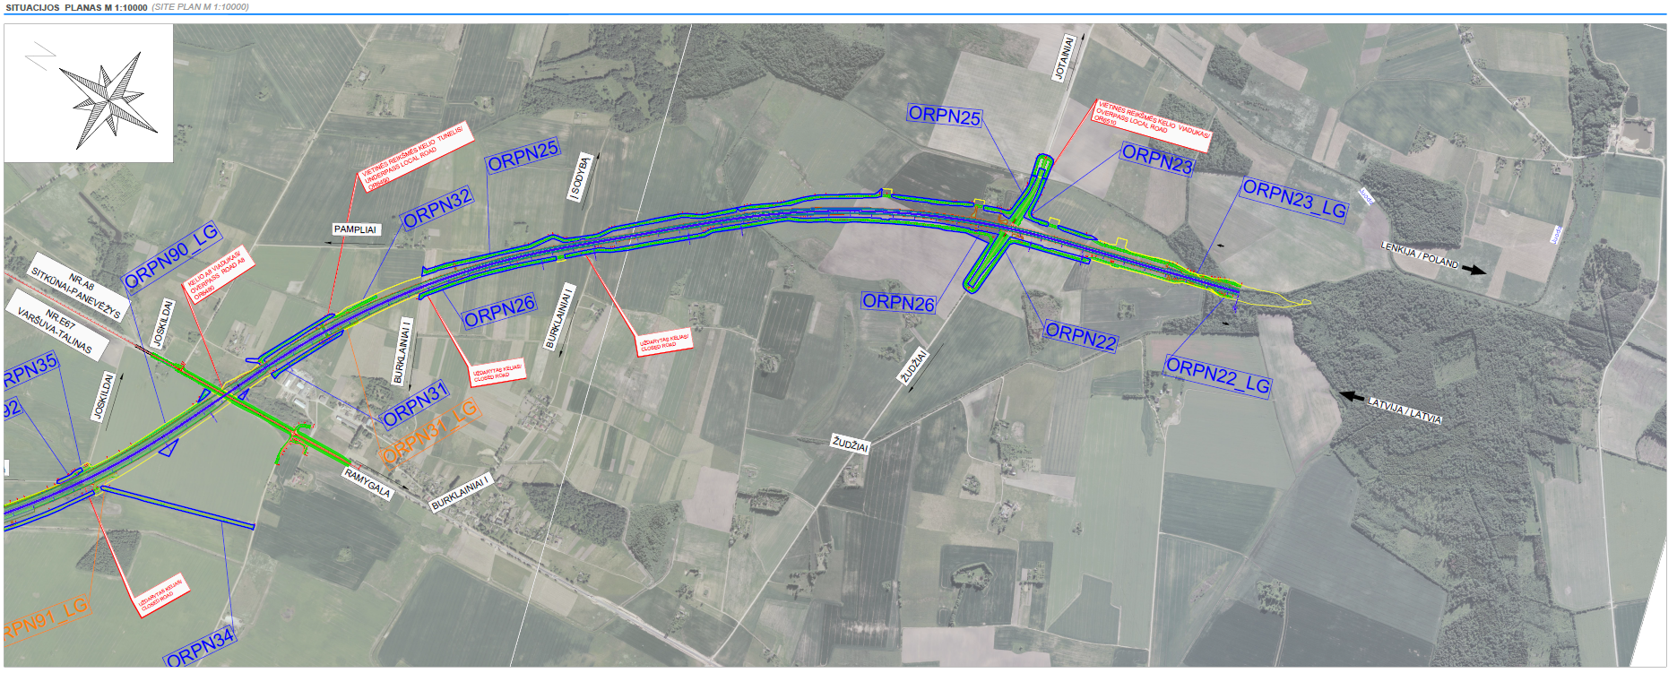
RAILWAY LOCATION PLAN-Panevėžys

Slide 9
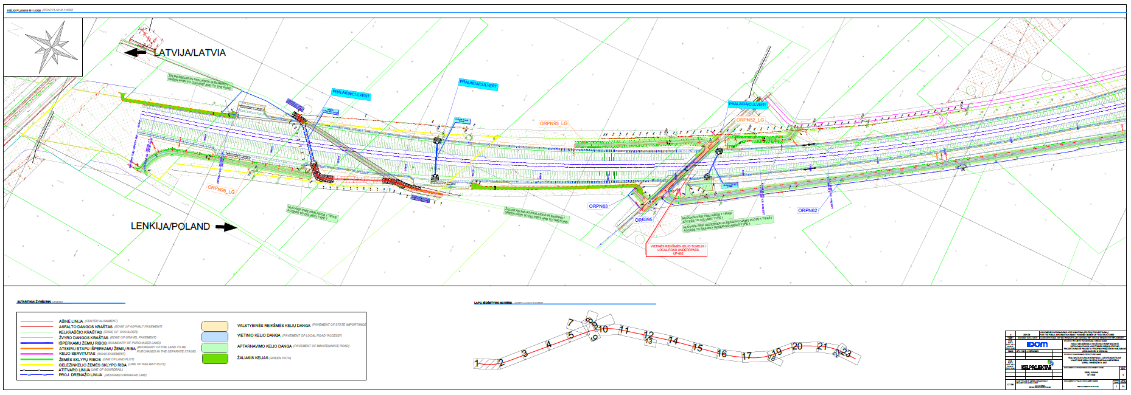
RAILWAY ALIGNMENT PLAN

Slide 10
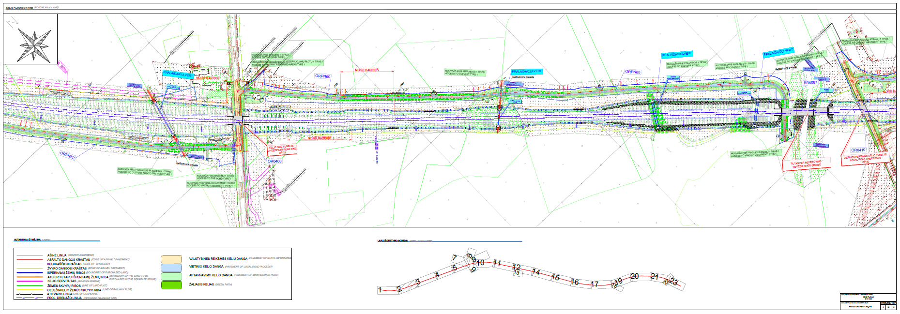
RAILWAY ALIGNMENT PLAN

Slide 11
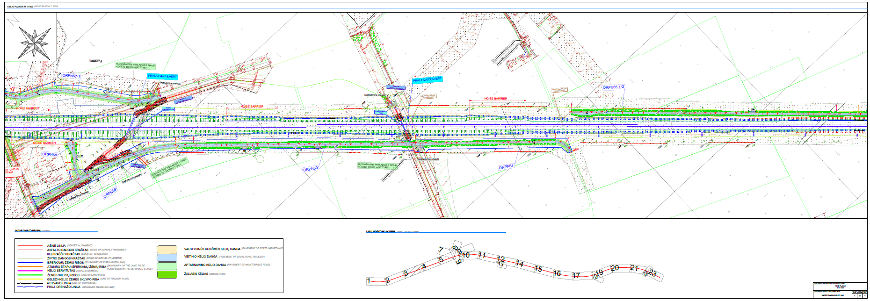
RAILWAY ALIGNMENT PLAN

Slide 12
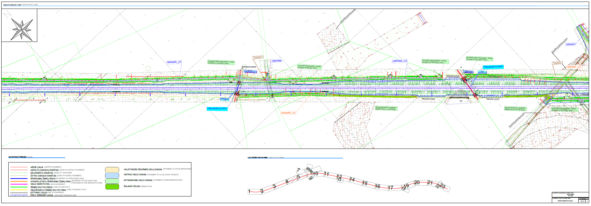
RAILWAY ALIGNMENT PLAN

Slide 13
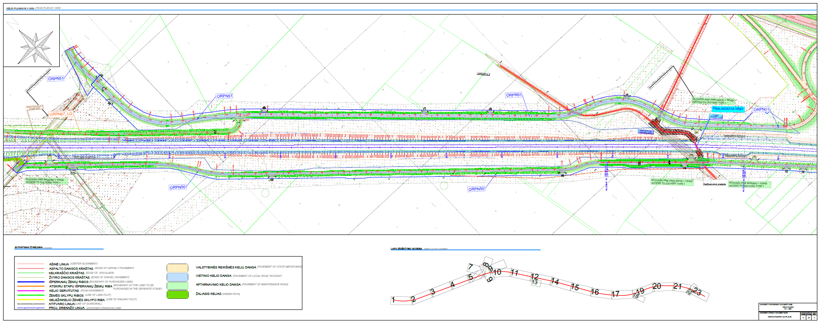
RAILWAY ALIGNMENT PLAN

Slide 14
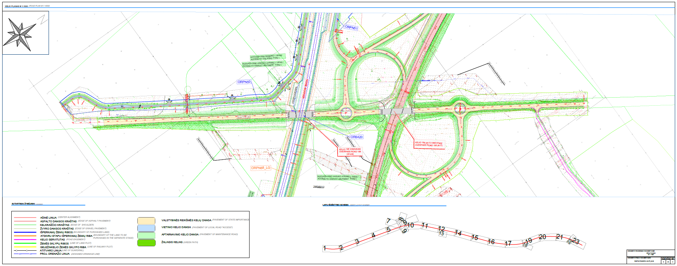
RAILWAY ALIGNMENT PLAN

Slide 15
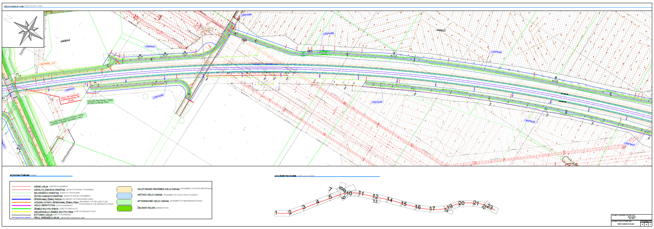
RAILWAY ALIGNMENT PLAN

Slide 16
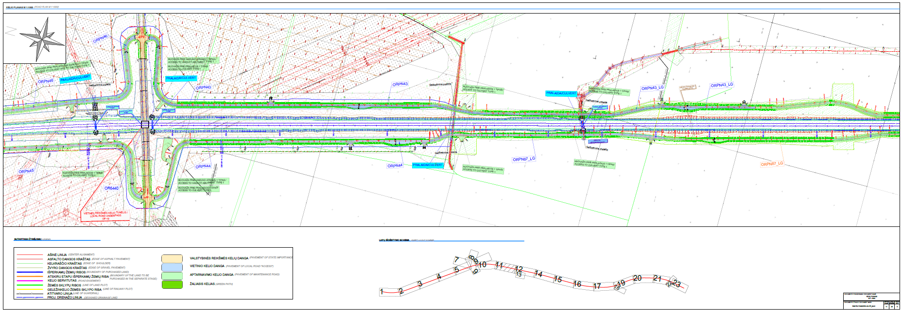
RAILWAY ALIGNMENT PLAN

Slide 17
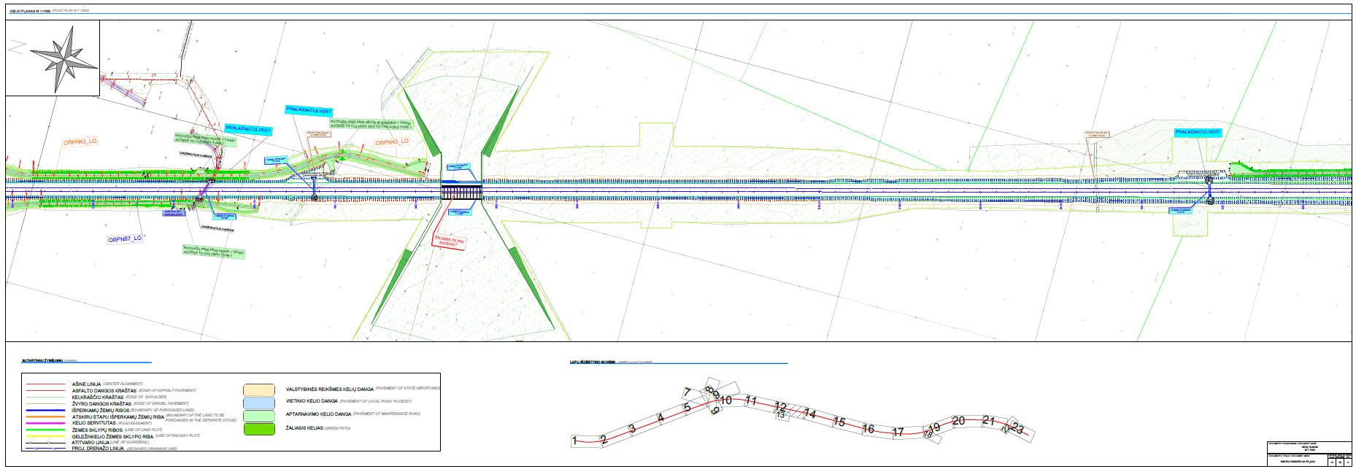
RAILWAY ALIGNMENT PLAN

Slide 18
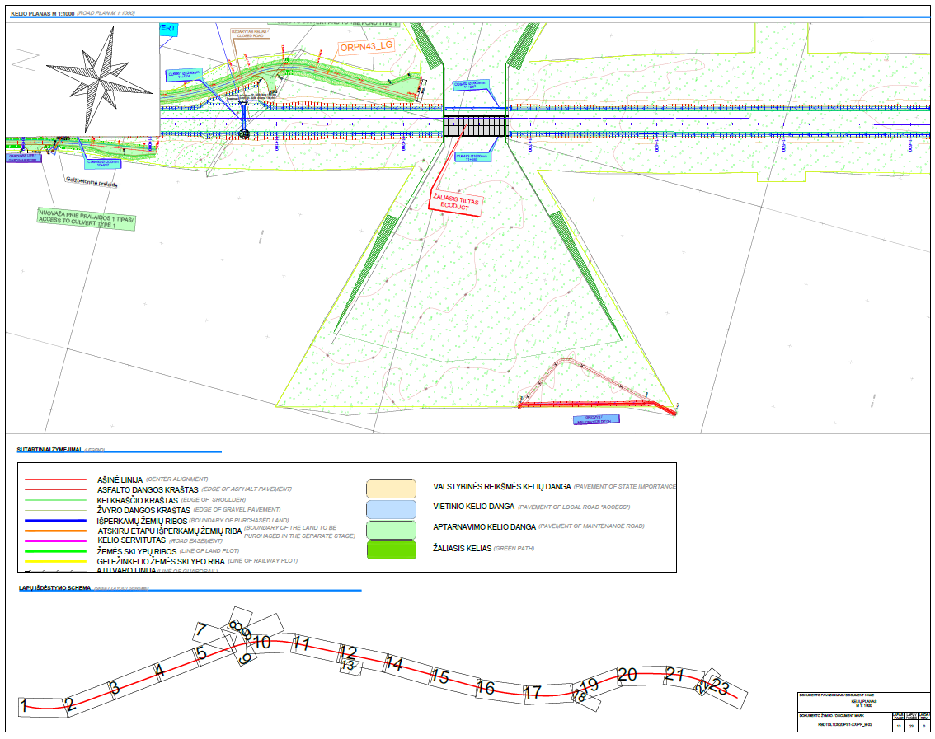
RAILWAY ALIGNMENT PLAN

Slide 19
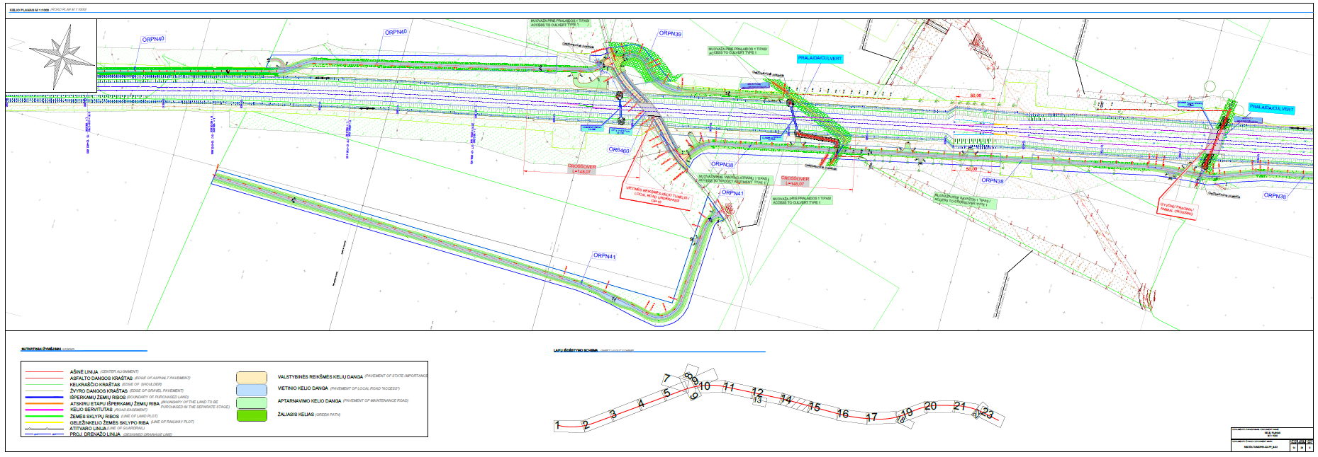
RAILWAY ALIGNMENT PLAN

Slide 20
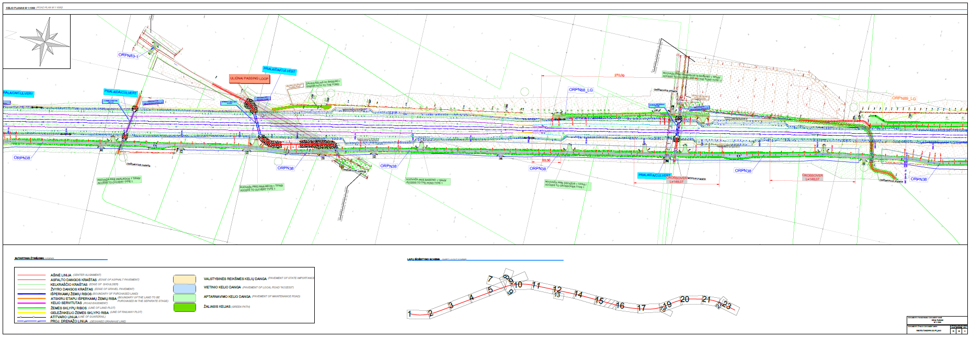
RAILWAY ALIGNMENT PLAN

Slide 21
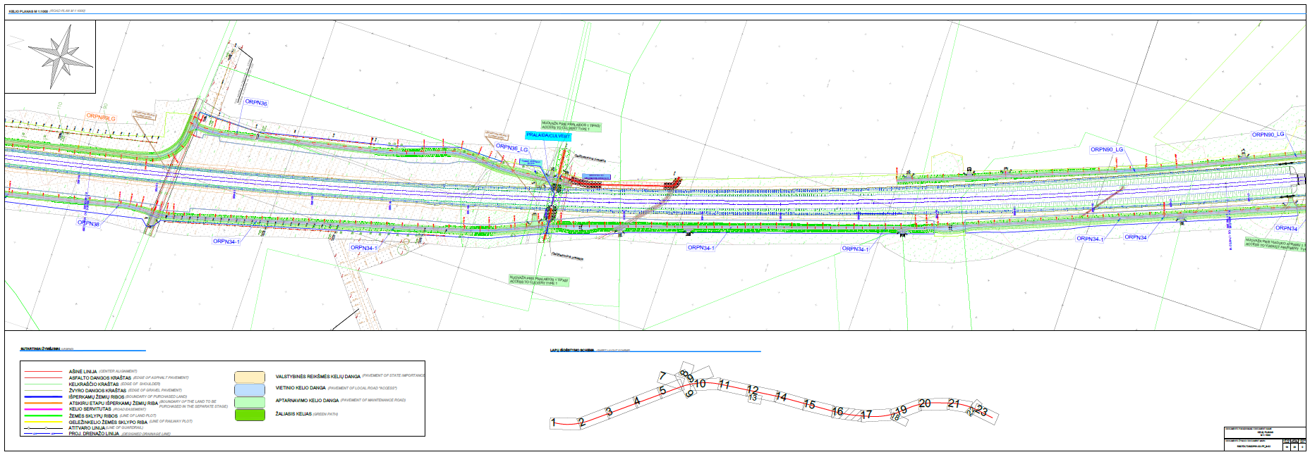
RAILWAY ALIGNMENT PLAN

Slide 22
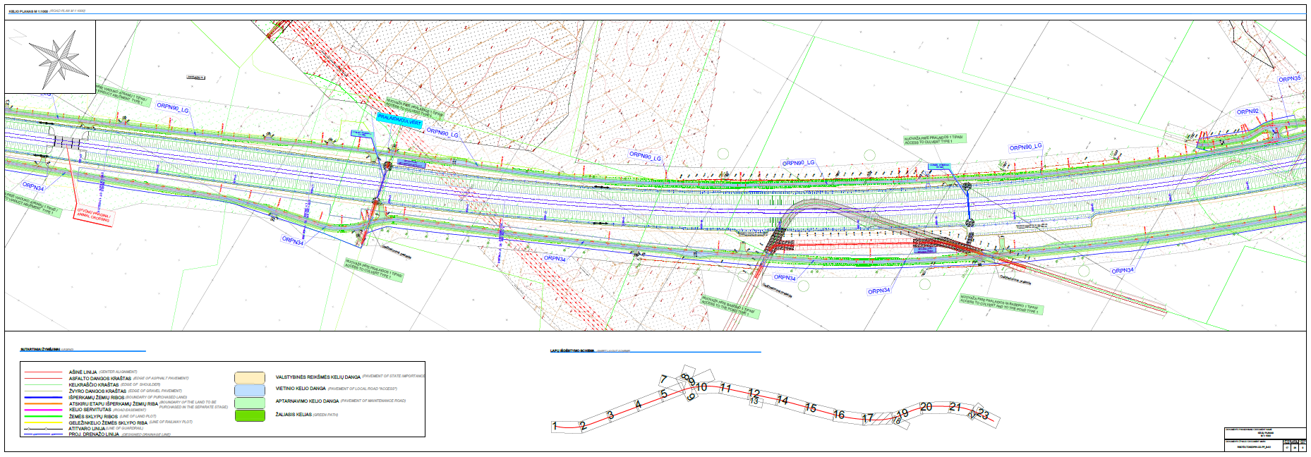
RAILWAY ALIGNMENT PLAN

Slide 23
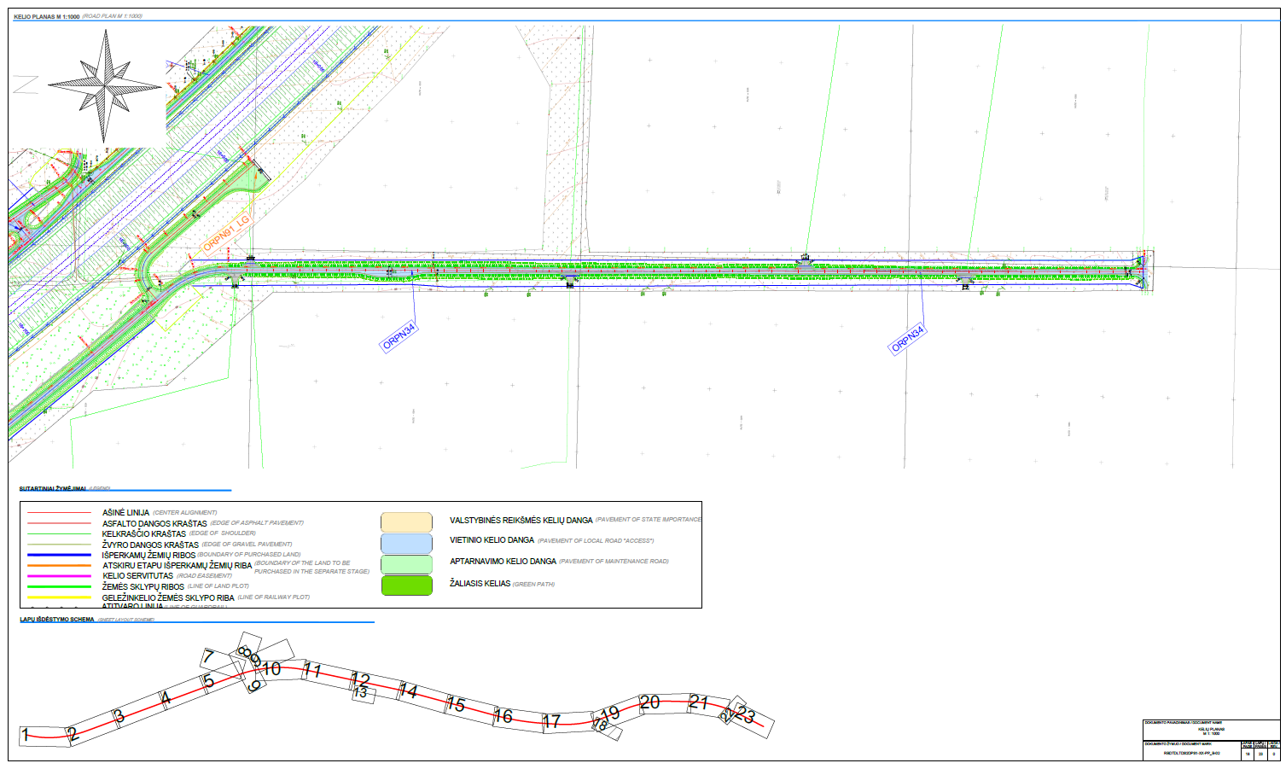
RAILWAY ALIGNMENT PLAN

Slide 24
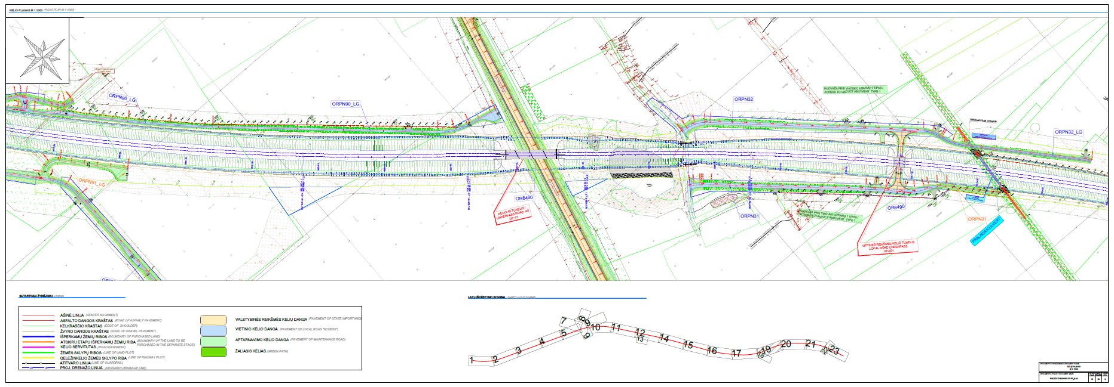
RAILWAY ALIGNMENT PLAN

Slide 25
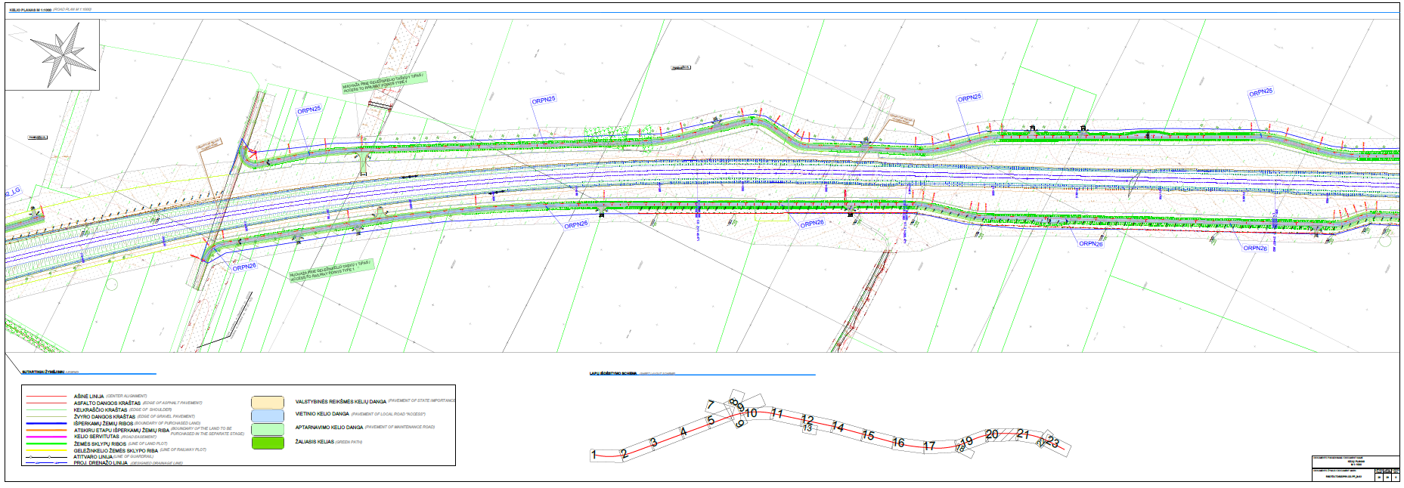
RAILWAY ALIGNMENT PLAN

Slide 26
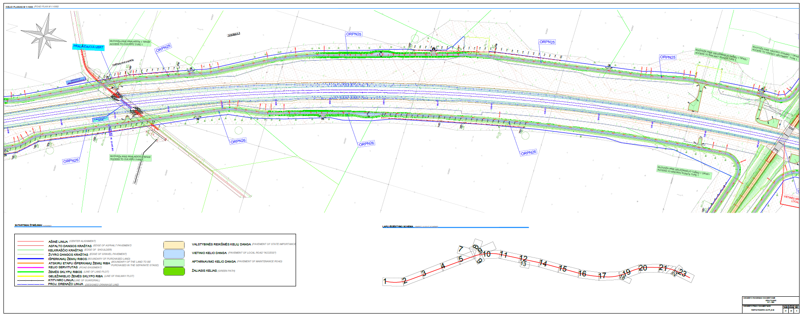
RAILWAY ALIGNMENT PLAN

Slide 27
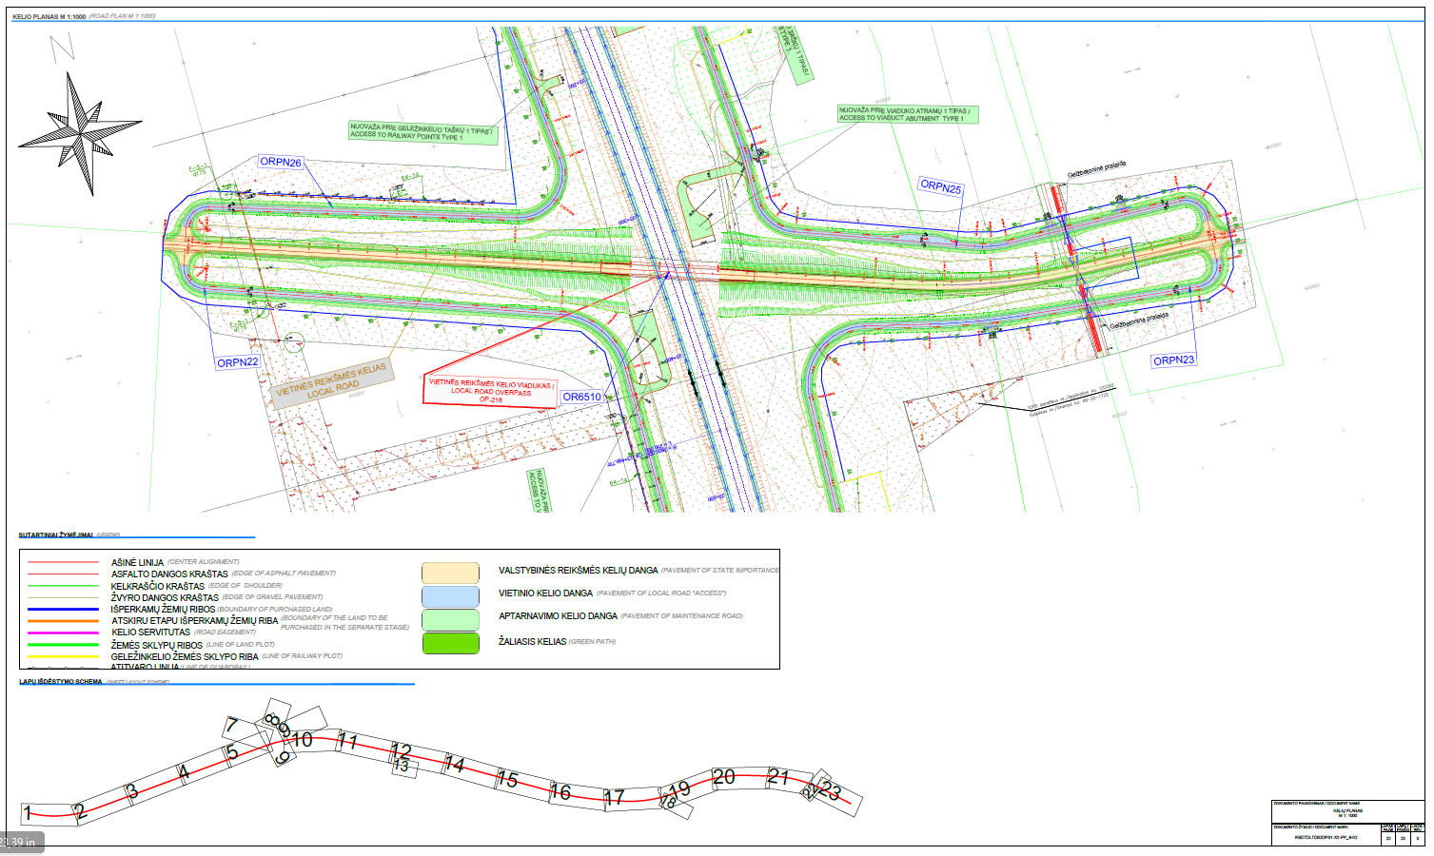
RAILWAY ALIGNMENT PLAN

Slide 28
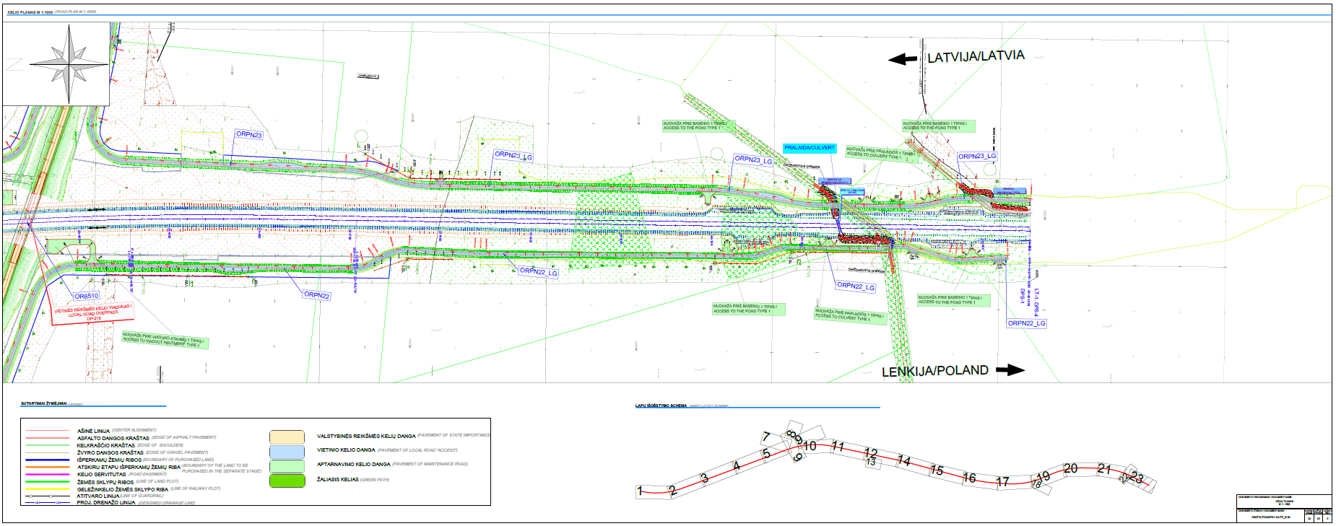
RAILWAY ALIGNMENT PLAN

Slide 29
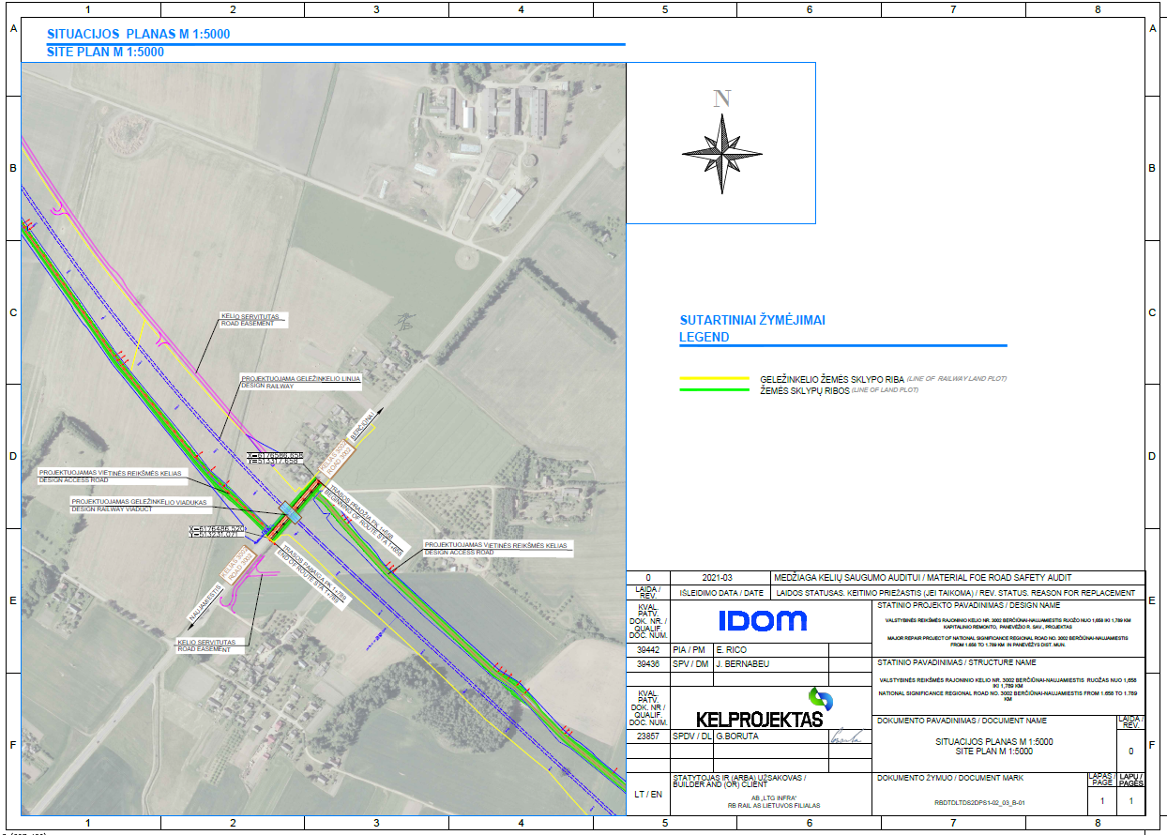
RAILWAY-ROAD NO.: 3002 CROSSING LOCATION PLAN
The railway line intersects with road no. 3002 Berčiūnai - Naujamiestis, in km 1+840.00 of the railway line
It is planned to install a railway viaduct at the intersection between railway and road.
It is planned to install connecting roads to provide access to enter railway terrain form road no.: 3002
Possibility of developing future pedestrian and bicycle traffic will be provided – requirement of Lithuanian Road Administration

Slide 30
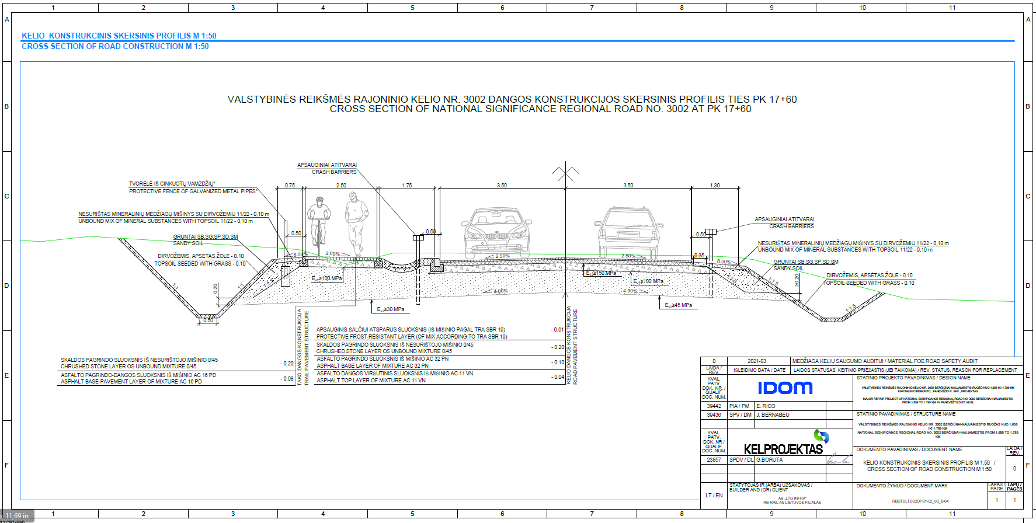
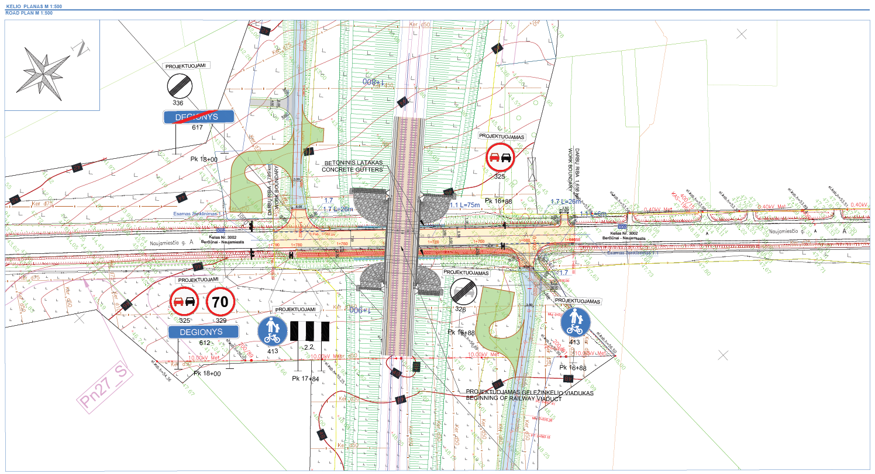
ROAD NO.: 3002
AND CROSS SECTION
ROAD PLAN
ROAD CROSS SECTION

Slide 31
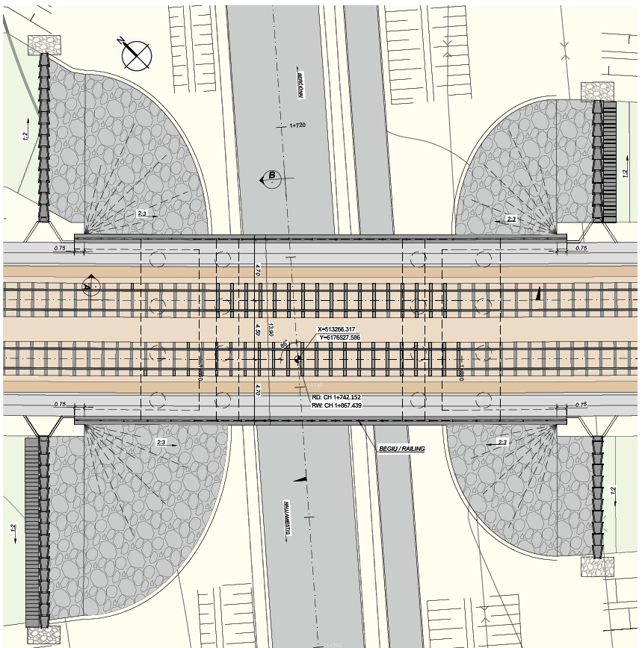
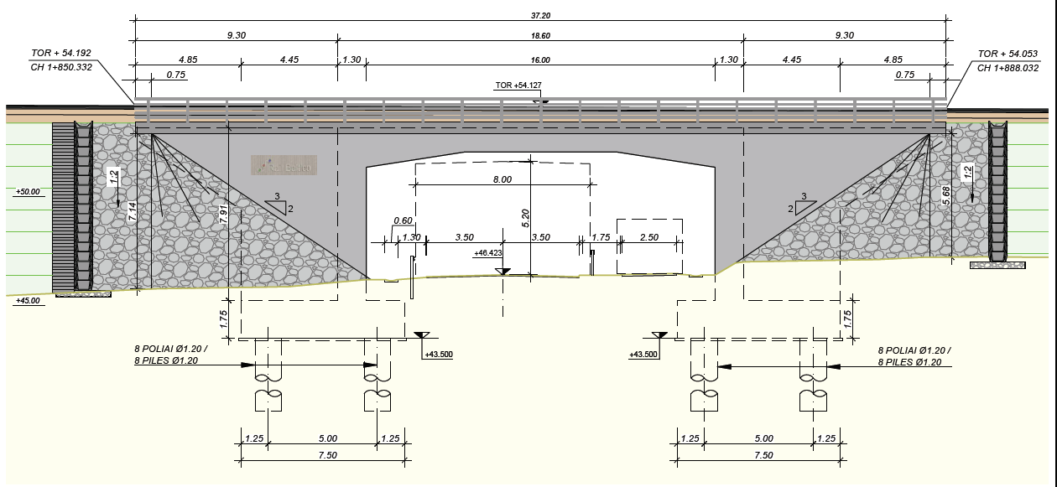
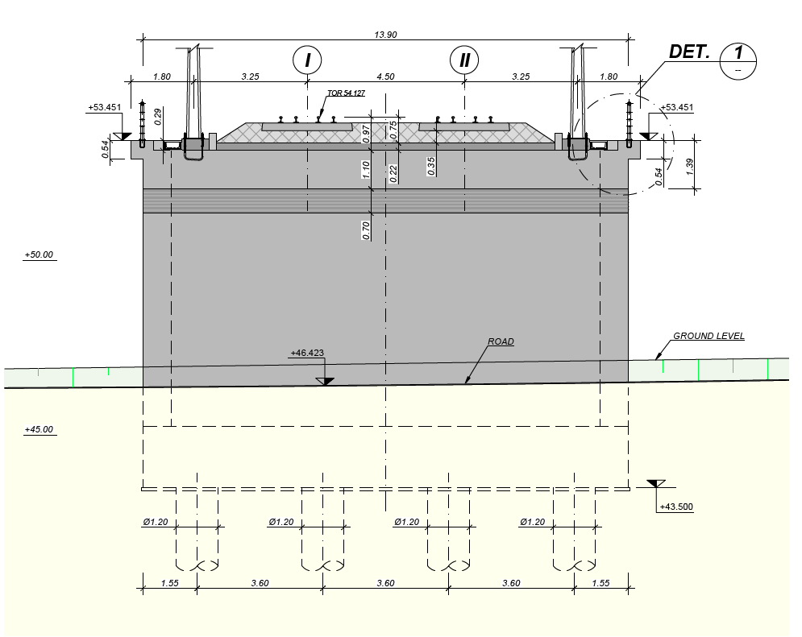
ROAD NO.: 3002 CROSS SECTION UNDER RAILWAY VIADUCT
ELEVATION 1
RAILWAY VIADUCT PLAN
CROSSSECTION OF RAILWAY VIADUCT

Slide 32
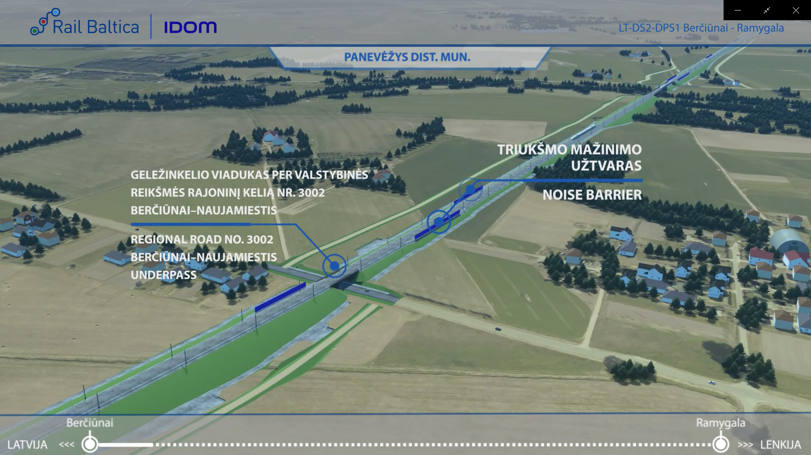
ROAD NO.: 3002-VISUALIZATION

Slide 33
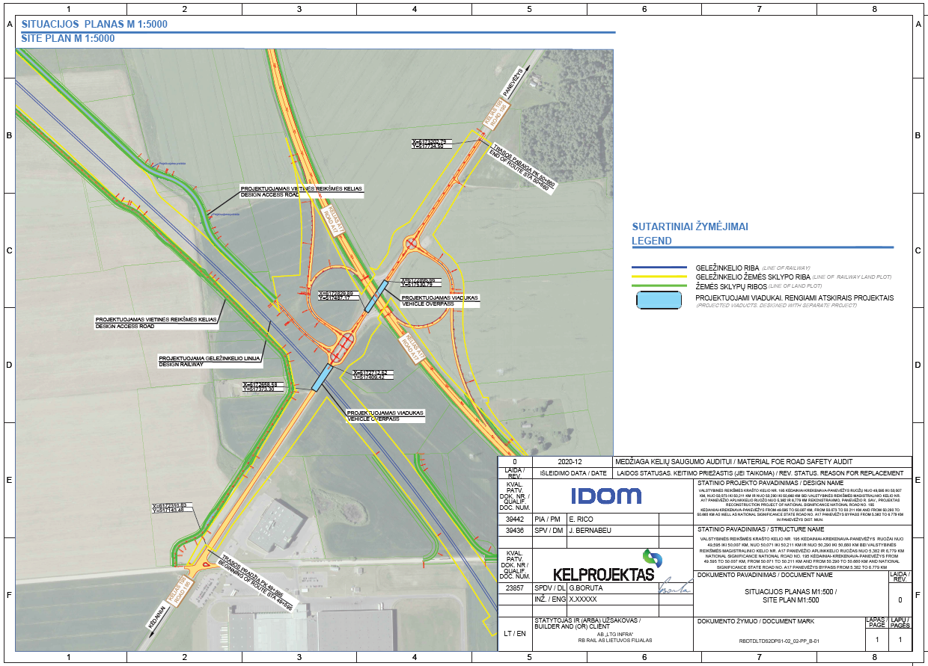
RAILWAY-ROAD NO.: 195,CROSSING LOCATION PLAN
The railway line intersects road no. 195 Kėdainiai – Krekenava – Panevėžys in km 7+500,00 of the railway line
It is planned to install a road viaduct at the intersection between railway and road.
It is planned to install connecting roads on both sides of the railway line to ensure the accessibility of private land plots.
No requirements about future bicycle or pedestrian traffic were provided by Lithuanian Road Administration.
To ensure safety for the users, the pedestrian path is separated from the district road by protective barriers.

Slide 34
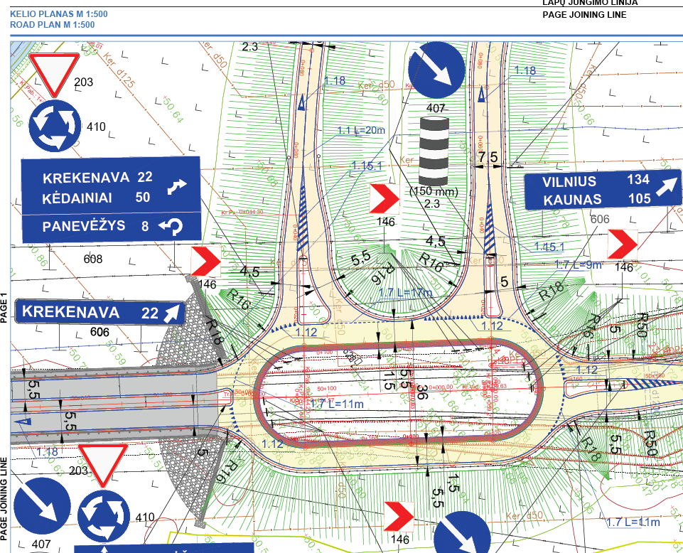
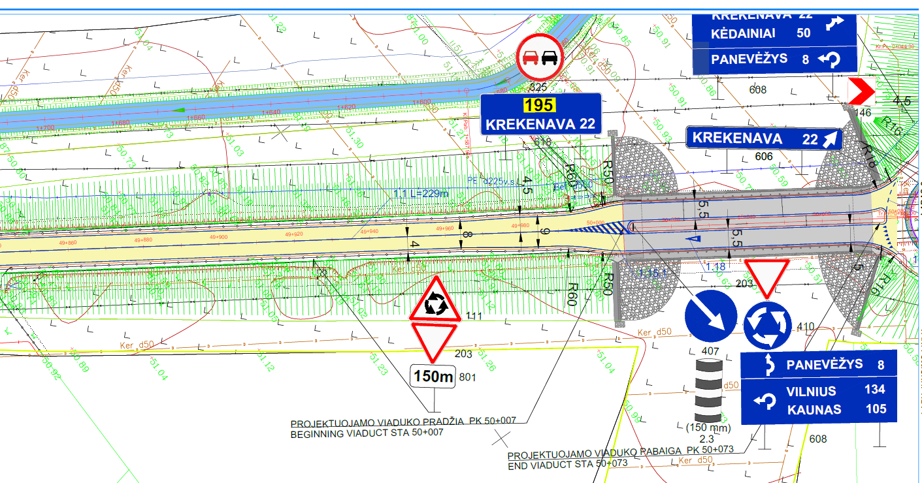
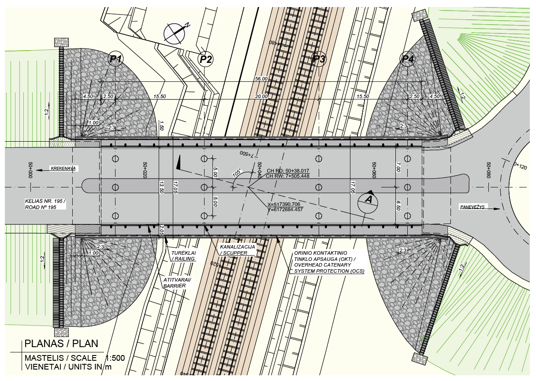
ROAD NO.: 195 PLAN AND CROSS SECTION
ROAD PLAN VIEW
ROAD VIADUCT IN PLAN VIEW

Slide 35
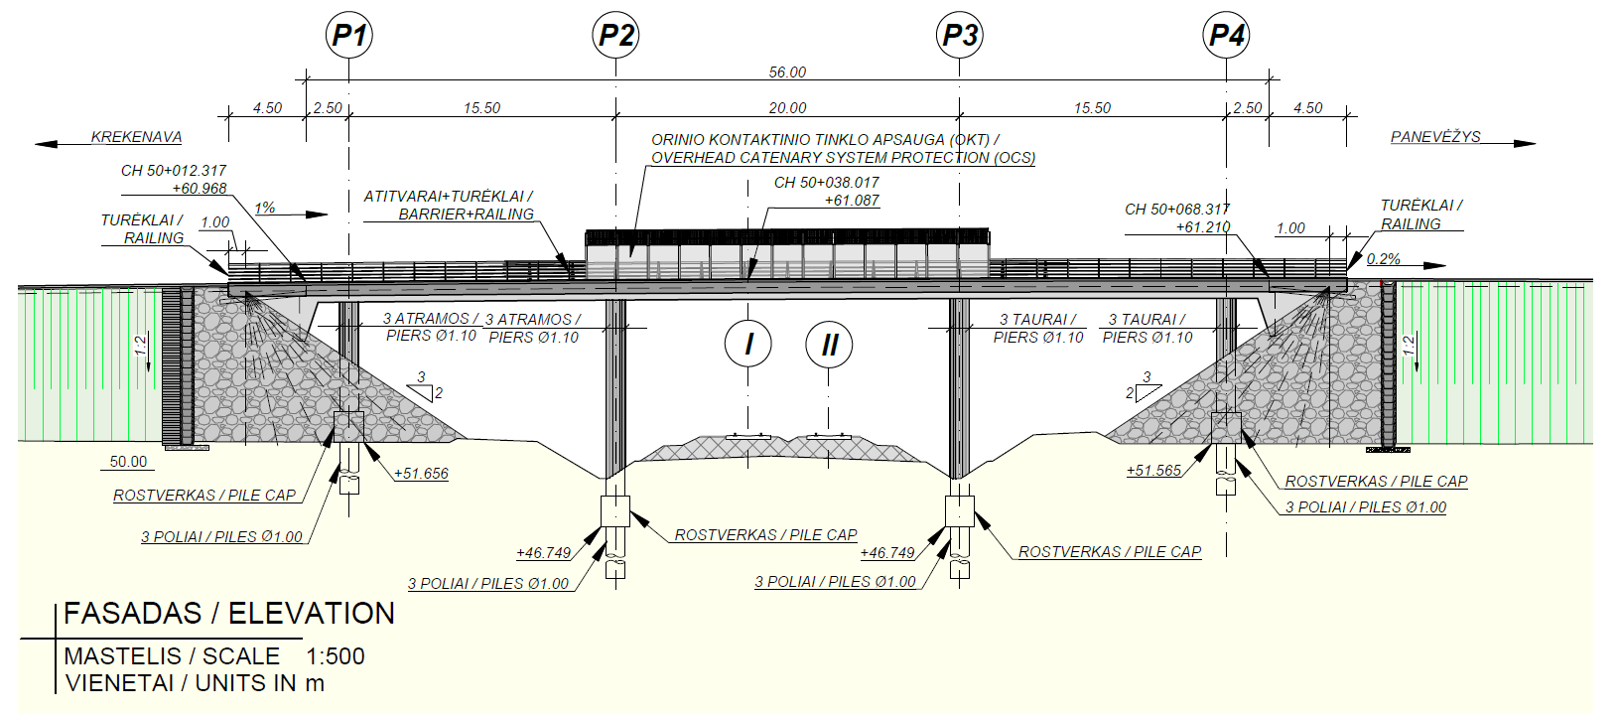
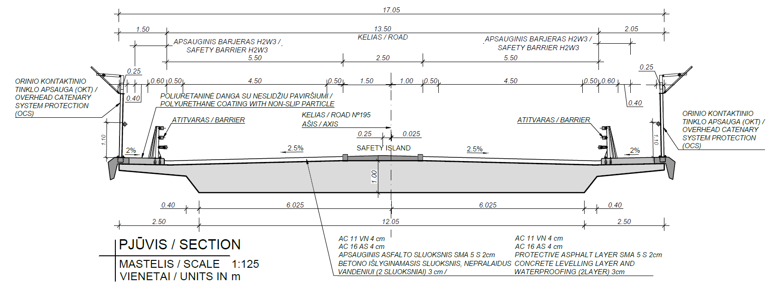
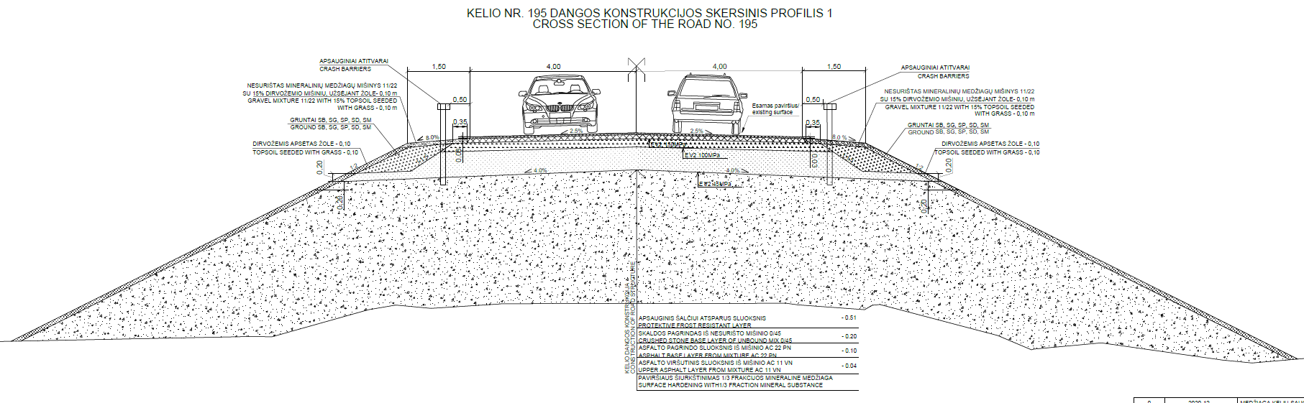
ROAD NO.: 195- OVERPASS ELEVATION AND CROSS SECTION
OVERPASS ELEVATION
ROAD CROSS SECTION ON VIADUCT
ROAD CROSS SECTION ON EMBANKMENT

Slide 36
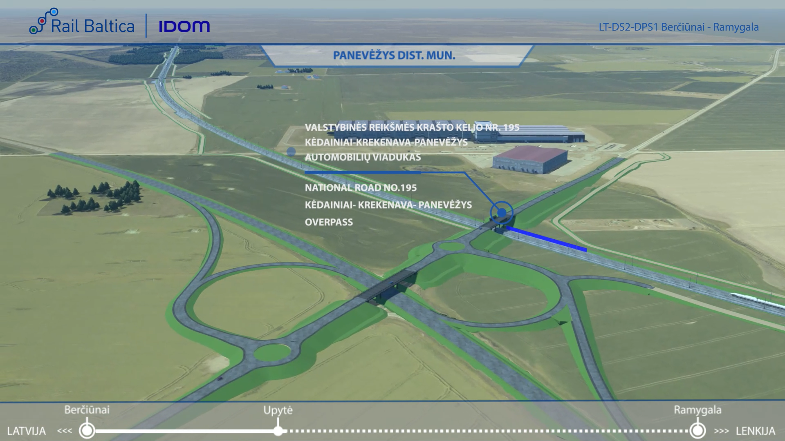
ROAD NO.: 195-VISUALIZATION

Slide 37
RAILWAY-ROAD NO.: A17 CROSSING LOCATION PLAN
The railway line intersects road no. A17 highway - Panevėžio aplinkkelis in km 7+500,00 of the railway line
It is planned to install a road viaduct at the intersection between railway and road.
It is planned to install connecting roads on both sides of the railway line to ensure the accessibility of private land plots.
No requirements about future bicycle or pedestrian traffic were provided by Lithuanian Road Administration.
To ensure safety for the users, the pedestrian path is separated from the highway road by protective barriers.

Slide 38
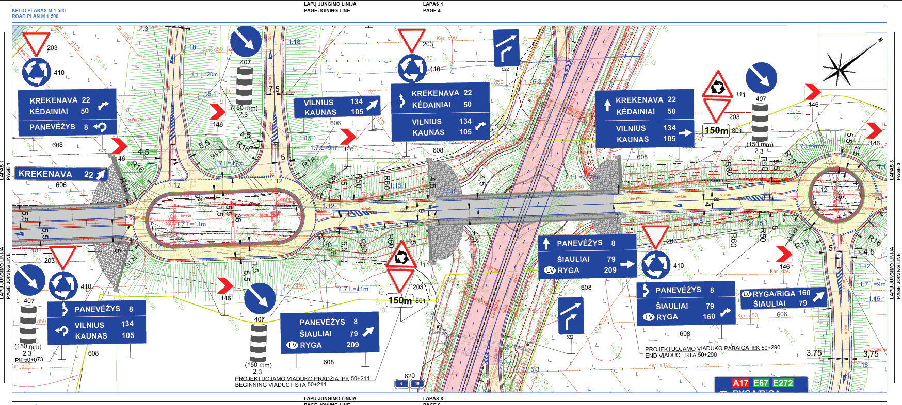
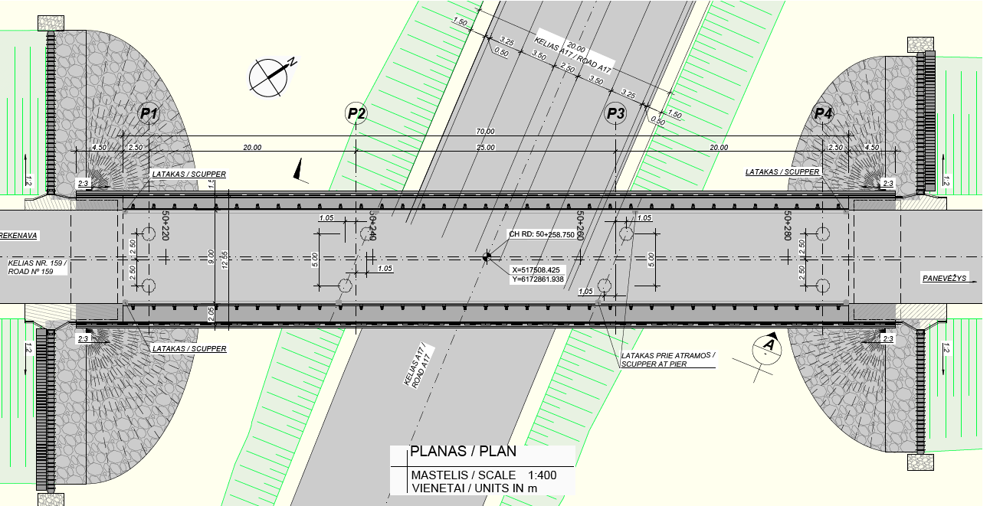
ROAD NO.: A17 PLAN AND CROSS SECTION
ROAD PLAN
OVERPASS PLAN

Slide 39
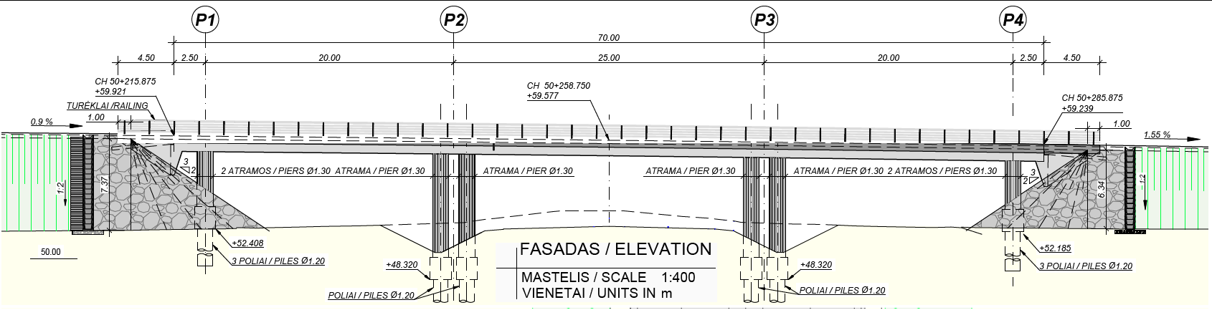
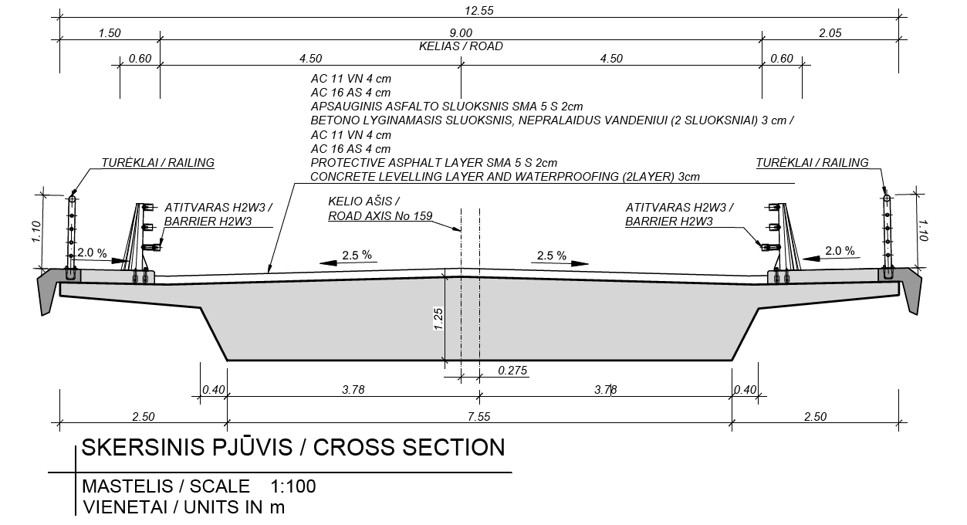
ROAD NO.: A17- OVERPASS ELEVATION AND CROSS SECTION
OVERPASS ELEVATION
ROAD CROSS SECTION ON VIADUCT

Slide 40
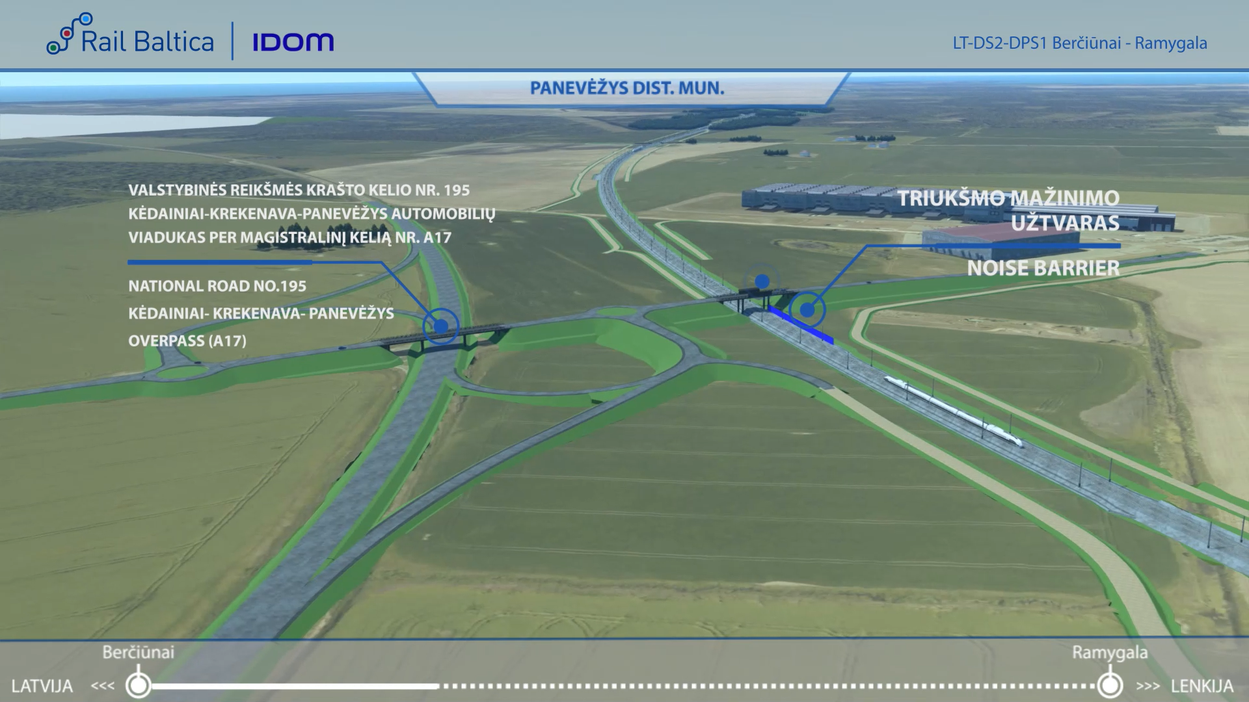
ROAD NO.: A17-VISUALIZATION

Slide 41
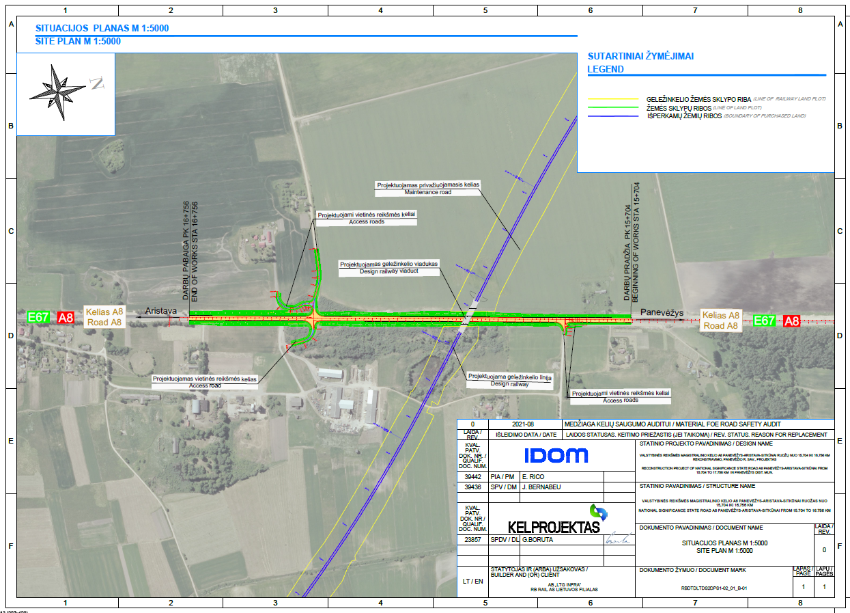
RAILWAY-ROAD NO.: A8 CROSSING LOCATION PLAN
The railway line intersects road no. A8 Panevėžys – Aristava – Sitkūnai, the section form km 15+704 to km 16+756.
It is planned to install a railway viaduct at the intersection between railway and road.
It is planned to install connecting roads on both sides of the railway line to ensure the accessibility of private land plots.
No requirements about future bicycle or pedestrian traffic were provided by Lithuanian Road Administration.
To ensure safety for the users, the pedestrian path is separated from the district road by protective barriers.

Slide 42
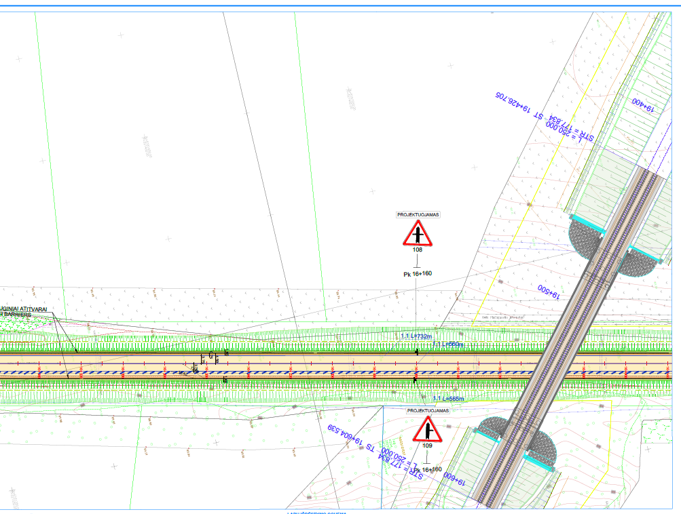


ROAD NO.: A8 PLAN AND CROSS SECTION
ROAD PLAN
RAILWAY VIADUCT IN PLAN VIEW

Slide 43



ROAD NO.: A8- OVERPASS ELEVATION AND CROSS SECTION
RAILWAY VIADUCT ELEVATION
CROSS SECTION ON VIADUCT
ROAD CROSS SECTION ON EMBANKMENT

Slide 44

ROAD NO.: A8-VISUALIZATION

Slide 45
ENVIRONMENTAL PROTECTION MEASURES
No Natura 2000 sites have not been identified along this stretch
Migration studies were conducted during the research phase - in accordance with the results, 1 green bridges (ecoduct)
Several noise mitigation measures are proposed in the vicinity of settlements:
Noise reduction barriers;

Slide 46


NOISE MITIGATION MEASURES
Residential area | Location | Noise mitigation measure
Panevėžys district municipality | 1+785 – 1+840, left side 1+972 – 2+060, right side 2+074 – 2+150, left side 3+052 – 3+137, left side 3+062 – 3+190, right side 3+488 – 3+577, left side 3+957 – 4+057, left side 7+400 – 7+500, right side | Noise Barriers
Example of Noise barrier
Example of Noise barrier

Slide 47
QUESTIONS?

Slide 48
THANK YOU

