Slide 1
Briefing on the submission of the Application
Procurement of Consolidated supply of railway ballast for Rail Baltica railway construction,
RBR 2022/14
Elīna Saule, Procurement specialist - lawyer, RB Rail AS
Jānis Lukševics, Senior Procurement Specialist, RB Rail AS
17.08.2022.

Slide 2
Agenda
Information on the published Procurement exercise;
Registration in the E-Tenders system (available user manuals);
Changes made after termination of the previously announced procurement;
Introduction to the Qualification stage regulations;
Procurement Q&A process;
Submission of the Application;
FAQ;
Answers to the questions from the participants.

Slide 3
Description of the subject-matter
What are we buying?
Railway ballast produced according to EN 13450. The Assessment and Verification of Constancy of Performance (AVCP) level of the production shall be 2+.
Property | Reference | Category (requirement)
Grading | EN 13450, Clause 6.3 | Category F (31,5 to 63 mm)
Fines content | EN 13450, Clause 6.5 | Category A (0,5%)
Shape index | EN 13450, Clause 6.6.2 | SI₂₀
Particle length | EN 13450, Clause 6.7 | Category D (12%)
Resistance to fragmentation | EN 13450, Clause 7.2 | LA_{RB} 16
Resistance to wear | EN 13450, Clause 7.3 | MDE_{RB} 11
Resistance to freezing and thawing (assessed based on water absorption) | EN 13450, Clause 7.4.3 | WA_{cm} 0,5
Sonnenbrand | EN 13450, Clause 7.5 | No signs of Sonnenbrand are allowed
Note: candidate can prove supplying experience with supplied materials produced according to one or several following standards EN 13450, EN 13043, EN 12620, EN 13242, EN 13285 or equivalent proving compliance with AVCP level 2+ as minimum.
Notes:
Rail Baltica is procuring consolidated supply of railway ballast that is produced according to European standard 13450 (thirteen thousand four hundred and fifty) with assessment and verification of constancy of performance level of 2+.
Detail technical specification can be found in tender regulation annex 2.2.
Important note: to qualify for procurement 1st stage candidate can prove supplying experience with supplied aggregates that are produced according to European standards with assessment and verification of constancy of performance level of 2+ as minimum.

Slide 4
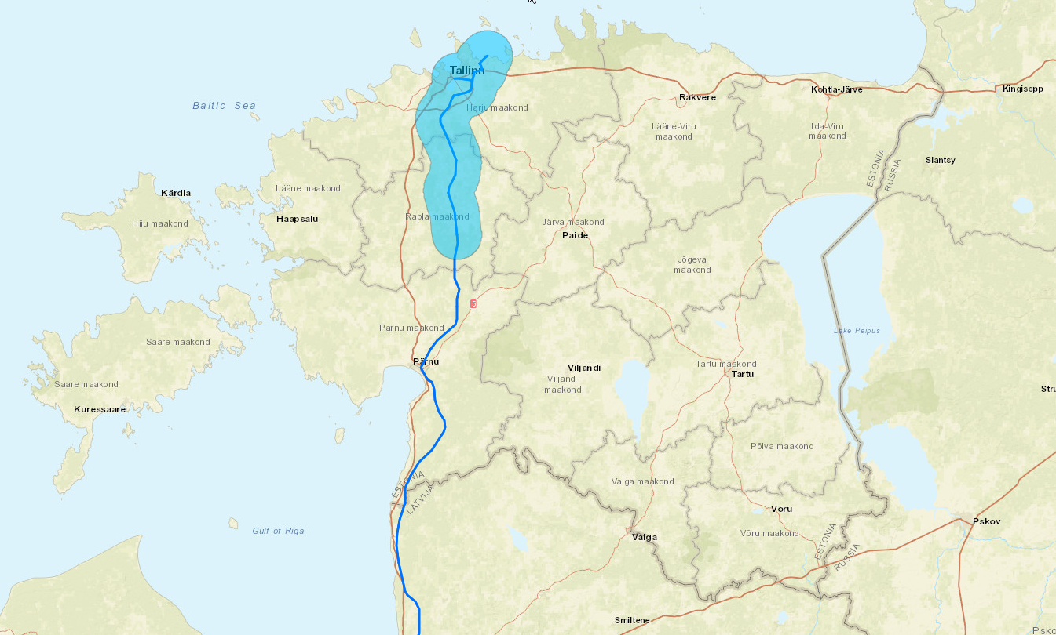
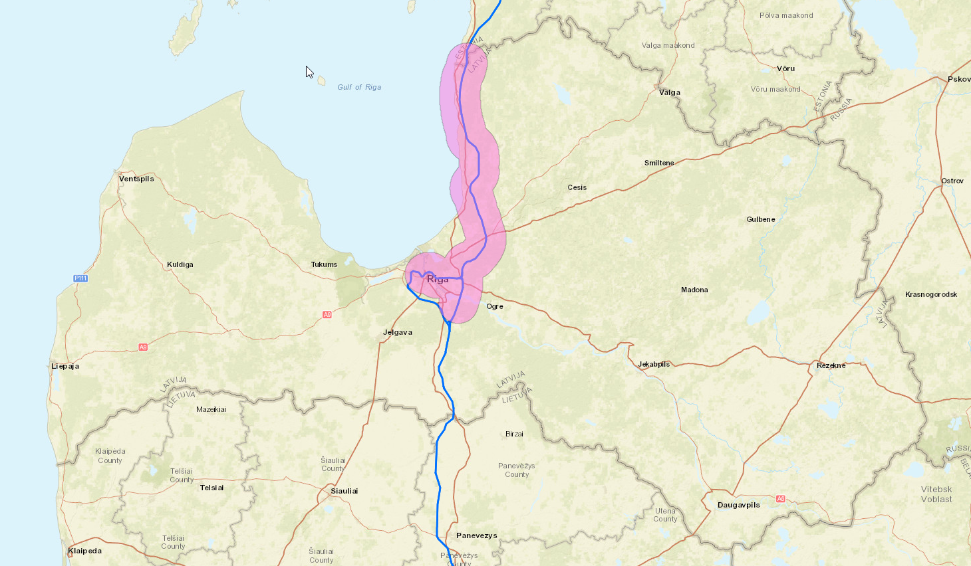
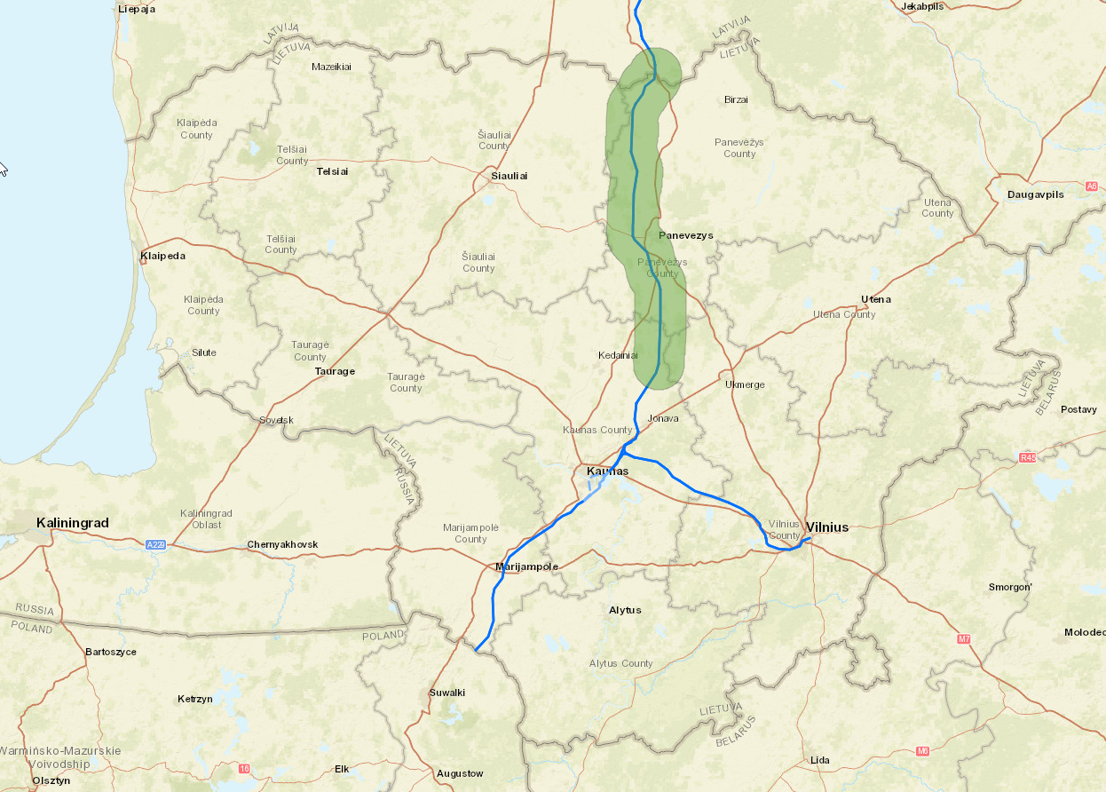
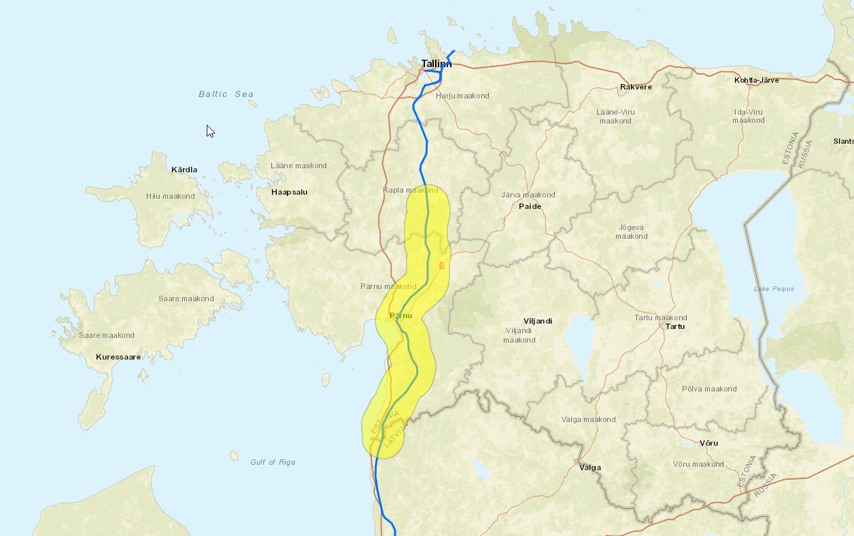
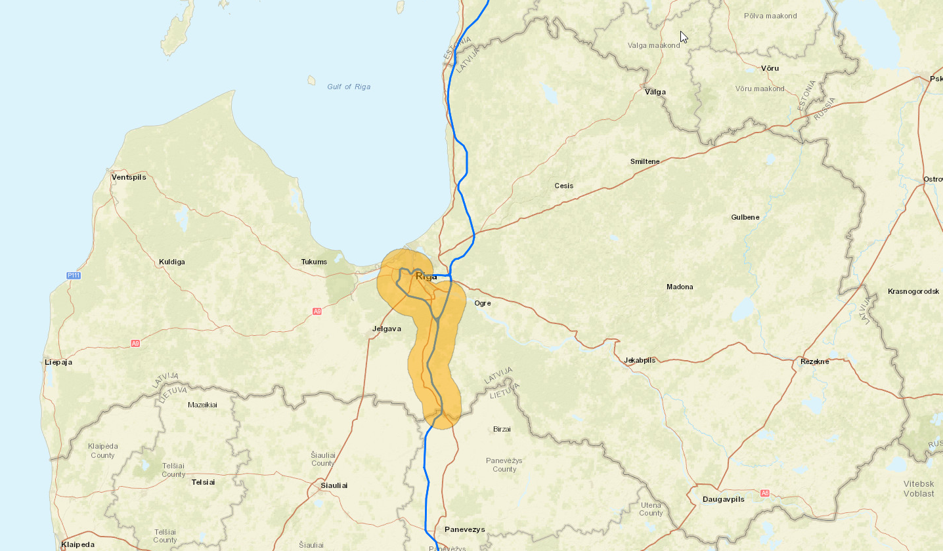
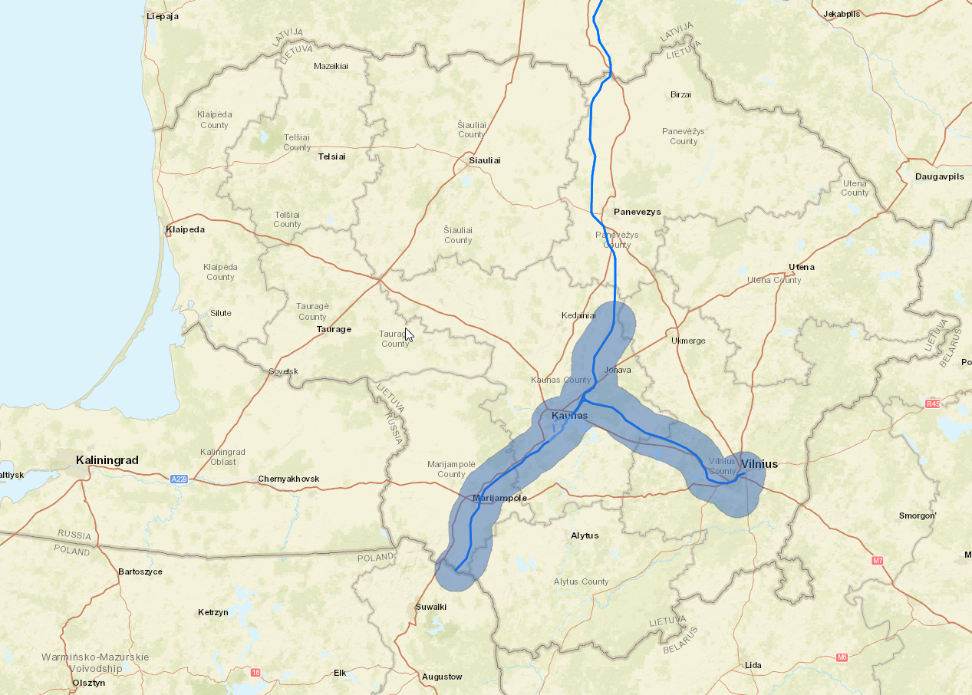
Description of Lots
Estonia
Latvia
Lithuania
Lot 1: Tallinn region
Lot 4: Skulte region
Lot 5: Panevežys region
Lot 2: Pärnu region
Lot 3: Iecava region
Lot 6: Kaunas region
Notes:
Procurement of consolidated supply of railway ballast for Rail Baltica railway construction is divided in 6 lots (2 lots for each of Baltic state). Each lot represent region where deliveries can take a place.
In these maps you can see very approximate region, where material bases (delivery locations) will be located. These maps are only visualizations for the explanatory purpose.

Slide 5
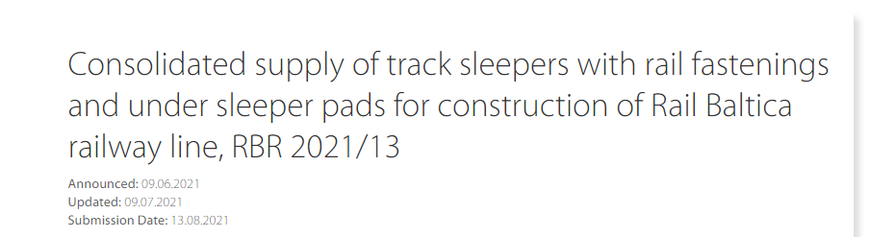
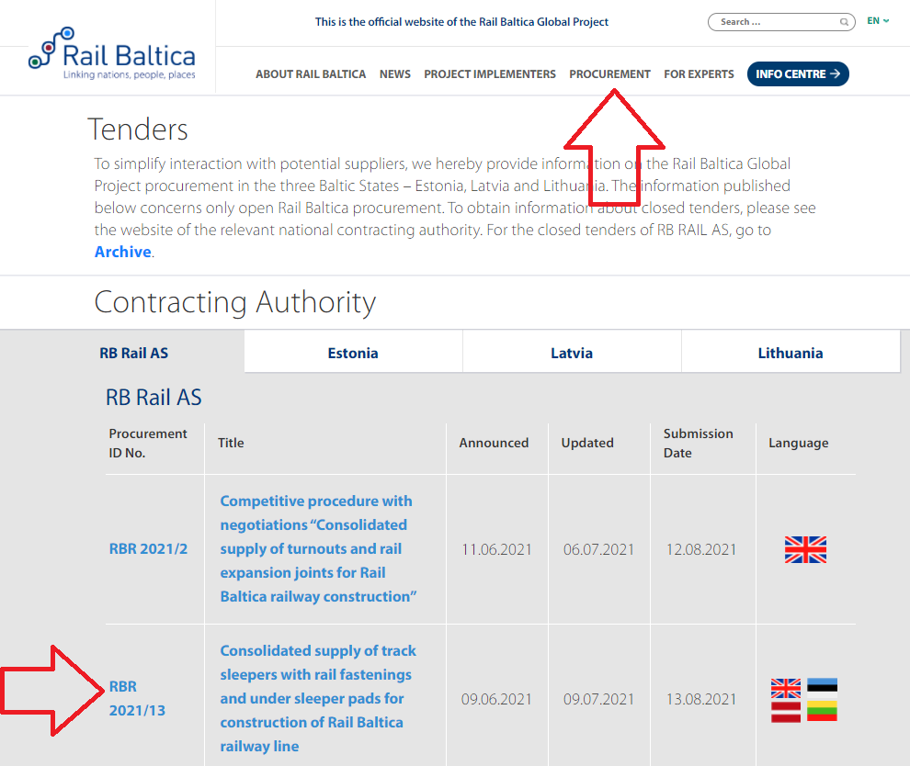
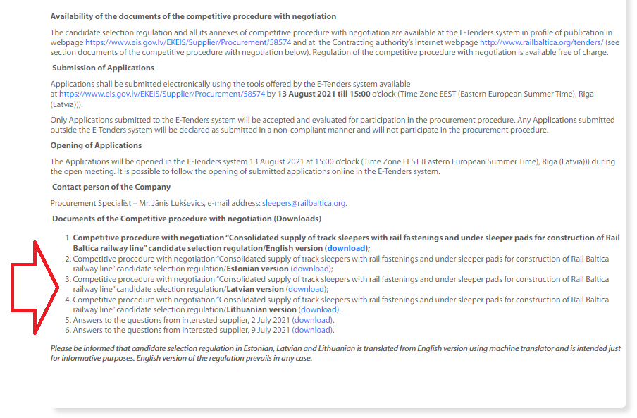
Where to find the information
www.railbaltica.org/tenders

Slide 6
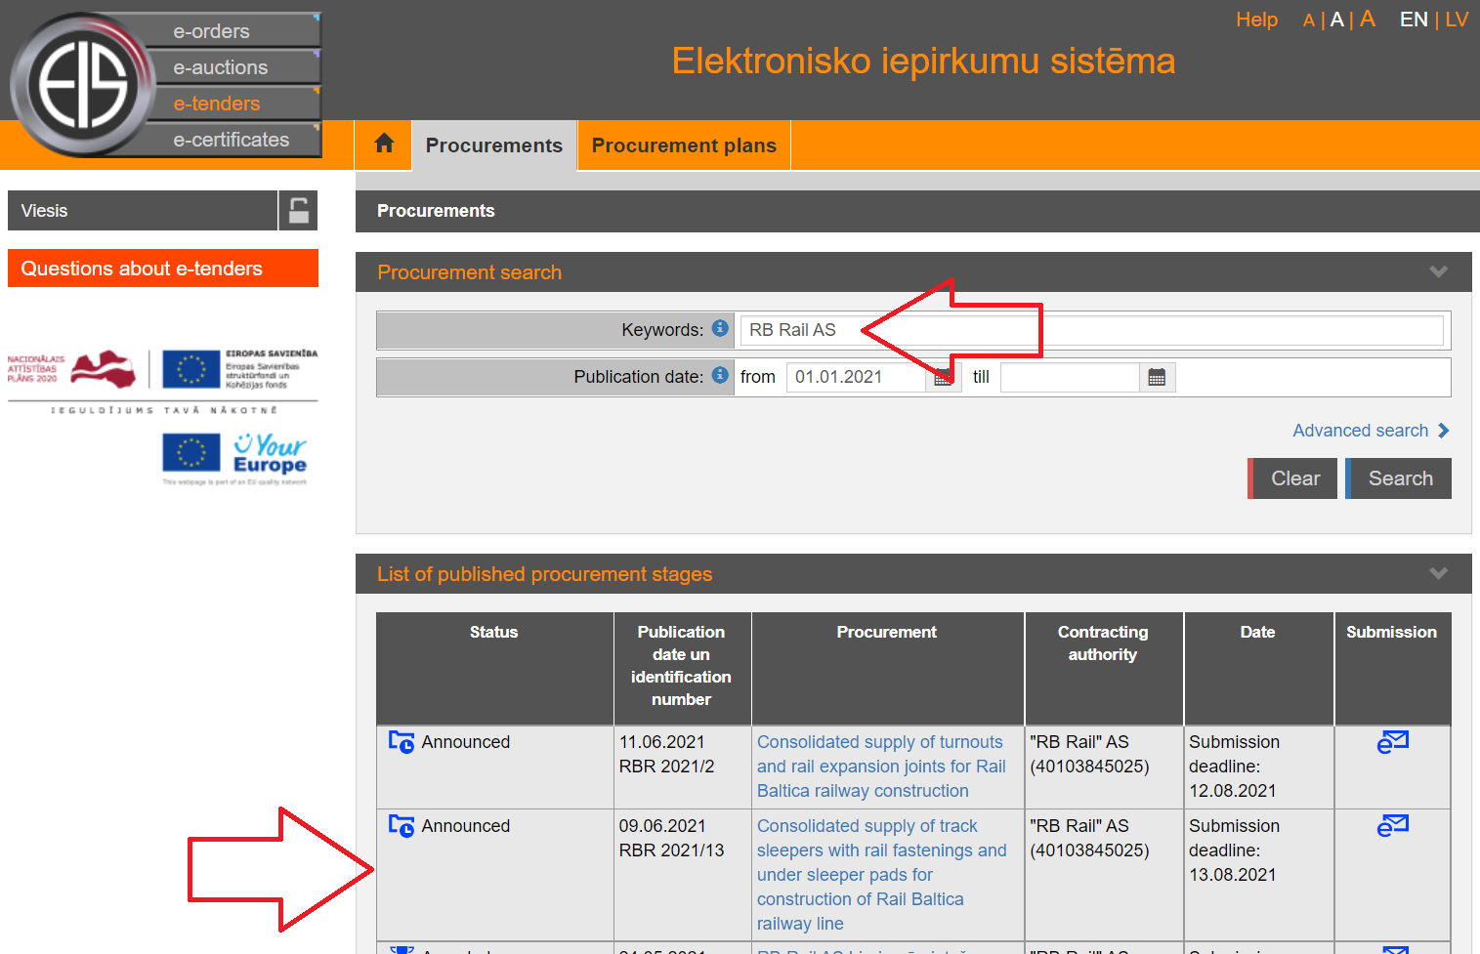
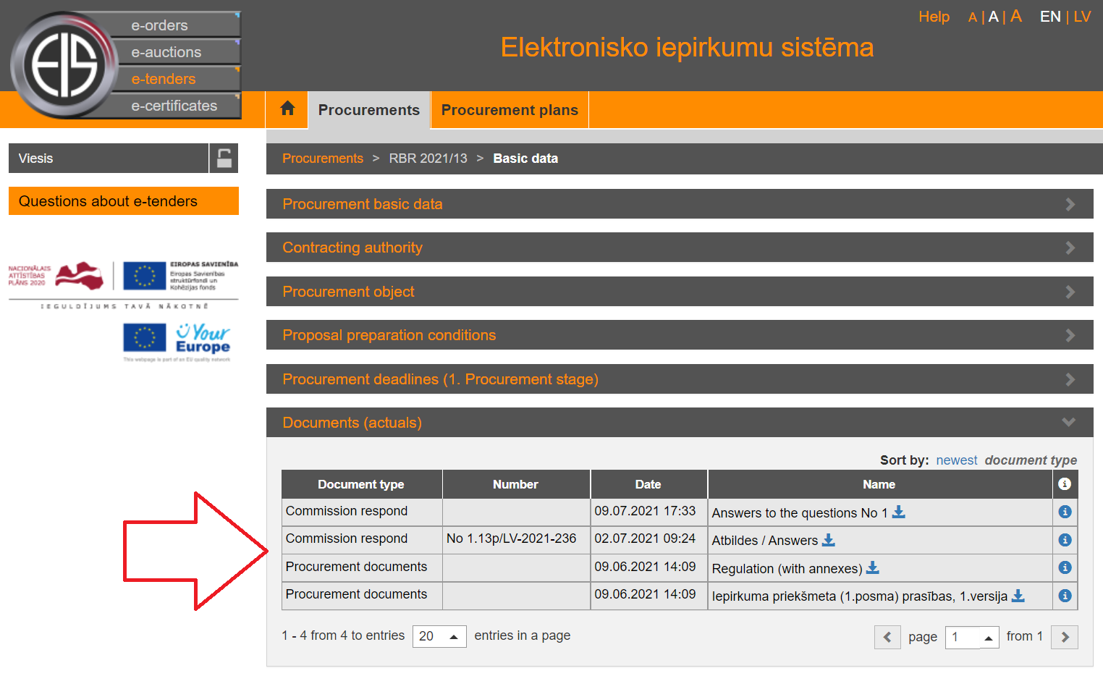
Where to find the information
https://www.eis.gov.lv/EKEIS/Supplier

Slide 7
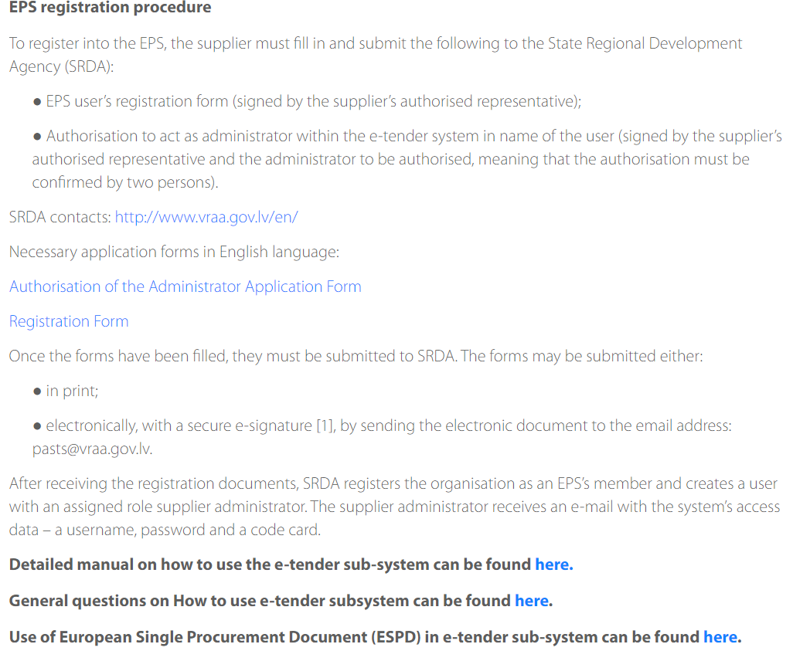
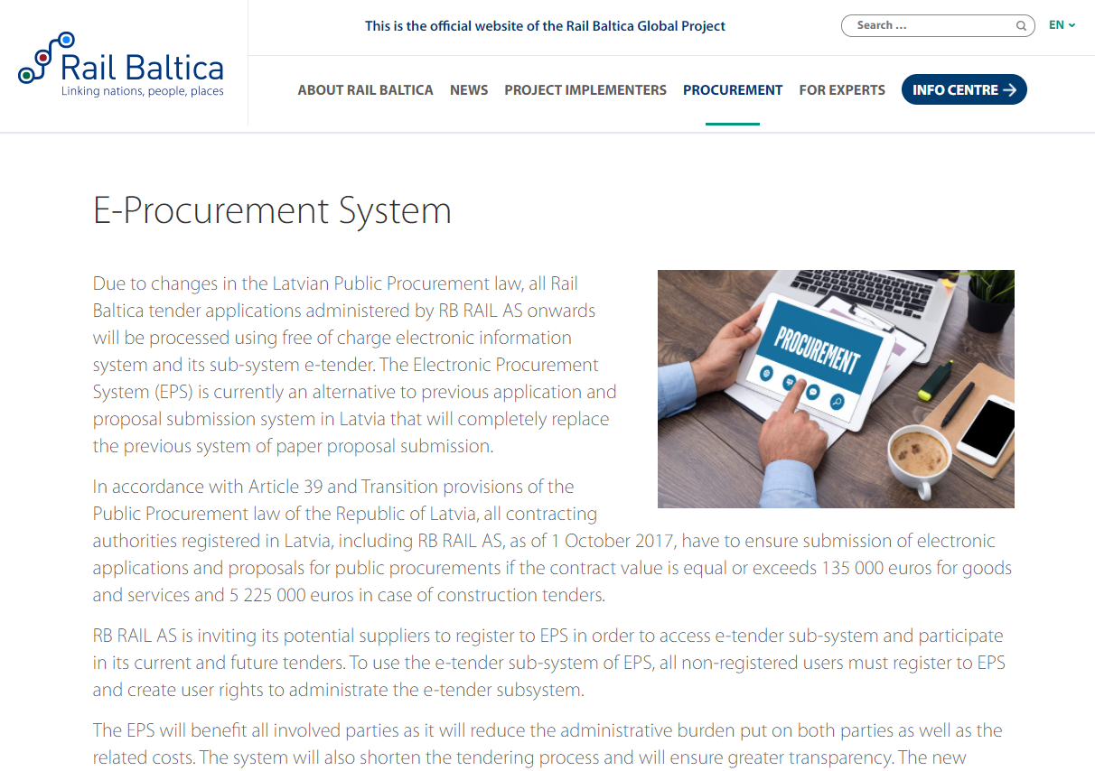
Registration in E-Tenders system

Slide 8
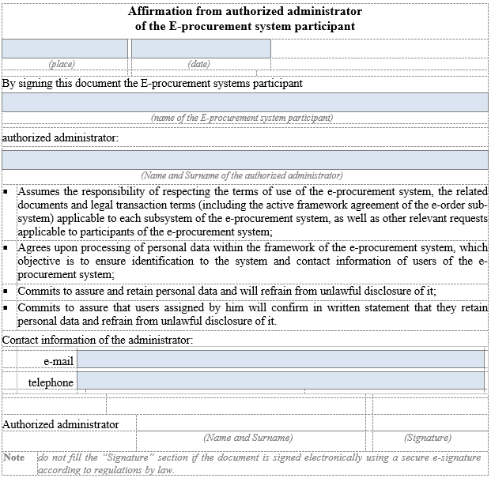
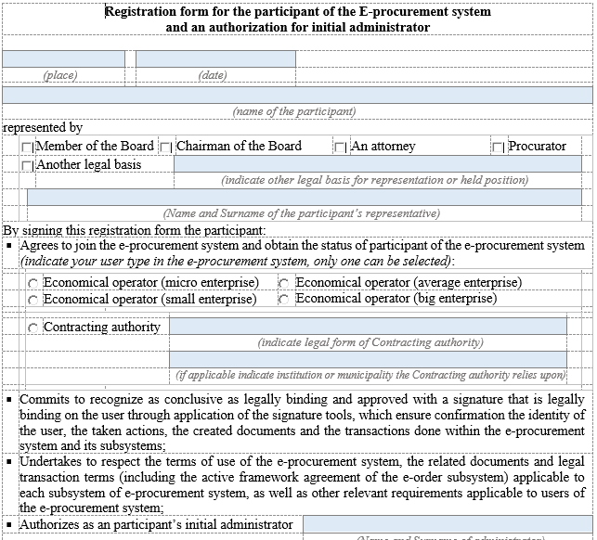
Registration in E-Tenders system
Two registration forms must be submitted to State Regional developement agency
To Assign the administrator of the of the Profile
Registration of the Company in E-Tender system
Electronically signed and sent to email address: pasts@vraa.gov.lv

Slide 9
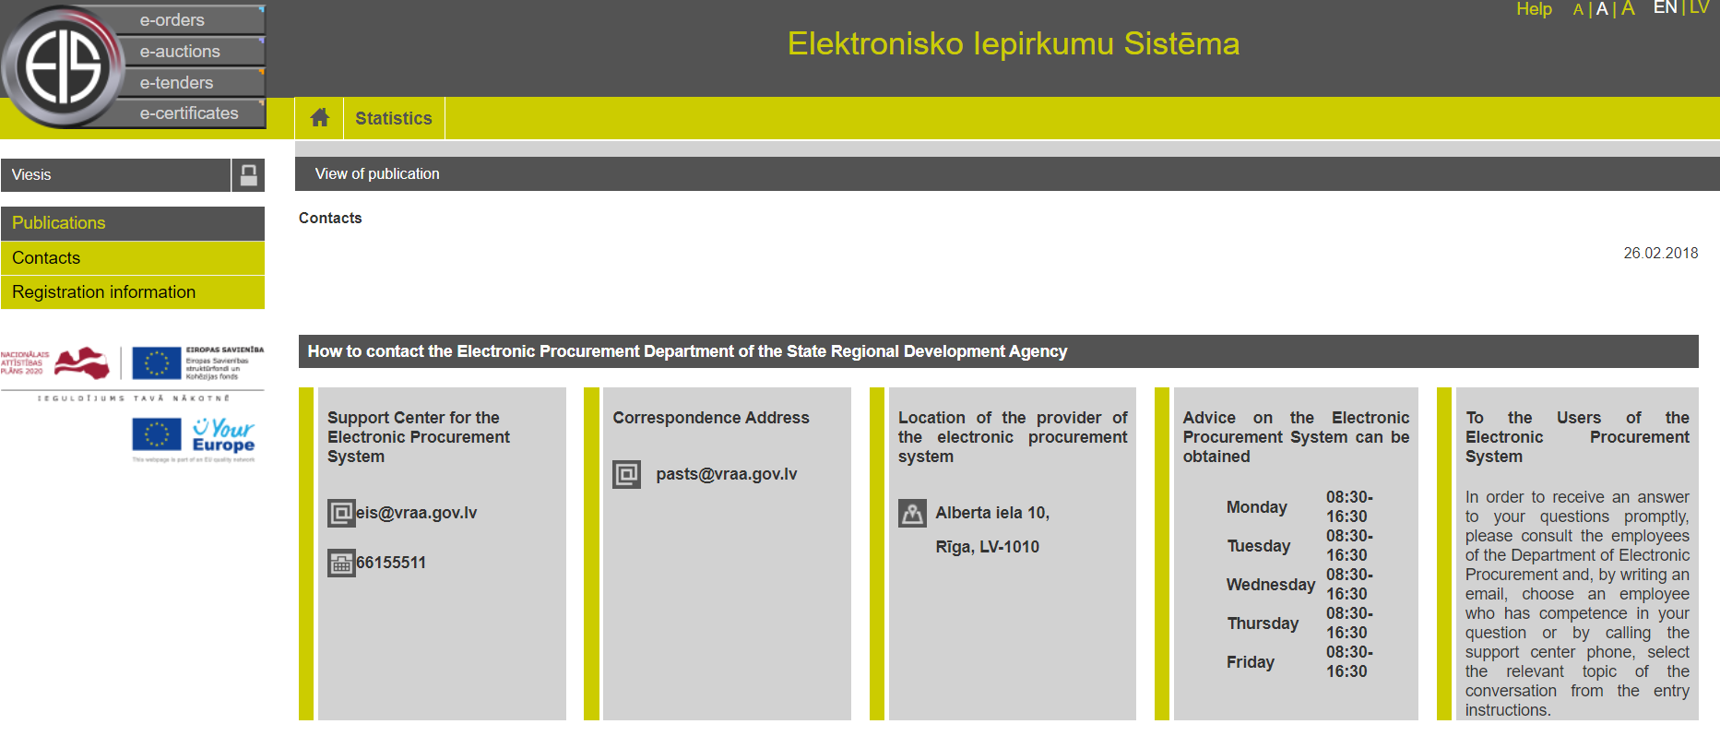
Registration in E-Tenders system
1) Please register as soon as possible;
2) Please specify in registration form e-mail address were incomming mails are checked regulary and check also spam folder before your registration is approved.
3) If you have any problems with registration or any other questions regarding EPS and E-Tenders subsystem, please contact:

Slide 10
Registration in E-Tenders system
If you have any problems with registration in EPS and E-Tenders subsystem, you may contact directly to:
Senior Consultant
Zigurds Drafens
zigurds.drafens@vraa.gov.lv
tel. +371 67509520
Advice on joining the e-Procurement system and updating user access data

Slide 11
Registration in E-Tenders system
Most frequent questions regarding registration of group of suppliers:
Q: Which companies shall be registered as users of E-Tenders system in order to submit Application/ Proposal if the Candidate or tenderer is a group of suppliers?
A: If the candidate is a partnership (consisting of several companies which have made commitment to submit application or proposal jointly):
All members may register as users of E-Tenders system and submit application jointly;
Partnership may authorize one member to submit application/ proposal on behalf of the partnership (partnership agreement must be concluded and attached);
If the candidate is just relying on capabilities and capacity of other entities in order to meet any of qualification requirements or involve sub-contractors, these entities shall not be registered as users of E-Tenders system.

Slide 12
Changes made in the re-launched procurement
Requirement
Requirement
1) Quality Management standards
The manufacturer of the products shall have valid quality management system that complies with ISO 9001:2015/ISO 14001:2015 standard or equivalent and which is approved by competent and independent authority.
2) Technical and professional ability
The Candidate shall have right, capabilities and capacity to supply ballast according to the requirements specified in Annex No 2 of Regulation for respective region (Latvia, Lithuania or Estonia) according to relevant lot where Candidate has applied).
Requirements regarding quality management standards and technical and professional ability have been removed from the Regulations. These changes will ease the submission of the necessary documentation for involved manufacturers.
*Please see published Q&A in RB Rail homepage.

Slide 13
Introduction of the Qualification stage regulations
Regulation
1. General information
  Procurement Procedure: Competitive procedure with negotiation
  The Competition consists of two stages:
    Stage One (qualification) – selection of the Candidates.
    Stage Two (proposals) – submission of initial proposal(s) of the qualified Candidates and negotiations, submission of final proposal(s) and awarding of Framework agreement.
    The subject-matter of the Competition – consolidated supply of ballast for construction of Rail Baltica railway line.
    General description of the subject-matter of the Competition is included in Annex No 2 “General description of the subject matter” to the Regulation for the Selection of the Candidates. During the stage of the Selection of the Candidates, General description of the subject matter is given for informative purposes only.
    Detailed description of the subject-matter of procurement will be issued to the Candidates, which will be selected for participation in the Stage Two of the Competition.

Slide 14
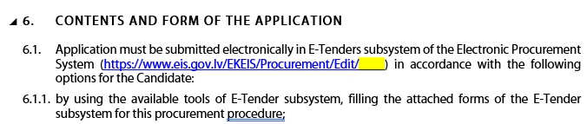
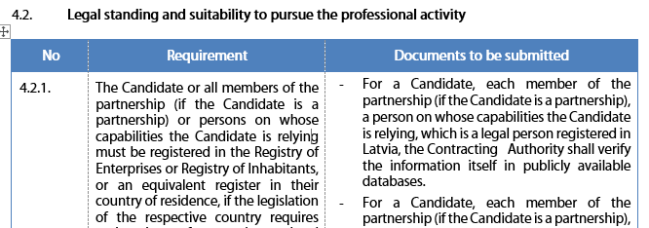
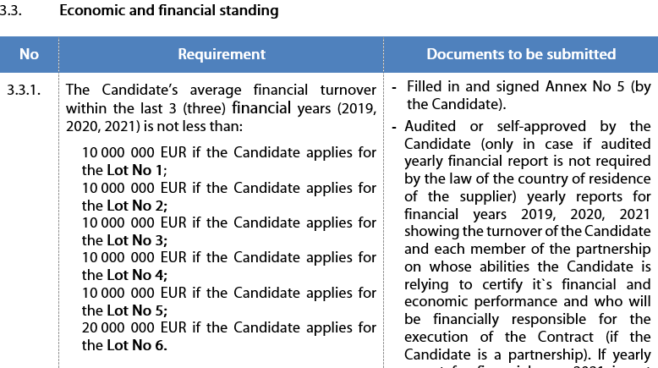
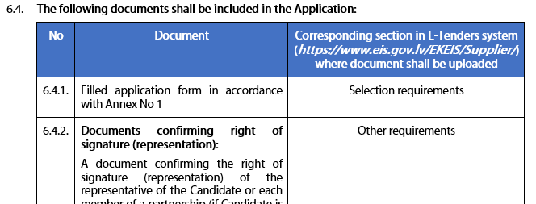
Introduction of the Qualification stage regulations
Regulation
2. information ABOUT the stage two of the Competition and the contract
4. Selection criteria for the CANDIDATES
4.1. Exclusion grounds (will be verified according to Section 10.2.3. of Regulation)

Slide 15
Information in the application/ proposal
Use the forms which have been provided in the procurement regulations (usually annexes regarding supplier experience, experts experience, financial standing etc.)
Annexes are prepared and structured in a way to assist the supplier in the preparation of all requested information and not to miss some information.
Consider the requirement included in the procurement regulations and describe the compliance at least in the same detail.

Slide 16
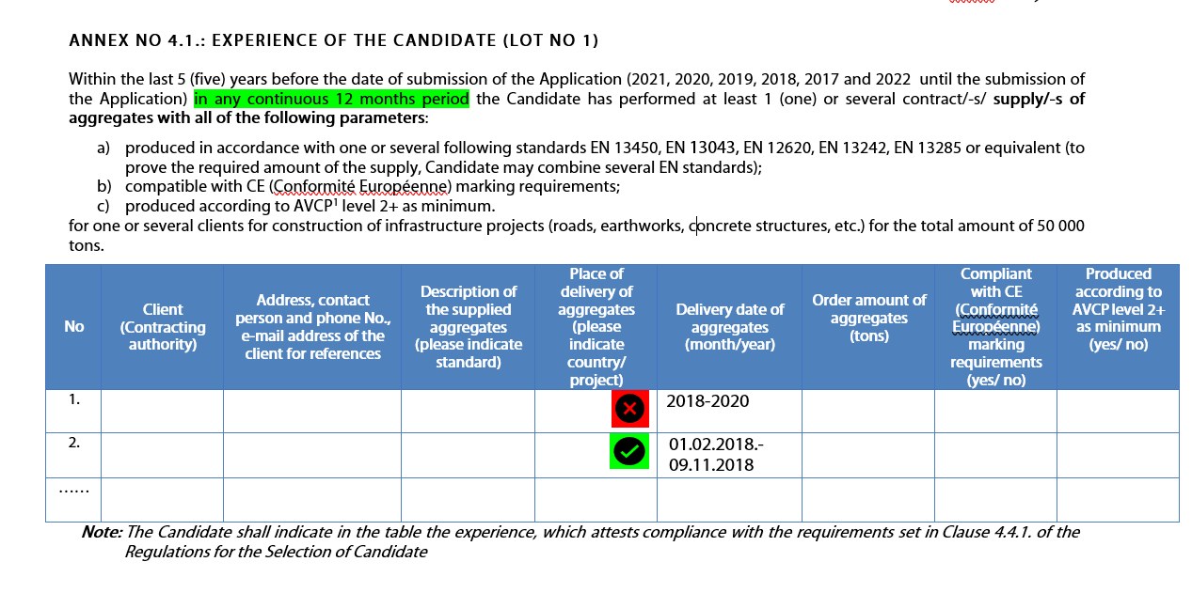
Example
Notes:
Please don't state just "YES", because that won't be considered as sufficient description, clear and detailed description must be included.

Slide 17
Actions before the submission
SUBMISSION DEADLINE
In Qualification stage questions may be asked:
1. By e-mail to: ballast@railbaltica.org
2. In EIS system
(for registered users)
Supplier can ask questions and clarify requirements and request to amend them
No amendments after submission! Tenderer has accepted the requirements by submitting the proposal!
NB! Please read the Q&A letters published in RBR website before asking your question!
Notes:
Ask in Q&A process contract draft comments/amendments DON’T include in only afterwards in the proposal – we cannot consider that anymore.
If the supplier has any questions or comments regarding requirements of particular procurement, until the proposal submission deadline it has rights to ask questions, clarify any requirements and request (with justification) to amend the requirements.
It is applicable as well to the draft contract which is one of the annexes of the procurement regulations. After the submission of the proposal supplier is not allowed to request for any amendments in the draft contract. DON’T include comments on the draft contract only afterwards in the proposal – PC cannot consider that anymore. No significant changes can be done in the draft contract before signing
NB! Please read the Q&A letters published in RBR website before asking your question as it may be that the same question has been asked by another supplier and has been already explained by the Commission.
After the submission of the proposal supplier is not allowed to request for any amendments in the procurement regulations, requirements etc. as it has accepted the requirements by submitting the proposal.

Slide 18
Qualification/evaluation
Qualification assessment is carried out according to YES/NO principle
Not allowed to add new projects to comply with company experience requirement
Is allowed to add new projects to comply with expert experience
  Can supplier add new projects to comply with requirement during the clarifications?
Evaluation according to award criteria
NB! During the qualification assessment or evaluation Commission is not allowed to deviate from the qualification requirements or award criteria.
Notes:
Please be aware that if experts have to be proposed, exact expert and its CV/respective annex table must be submitted.
Please don’t send several expert CVs and documents for one position, because PC won’t accept it and will ask the tenderer to clarify which person is proposed for specific position, PC won’t find it out by itself. This will allow to avoid one additional clarification.

Slide 19
Clarifications/Amendments
Commission is willing to clarify all unclear information in the proposal before it makes the decision regarding non-compliance, however…
Commission must ensure:
  Transparency
  Free competition
  Equal and fair treatment
  Effective use of the funds of RB
Dos and Dont’s:
  It is allowed to clarify information which is included in the proposal (clarifications)
  It is not allowed to add totally new information to the proposal (amendments)
NB! Commission cannot recognize as compliant agreements, documents etc. which are dated after the proposal submission deadline, except the exclusion ground documents.
Notes:
EU Court of Justice practice:
it has been recognised that the principle of equal and fair treatment and non-discrimination, as well as the obligation to ensure transparency, do not allow any negotiation between the contracting authority and any of the tenderers during the award procedure, which means that, in principle, the proposal may no longer be amended, either on the initiative of the contracting authority or on the initiative of the tenderer. Therefore the contracting authority, if it considers the tender to be incorrect or non-compliant with the technical specifications, cannot require explanations from the tenderer (Court of Justice decision No C 3 24/14 dated 7 April 2016).
NB! Only exception is competitive procedure with negotiations where negotiations can be carried out according to the procedure and regarding topics indicated in the procurement regulations.

Slide 20
Partnership
There are no restrictions in any of RB Rail AS Procurements regarding the form in which supplier/-s can participate in the procurement.
However, in case supplier plans to participate in the procurement as partnership there are specific requirements, such as:
In the proposal a cooperation agreement must be submitted where it is agreed upon liability and responsibility of each member of the partnership.
Content of the partnership (members) cannot change during the procurement procedure. Choose the potential partners carefully to minimize the risk of future disagreements!
20
NB! Agreement must be signed by all members of partnership.
Notes:
Partnership = consortium = joint venture
Reliable partners must be chosen.

Slide 21
Entities on which capabilites supplier is relying
These are entities which experience, financial status etc. supplier is relying upon to comply with qualification requirements.
All Entities must be clearly indicated in the annex attached to the procurement regulations.
There must be signed agreement or other document between the supplier and the Entity indicating that the resource on which it is relying will be available during the contract.
Entity and subcontractor is not the same, but a third party can be Entity and subcontractor at the same time.
NB! Employees of the tenderer are not Entities or subcontractors.
Notes:
Commission must verify that such agreement between the tenderer and the entity on which capabilities it is relying exists.
It must be done to be sure that it is not just a formal way how tenderer wants to comply with the qualification requirements. Commission must be sure that the resources (as per qualification requirement) will be available to the tenderer in case of winning the procurement.
Entities on whose capacity supplier relies (Entity), are entities which experience, financial status etc. supplier is relying upon to comply with qualification requirements. So it means any legal or natural person on which capabilities the tenderer is relying to comply with qualification requirements of the regulation.
For example, natural person which is proposed as an expert and is an employee of a tenderer is not an “entity”, but a natural person which is proposed as an expert and is a freelancer is an “entity”.
Difference between Entity and subcontractor – subcontractor is third party to whom part of the performance of the contract is assigned. In case when the tenderer rely on capabilities of a third party to comply with any qualification criteria and at the same time this third party also is assigned to perform a part of the contract, then this third party will be Entity and subcontractor at the same time.

Slide 22
Representation rights/PoA
Commission must verify that the proposal and other respective documents have been signed by a person who has representation rights.
If the person/-s in the company registration certificate differs from the one signing the proposal, it is mandatory to submit the respective power of attorney or other document that verify the persons rights to represent the supplier.
In some cases the chain between the person indicated in the company registration certificate and the person who has signed the proposal consist of several documents.
NB! All chain of documents (PoA) must be provided to the Commission.
Notes:
Not applicable to contact person – it could be any person.

Slide 23
Useful Information
Deadline for the submission of the Applications: 16 September 2022, 14:00 (EET) in E-Tenders system
Please note: make sure you submit the Application timely (do not leave to the last day/minute),
Applications submitted earlier are not accessible or readable before the opening time!!!
  RBR website: https://www.railbaltica.org/tenders/
  RBR Procurement plan 2021: https://www.railbaltica.org/procurements/
  RBR procurements in E-tendering system: https://www.eis.gov.lv/EKEIS/Supplier/Organizer/3001
  Public Procurement Law of the Republic of Latvia: https://likumi.lv/ta/id/287760-publisko-iepirkumu-likums
  Cabinet Regulation No. 107 of the Republic of Latvia: https://likumi.lv/ta/id/289086-iepirkuma-proceduru-un-metu-konkursu-norises-kartiba
  Procurement Monitoring Bureau of Republic of Latvia website: https://www.iub.gov.lv/en
  EU public procurement directive: https://eur-lex.europa.eu/legal-content/EN/TXT/?uri=celex%3A32014L0024
European Court of Justice judgements: https://curia.europa.eu/jcms/jcms/j_6/en/

Slide 24
Thank you!
Time for Q&A session!

